Slide 1
Delivering Results through a Collaboration between Arctic EU Programmes Ole Damsgaard, Lena Anttila, Päivi Ekdahl, Jenny Bergkvist
European Week of Regions and Cities, 11th October 2017
Centre Borschette, Brussels

Slide 2
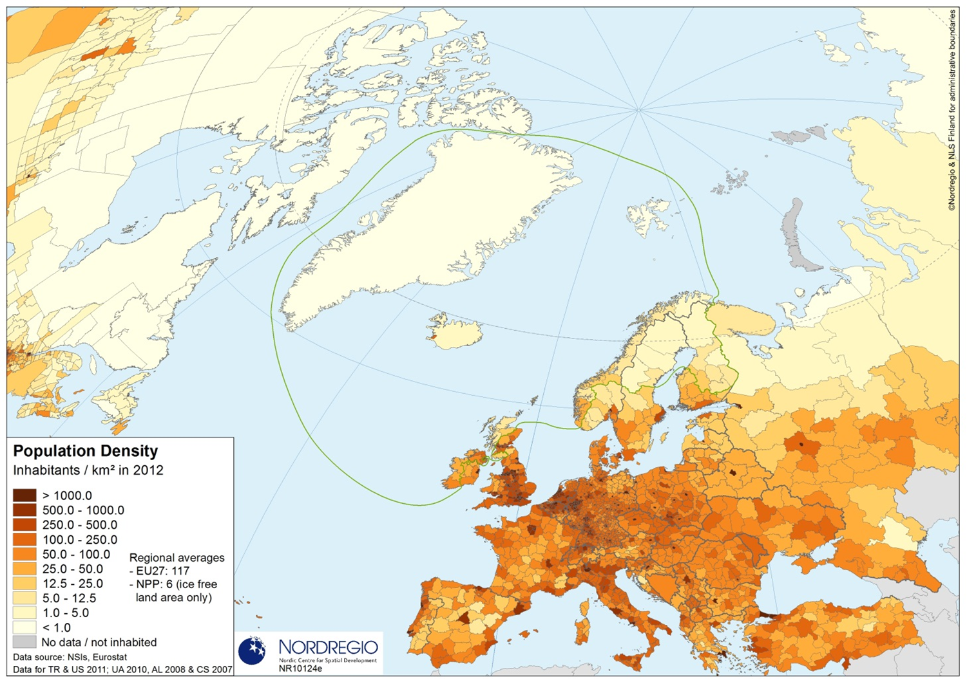

Slide 3
Peripherality & low population density = key challenge
Lack of critical mass
Weak access to key markets
Little external orientation of SMEs
Little economic diversity
Shrinking rural communities
Aging/gender imbalance

Slide 4
Natural resources & versatile business sector = key potential
Globalisation
Climate change
Green Economy
Rising demand for minerals, bio mass, food etc. at world market
Innovation capacity & place based competences

Slide 5
The EU-Arctic Communication
European Arctic suffering from underinvestment
Enhancing collaboration and coordination between different EU funding programmes
NPA shall lead a pilot activity
Arctic Stakeholder Forum 2017

Slide 6
In the light of the Arctic Communication
Discussion between Interreg programmes was initiated, preparations already in 2015
Core group: NORD, Kolarctic, Botnia Atlantica, NPA + Karelia ENI, Baltic Sea
Additional organisations: Northern Dimension, Barents Forum and others involved in discussion

Slide 7
Common for the NSPA regions – OECD study
Considerable degree of coherence across the vast territory
Similar natural environment
Similar political, social and commercial institutions
Internal structure of the economies is somewhat similar
Notes:
Similar natural environment: harsh climate, strong natural resource endownment but with a relative lack of agriculture, strong potential for renewable energy, long distance from markets, high cost of land transport
-> makes the region particularly dependent on the export of raw and semi-processed natural resources
Similar political, social and commercial institutions: a common political structure (loosely referred to as the Nordic Welfare State)
-> all the regions of the NSPA face a common political challenge to ensure public policies continue to meet the needs of the northern areas
Internal structure of the economies: each region contains multiple local labour markets that are not well connected, significant diversity of socio-economic conditions within regions
-> economic growth is concentrating in particular LLMs

Slide 8
NSPA democraphic trends – OECD study
Unique settlement structure within the EU (5 persons/ km², lowest in Finnmark 1,64, highest in South Savo 10,91, OECD average 36,76)
Diversity in terms of distribution of population
Ageing population
Mismatch between available skills and employers requirements
Notes:
Unique settlement structure: population of Rome inhabiting the whole area of Spain
Diversity in distribution of population: need to be considered in the design and implementation of public policies
Ageing population: implication for replacement of workers, higher costs for providing health care and senior services, shortage of workers providing the services, falling local tax revenues
Mismatch: leads to reduced production, significant unemployment and high outlays on social welfare

Slide 9
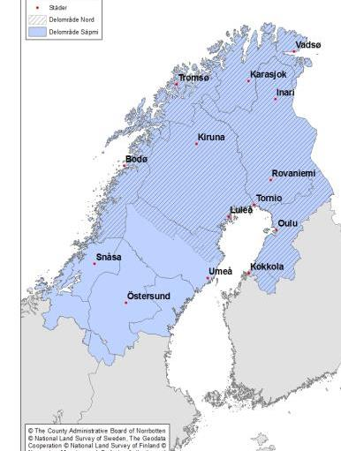
Programme area Nord
Sub areas - Nord and Sápmi
Sub-area Nord Norway: Nordland, Troms, Finnmark Sweden: Norrbotten, Norsjö, Malå, Skellefteå and Sorsele municipalities in Västerbotten Finland: Northern Ostrobothnia, Central Ostrobothnia and Lapland Sub-area Sápmi Norway: Finnmark, Troms, Nordland, Nord-Trøndelag, Sør-Trøndelag and part of Hedmark Sweden: Norrbotten, Västerbotten, Jämtland and Västernorrland and Idre Sameby area Finland: Northern Ostrobothnia, Central Ostrobothnia and Lapland
Notes:
The overall goal of Interreg Nord 2014-2020 is to strengthen the competitiveness and attractiveness of the programme area. The Nord programme is divided into two geographical sub-areas, sub-area Nord and sub-area Sápmi.
Special features:
The Nord programmes preconditions and requirements are unique in many ways, and the programmes design is essentially common to both sub-areas.
Unique goals for Sápmi: Strengthened Sami language within the Sami population.
Unique goals for Sápmi: Strengthened skills and knowledge development in Sami enterprises.
The program has more focus on SMEs and results compared to previous program period.
The program area is strong within the tourism industry, cooperation between environmental authority's and cooperation between the universities.

Slide 10
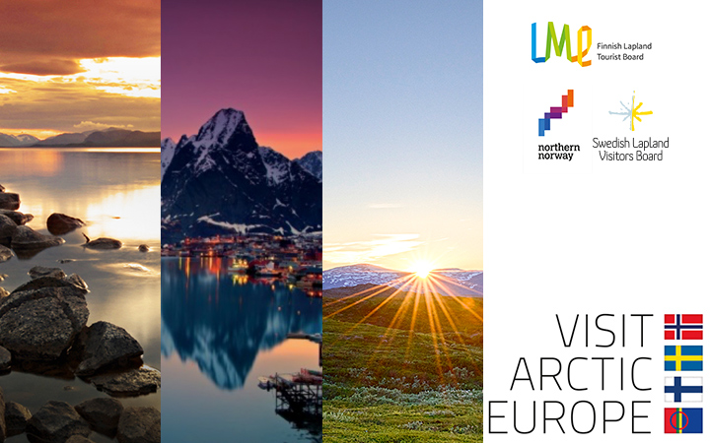
Notes:
Project budget: 6,4 Million EUR
Visit Arctic Europe is designed to help establish cooperation between small and medium-sized enterprises (SMEs) in Finnish and Swedish Lapland, Northern Norway and Sápmi. Through networking, development and marketing efforts, the project aims to increase the level of business collaboration across borders, with the goal of improving joint competitiveness in a global market. The project is based on the common strengths and values of the region with a view to developing new and innovative cross-border tourism concepts for distribution in selected markets and to selected markets. Accessibility to and within the region is a prerequisite for growth in tourism and the project will therefore work to improve transport connections to the region and between destinations across borders within the area of VAE.
Project’s headlines:
Functional networking
Develop crossborder co-operation between the areas and companies
Create crossborder travelpackages in co-creation process with companies and delivery chain
Accessibility
Accessibility from market areas to VAE area
Model for internal traffic in VAE area
Marketing
In cooperation with Tour Operators
Selected market areas are: UK, Benelux, German speaking Europe
China and US
R&D
Indicators for success of project, measurement
Future travel trends
Digital trends
Crossborder trade obstacles
Participants: Travel businesses in Northern Norway, Swedish Lapland and Finnish Lapland who want to create new crossborder collaborative constellations and product combinations aimed at an international market

Slide 11
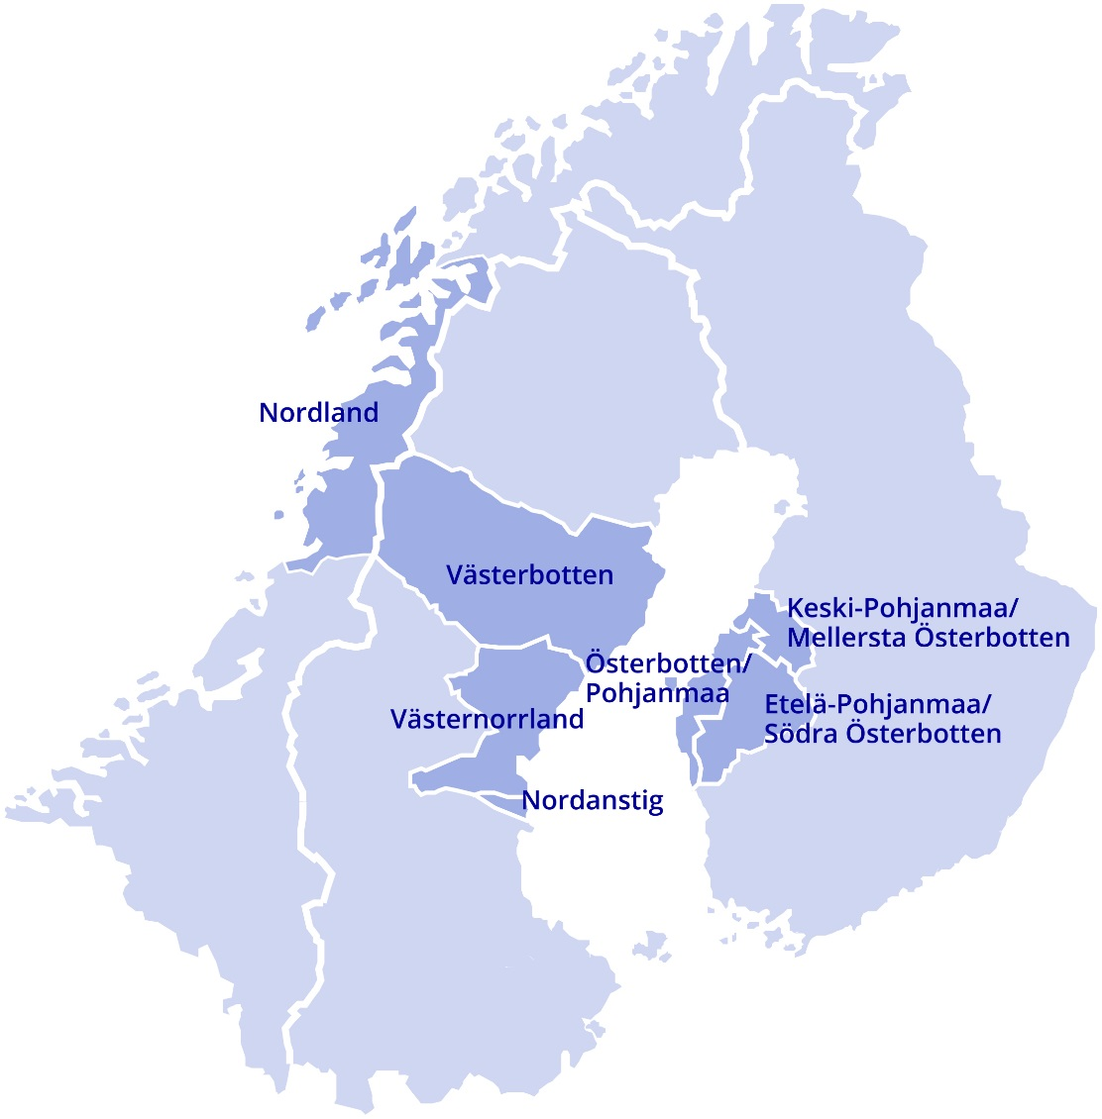
Botnia-Atlantica
Norway: Nordland
Sweden: Västerbotten Västernorrland Municipality of Nordanstig
Finland: Mellersta Österbotten Österbotten Södra Österbotten
Notes:
The geography of the Botnia-Atlanticaprogramme origins from the cooperation between Helgeland in Norway and Västerbotten in Sweden (where the boarder-organisation MidtSkandia is active) and Västerbotten and Ostrobothnia (where Kvarkenrådet is active). This was the first programme-geography in 1995 that since then has grown bigger in all three countries.
During all programme periods, the E12-link from Mo i Rana through Västerbotten and over to Vasa (a ferry line) and continues through southern ostrabothnia has been a focus and a precondition for the east-west cooperation.
As you saw in the previous picture from Nord, the Sápmi-programme covers almost the whole area of Botnia-Atlantica and this is because of a wish to keep the Sápmi cooperation in one programme with special features, not depending on different content in the Nord and Botnia-Atlantica programme.
Ostrobothnia and Southern Ostrobothnia in Botnia-Atlantica are not part of any other programme represented here, nor Nordanstigs kommun.
Suseccful cooperation during the periods have among other things been concerning
the east-west link (E12),
the world heritages
environment (for example new ways to restore streams and innovative solutions to map out shallow sea-bed)
energy/Cleantech
small scale food production (and ther are also food industrys in the area)
Many former projects have been of use for the people in the area as for example mountainrescue between Norway and Sweden, test between Finland and Sweden if a big accident would accure in Kvarken and cooperation between energency healthcare in the area.

Slide 12
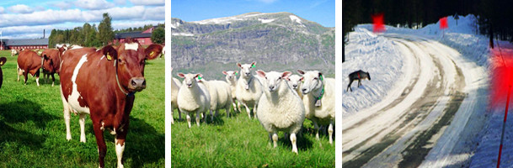
AnimalSense A competence center for animal sensor technology
http://www.animalsense.eu/
Notes:
Project description
By establishing a competence center in the area of farming technology and connecting researchers from both animal science, technical research, farmers, reindeer herders and companies from the ICT sector to this competence center the project can provide new tools to improve the efficiency and quality of the farming and reindeer herding sector within the Botnia-Atlantica region.
The competence center will work on three specific cases during the project period where strong collaboration can be built on. These cases are positioning and activity monitoring technology for cattle in loose houses, positioning and monitoring system for grazing animals, and reindeer warning system to reduce number of reindeer killed on road and railway.
Priority:
Innovation
Specific objective:
Developing long-term sustainable competence centers
Lead partner:
Umeå University (SE)
Other project partners:
Swedish University of Agricultural Sciences (SE), Centria University of Applied Sciences (FI), Svenska Samernas Riksförbund (SE), ProAgria Central Ostrobothnia (FI), Ildgruben reinbeitesdistrikt (NO), Norwegian Institute of Bioeconomy Research NIBIO (NO), The Norwegian Public Roads Administration (NO), Saltfjellet reinbeitesdistrikt (NO), Biocontrol AS (NO), Telespor AS (NO)
Project timetable:
2015-09-01 - 2018-05-31
Budget Sweden/Finland:
1 134 466 EUR
EU-support:
668 400 EUR (58,92 % of budget Sweden/Finland)
Budget Norway:
443 186 EUR
TOTAL PROJECT BUDGET:
1 577 652 EUR

Slide 13
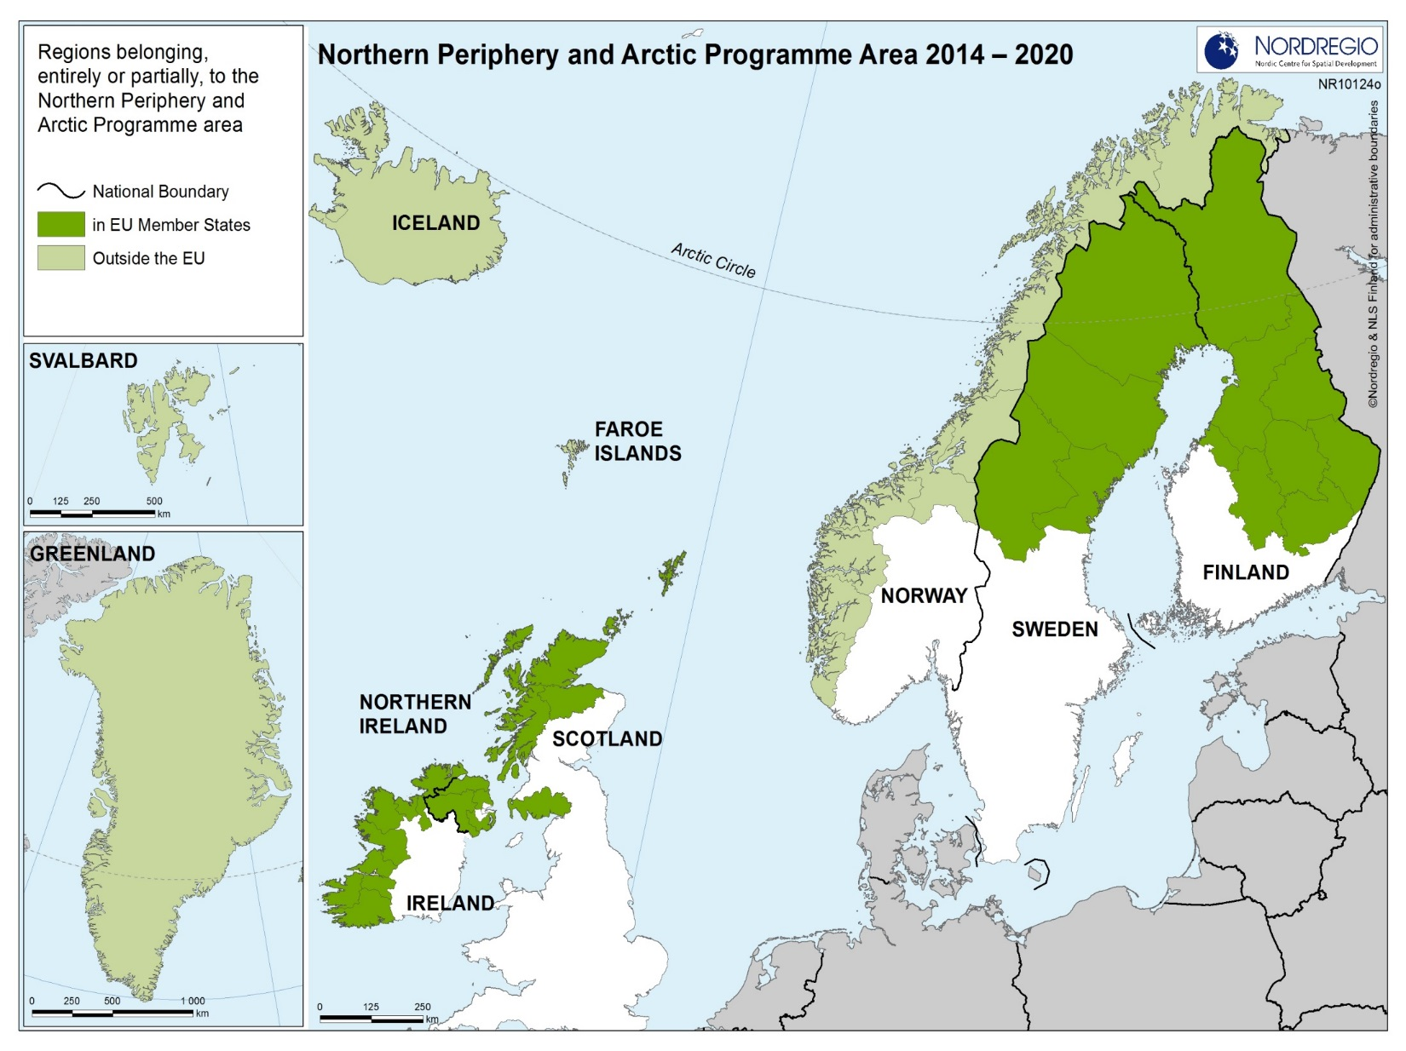
Notes:
Not a programme for cooperation between neighbors as Nord and Botnia-Atlantica, but cooperation between areas with common features within a larger geography.
NPA Area – From Finnish Russian boarder to Greenlandic Canadian boarder. Overlap can be seen in Northern parts of Norway, Sweden and Finland.
Geographical similarities and number of common features, such as low population density, low accessibility, low economic diversity, abundant natural resources
Complimenting goals such as need to develop competitive and sustainable communities, harnessing innovation, expanding the capacity for entrepreneurship and seizing the unique growth initiatives and opportunities.
Over arching strategies such as Strategy, national and regional policies and development strategies, macro regional and sea basin strategies, and other programmes covering parts of the geographical area.
Increased interest and rapid developments in Arctic regions have resulted in a more explicit recognition of the programme’s Arctic dimension in regional development
NPA Cooperates between areas with common features within a larger geography, currently the programme is not designed for cooperation between neighbours as Nord and Botnia-Atlantica, but through the EU Arctic communication is seeking to collaboration between programmes.
Originality of the programme:
Huge territory – Finland to Greenland
composed at 50% by non EU states, and even more if we think about Canada and Russia having observer status in the Monitoring Committee
Indigenous peoples are represented on the Monitoring Committee by the Indigenous Peoples’ Secretariat, Arctic Council
Increased attention the NPA has received lately is mainly due to its Arctic character and EU Arctic communication in which the NPA has an explicit role to bring together INTERREG Managing Authorities together to collaborate

Slide 14
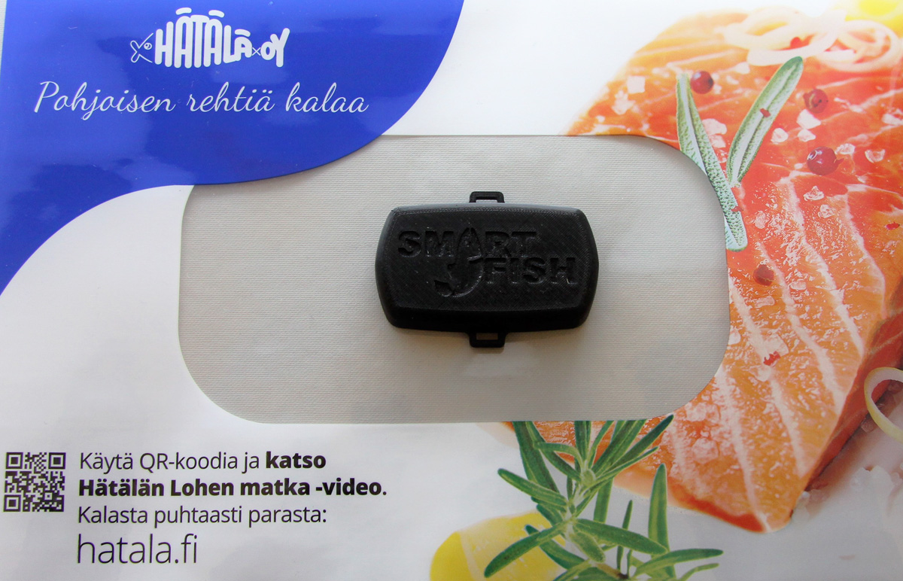
Notes:
Project: Smartfish
Priority Axis Innovation
Icelandic-led project, 3 other countries (Finland, Norway, Scotland)
Purpose: ensuring quality of Arctic food products internationally
Output
Printed electronic Smart Labels to put on food packages for measuring temperature
Cloud system where users can track the data

Slide 15
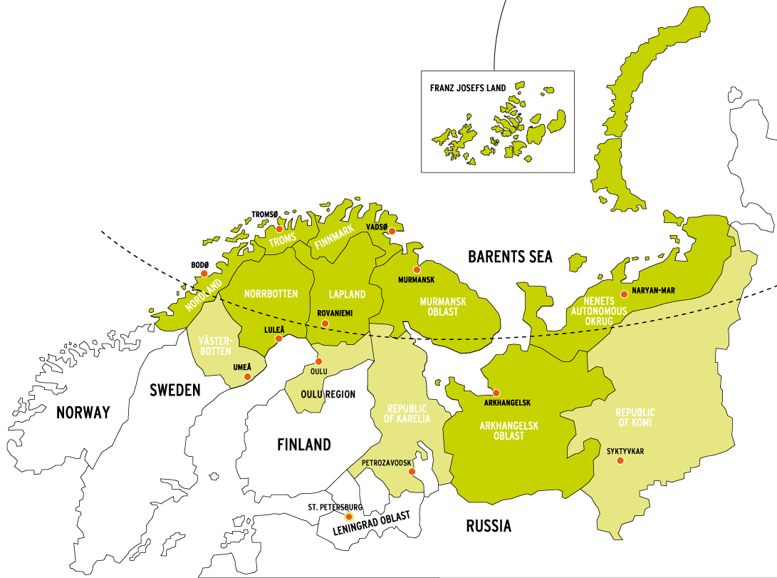
Kolarctic
Notes:
What is different between the other programmes here and Kolarctic, is strand. Kolarctic is not one of the Interreg Programmes, but belongs to a goup of programmes promoting cooperation across the external borders of the European Union; the CBC programmes.
Special with the cooperation with Russia
he EU-Russia border in this region is a long land border, and different compared to the marine located borders of e.g. NPA. The Sweden-Norway border is another long external land border between EU and its neighbours. But as a neighbour, Norway is different from Russia. There is no border management and border security themes in e.g. Interreg Nord, why? ☺

Slide 16
Priorities in the programmes
Nord | Botnia-Atlantica | Kolarctic | NPA
Research and Innovation | Innovation |  | Innovation
Entre-preneurship | Entre- preneurship | Business and SME Development | Entre-preneurship
Culture and Environment | Environment | Environmental protection, climate change adaptation and mitigation | Energy
 | Transport | Accessibility, sustainable and climate-proof transport and communication networks and systems
Common Labour Market |  | Promotion of border management and border security, mobility and migration management | Sustainability
Notes:
The European Commission set up different priorities, between which the programme could choose when writing the programmedocument. The selection of priorities are made by the regions in each programme.
The programmes have made different choices within these priorities, and even if the headline is the same, the content differs between the programmes. . This is especially the case for the third priority Environment.
The programme compliment each other through their unique empharise on similar priorities:
Innovation: Most similarities between the programmes
Nord: Strengthening research, technological development and innovation
BA: Developing long term sustainable competence centers and increasing implemantation of innovative solutions ex Trans Algae (innovativa lösningar) alger av avfall
Kolarctic:
NPA: Objective: Increased innovation and transfer of new technology to SMEs in remote sparsely populated areas
Results sought: Clusters across borders, transnational innovation infrastructures, new alliances between SMEs and R&D, new products
Entrepreneurship: Here we have similarities, but also differenties in focus
Nord: Increasing the competitiveness of small and medium-sized enterprises. (increased business models and increased export)
BA: Increased capacity for cross-border business cooperation ex CleanTech
Kolarctic:
NPA: Promoting Entrepreneurship to realise the potential of the NPA’s competitive advantage.
Results sought: contribute to an improved entrepreneurial business environment supporting start-ups and existing
Environment: Differenties between the programmes:
Nord: Protecting the environment and promoting the sustainable use of resources
BA: Sustainable utilizaton of natural and cultral heritage, handeling challenges in marin, costal and mountain araeas and in water running to the sea ex Spotlight Highlow coast (produktpaket för att locka besökare)
Kolarctic:
NPA – Energy efficency: Objective: More reliable, sustainable and affordable energy supply in remote and low dense populated areas
Results sought: Increased awareness about and increased readiness to invest in energy efficiency measures and renewable energy solutions whit in the housing sector and public infrastructures.
Common Labour Market:
Nord: Promoting employment and the mobility of labour
Transport:
BA: Strategies connected to sustainable transport links in east-west direction
Kolarctic: Accessibility, sustainable and climate-proof transport and communication networks and systems
Promotion of border management and border security, mobility and migration management
Kolarctic: The nature of Kolarctic as a CBC programme across the external borders can be seen here: One of Kolarctic’s thematic objectives is Promotion of border management and border security, mobility and migration management.
Sustainability:
NPA –Objective: To help communities mitigate negative impacts from climate change and from mega-investments
Results sought: Increased preparedness for community-based sustainable environment management.
Many partners such as universities and regional authorities are active in several of the four programmes.

Slide 17
Budgets
 | Interreg North | Interreg Botnia-Atlantica | Kolarctic CBC | Northern Periphery and the Arctic
EU-budget | 42 M€ | 36,3 M€ | 24,7 M€ | 47,2 M€
Total budget | 83 M€ | 67,3 M€ | 63,4 M€ | 78,7 M€
TOTAL 292,4 M€
Notes:
Total budget includes finance from memberstates and also finance from non-memberstates
Concerning Kolarctic, the (original) plan is that the EU would grant another part of financing to the programme after a mid-term evaluation. But we never know… so here is only the part of Kolarctic financing that has been allocated by the EU so far.

Slide 18
Roadmap for cooperation
Notes:
What have we been doing so far?
Meeting between the programmes (physical and via skype) where we have discussed the forms of our cooperation and where we as programmes and also our ongoing projects could benefit from the cooperation
We have made a roadmap (three strands) (some overlapps between the strands)

Slide 19
Operation of the Arctic Programmes
Better and more efficient information about the programmes
More efficient use of programmes’ funding
Better and clearer outputs from funded projects
Better and more efficient dissemination of results
Notes:
operations of Arctic programmes is about cooperation and coordination of the day to day work of the programmes aiming at a more efficient use of the programme funding for example through common project development, coordinated calls, clustering of funded projects and common information activities.
The overarching purpose for work envisaged under this strand is to improve the efficiency of the programmes by means of…
through the basic channels of communication such as the programmes´ websites, COMMON information about the programmes in the Arctic area and what we are doing in our cooperation
fewer overlaps and repetitions, pooling of resources, more targeted actions and coordinated assessments of applications. To achieve this we share our applications between the programmes (basic information) so that we can see if we have any similar project or partners in other projects in other programmes and we also tries to bring projects together within different themes (cross-programmes)
better partnership development, better guidance from programme bodies during projects development and implementation , better preparation of calls, more targeted calls – we can all have better knowledge about what is going on in other programmes and help our projects to find partners/other projects in other programmes within their area – we also help projects to reach a wider audience through using project-examples from other programmes on for examples annual events. Which bring us to:
though common communication actions and involvement of broader and more relevant target groups
Whish to show how our programmes through the projects have impact at local and regional level
As programmes we are much more aware of each other, and what each programme’s specific role is. This makes it easier for us to communicate with potential applicants in the near and further future.
We have included in our application assessment routine that we share applications with each other to avoid overlap
We are starting to notice economies of scale, because we are organising events in rotation, and will start to see further benefits when we develop joint publications, instead of programme by programme.

Slide 20
Strategic and Thematic Initiatives
Higher visibility of the cooperation programmes, the Arctic area and the cooperation between the programmes
Promoting cooperation to stakeholders as a means of strengthening the Arctic region
Better and more visible results of the cooperation programmes
More impact at local and regional level
Notes:
2. “strategic and thematic initiatives” is about how the programmes can be more visible in relation to key stakeholders groups, how results can be communicated more efficient and about initiatives in relation to themes of specific Arctic importance.
The overall purpose of the work under this strand is to support the strategic positioning of the Arctic cooperation area. In particular we aim to promote…
showcase strategic implementation in order to highlight the importance and uniqueness of the Arctic region and cooperation.
Greater awareness of Arctic cooperation among the funded projects through the Arctic project awards, which rewards good practice projects. This should result in a higher visibility of these practices. The full effect of this is still to come.
Projects from the different programmes have started to get to know each other and are starting to cooperate (clustering projects) on a thematic basis.
As cooperating programmes we have received recognition from the European Commission; we have a voice.

Slide 21
Preparation for the post-2020 programming
To be prepared and proactive
To utilise the cooperation experiences fully
To ensure more benefit for the Arctic region
Notes:
3. “preparation for the post-2020 programming” is about utilising the experiences gained from the cooperation for the future programming process for example through common documentation and information about gained results.
The main purpose of the work is to be well prepared for the negotiations for future programme period .
Some of the more ”hands-on-activities” are:
Common info on the webb
Comparing applications
Participation in each others annual event
Some of the more exceptional activities are:
Arctic Project Award
Clustering event
clustering call

Slide 22
Arctic Project Clustering Event
Themes:
Bio-economy
E-health
Entrepreneurship
Energy Efficiency
Notes:
About 90 participants,
Specially invited projects from all our programmes, if some programme did not have any projects within one theme they invited experts from the programmearea to participate in the group.

Slide 23
Funding Opportunties
New NPA funding instrument
Clustering projects for all NPA priorities across the collabration area
Micro projects for NPA project idea holders
Notes:
Clustering projects: Clustering activities can take place between projects from different programmes dealing with the same theme or projects that are addressing the same territorial challenges.
Clustering projects can runs for 6 to 12 months with the purpose of:
Synergy, mutual inspiration, complementing expertise and cross fertilising between projects
Ensure more resources and critical mass for solving important problems
Ensure higher quality of outputs
Ensure more resources for dissemination activities and bigger outreach
Extend existing partnership and develop new
Budget:
Total budget of up to 45 000 EUR, with a maximum programme grant of 29 250 EUR. A grant rate up to 65% of eligible costs applies to all partners with the exception of SMEs who are only eligible for a grant rate of up to 50%.
Lump sums for clustering projects
It has been decided that the simplified cost option of “lump sums” will be applied to all clustering projects.
Calls for Applications
Clustering project calls will normally be developed in cooperation with Joint secretariats for other programmes and will be announced on the NPA website.
Micro projects
Micro projects are for the building up of capacity and experience for representatives for specific under represented groups (women, young people, and indigenous peoples) in the NPA programme area.
Micro projects are expected to specifically contribute to the Arctic dimension of the NPA programme and to the EU Arctic Communication, “An integrated European Union policy for the Arctic”.
Purpose of micro projects
Engagement of groups and representatives for groups that are not usually represented as partners in NPA main projects
Capacity building and networking in relation to the role as partners in transnational cooperation projects
Support development of more need and user driven projects
Contribute to the Programme’s Arctic Dimension

Slide 24
What next?
A clearer communication about roles and specific features of the programmes
Arctic themes addressed in coordinated calls
“Tap into” specific EU-initiatives
Development of clustering initiatives
Cross programme promotion of project results

Slide 25
Beyond 2020
Common “Arctic EU Programmes” entrance
Continuation of mainstreaming of programme rules
Arctic thematic objectives in each programme to facilitate implementation of the Arctic Communication

