Slide 1
Coordination of financing instruments
...for the benefit of the regions
Päivi Ekdahl, Regional Council of Lapland
30.9.2015

Slide 2
What to coordinate and how?
What to coordinate?
-> cooperation?
-> programmes?
-> activities?
Who benefits from the coordination?
-> Regional/ National Authorities?
-> Programme authorities?
-> Stakeholders?
-> People living in the area?
-> Politicians?

Slide 3
Why bother? Can't we just do our work?
Who benefits if...
-> the programmes are better coordinated?
-> the activities are better coordinated?
-> the planning is better coordinated?
Who's task it is to coordinate? Who wants to be coordinated?
Purpose of the activities set the purpose and need of cooperation/ coordination
It always rises from a need to do something together, to get better results

Slide 4
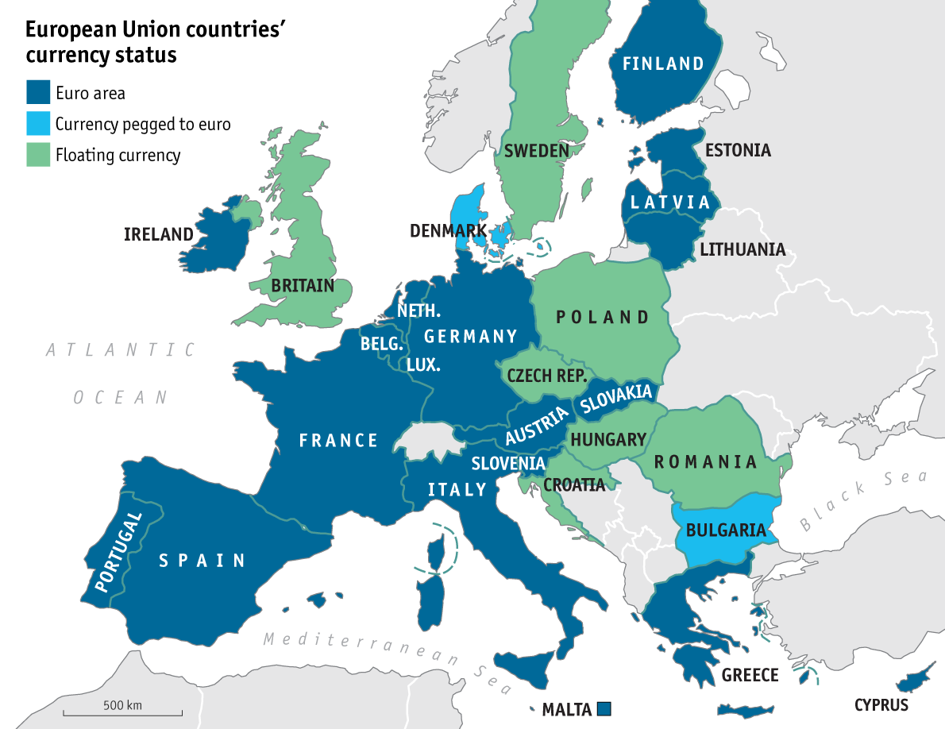
In reality, this is our challenge for cooperation

Slide 5
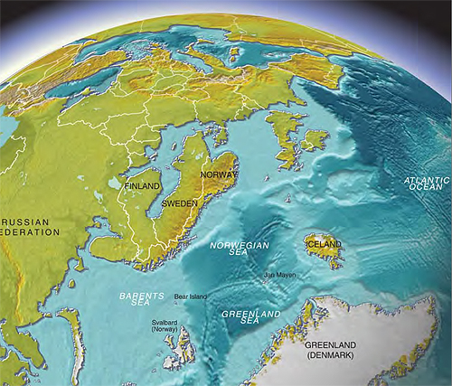

Does it help if we turn our thoughts?

Slide 6
At least we can turn around the way we think...
We should not start from a ready framework to which we try to fit the needs
We should not try to concure the world but to take small steps
If we cannot get extra resources for the work we have to start from a realistic level and concrete activities
Outcomes of the Coordination Mechanism pre-project
Example "Modern clusters in Lapland"

Slide 7

Lapland's Arctic Specialisation
Pillar industries of the regional economy
Mining and metal industries
Bioeconomy
Tourism and related industries
Refining new products and services
Positive cumulative impact
Services and industries arising from the needs of the basic industries
Independent or new industries
Stimulation and nurturing next generation’s industries
In Lapland we are looking for the functional spearheads supporting the development diversely strengthening and sustaining the basic industries, initiation of the new industries
Education, research and development better integrated in the refining new products and services

Slide 8
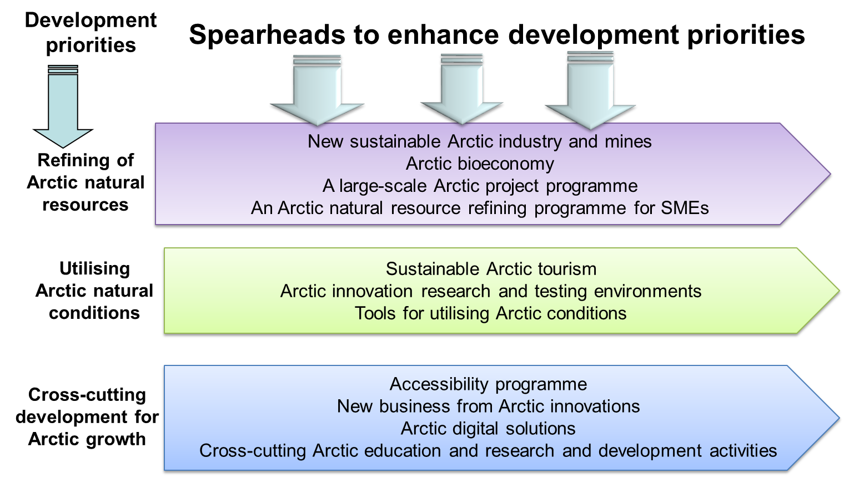
The foundation of the Lapland's S3

Slide 9
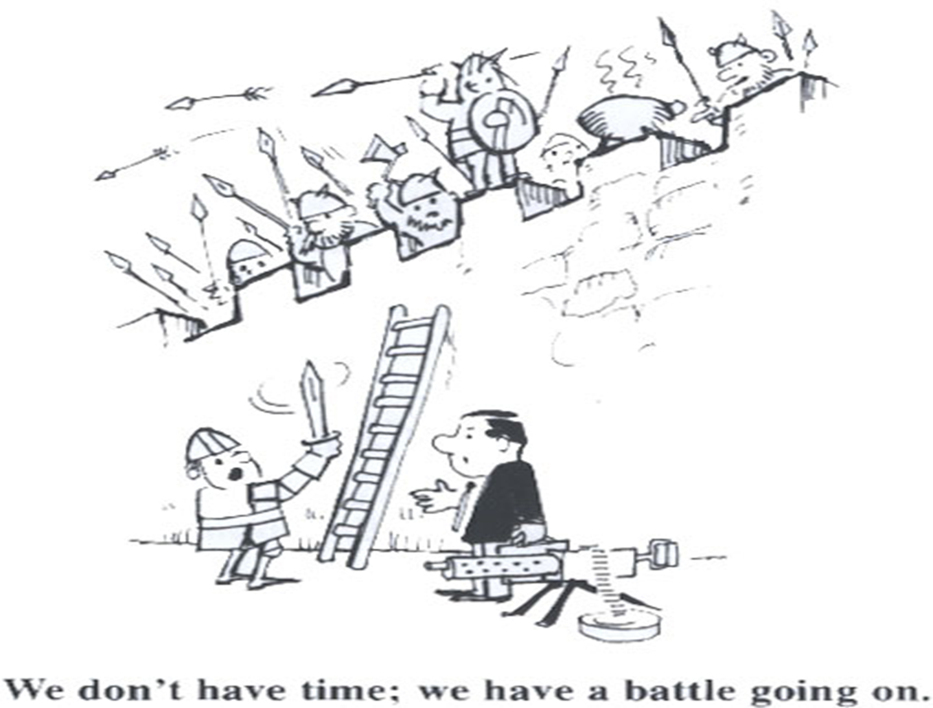
”We should not be reinventing the wheel, admittedly, but what use is it if it has stopped turning properly?”

Slide 10

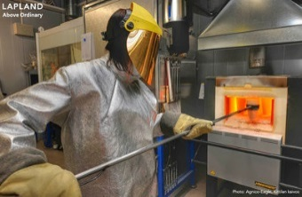
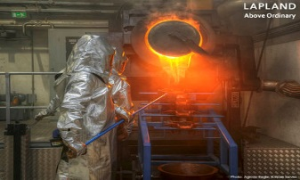
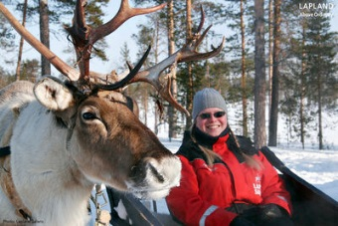
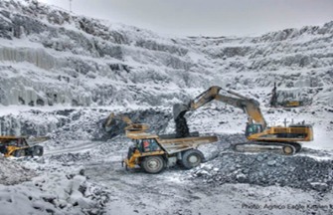
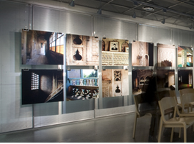
Putting S3 in to the practise - Looking after the truffles…
During last decades support is directed towards refining industry, tourism, creative industries, learning and testing environments, rural development, wood processing, resource efficiency, natural product and food, internationalisation, natural resources and land use…. analyses over 650 project funded during previous program period in Lapland
Potential for the modern clusters which are regional, looking beyond the boundaries, cross-fertilisation…
Cleantech on Arctic industries
Arctic safety and security
Arctic Smart Rural Communities
Arctic innovation and testing environments
Arctic design

Slide 11
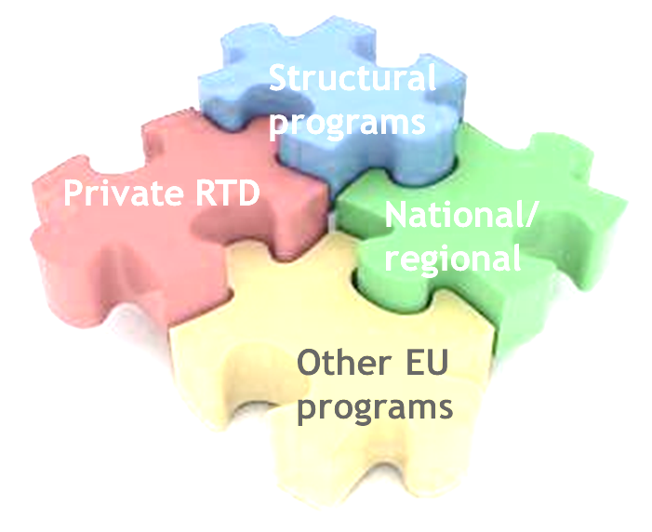
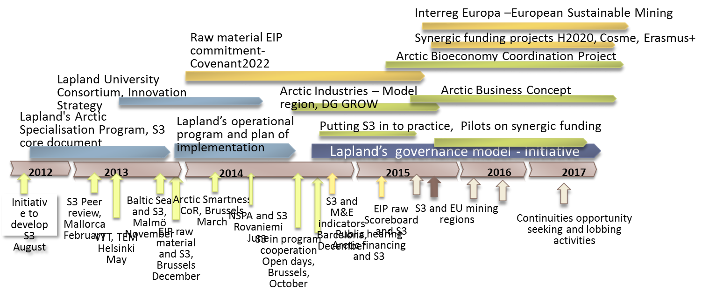
Strategic approach to apply support
S3 is developed to have strategic approach towards regional development but also to attract financing
ESIF programmes: to develop the operational environment and build the capacity
Horizon 2020: to increase R&I capacity
Erasmus+: to develop education
COSME: strengthen the SME
European Territorial Cooperation: to learn from each other
Other specific programs like Creative Europe, Justice etc.

Slide 12
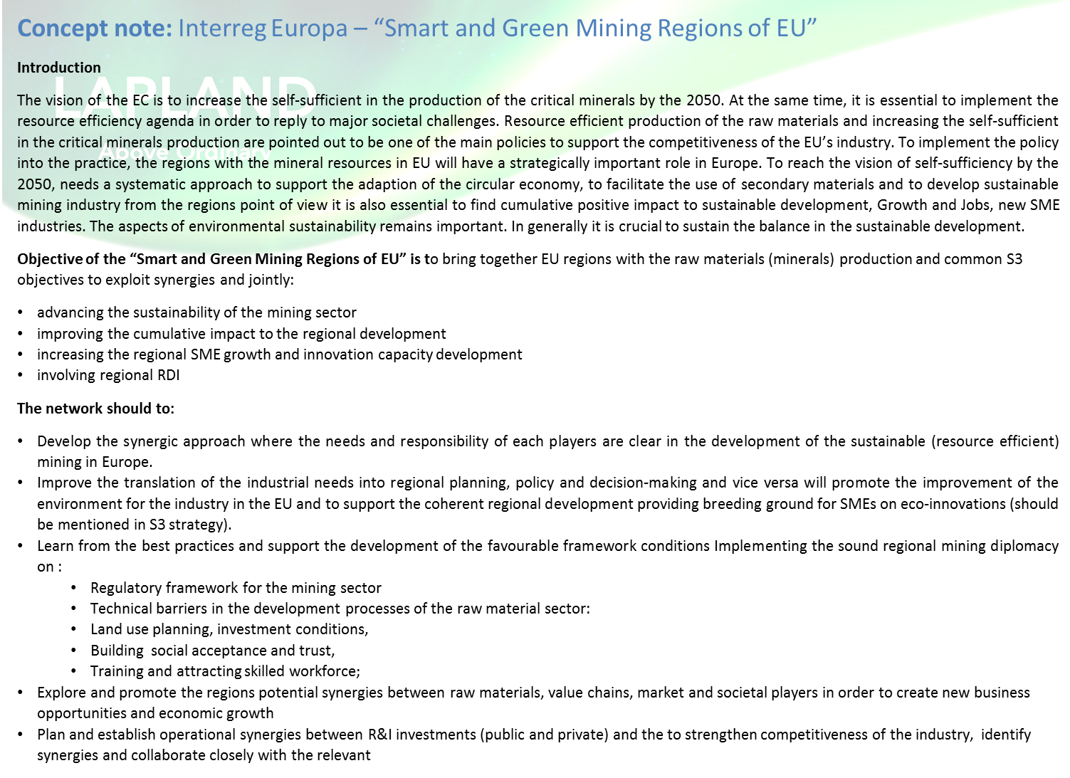

Slide 13
