Slide 1
Programme result baselines and targets - a glimpse into the future Annual Conference of the Northern Periphery and Arctic Programme
30th of September 2015, Kuopio/Finland

Slide 2

The Northern Periphery in 2023?

Slide 3
Rationale
Programme has to demonstrate that its projects have a direct, positive and measurable impact in the programme territory
Focus of the programme on the remotest, most rural and sparsely populated region within the programme territory
Lack of consistent and timely statistical data on regional level

Slide 4
Selection of experts
Experts have
detailed insight into the regional situation regarding innovativeness and internationalisation of SMEs, entrepreneurship, telemedicine, building energy performance or sustainable environmental management.
strong regional ties
well-established links with the end beneficiaries of project interventions (e.g., SMEs, health care workers, local public authorities, etc.)

Slide 5
Selection of regions
Sample regions are selected based on the NUTS 3 statistical areas
The remotest and most sparsely populated regions within each country
One region from Scandinavia, one region from the British Isles, one region/country from the North-Atlantic Space
Capture the range of socio-economic conditions across the programme area by reference to indicator-specific statistical data
Balanced representation of the eight programme countries

Slide 6
Result indicator scoreboards
+ Composite indicator
+ contextual information on external factors likely to affect the composite indicator
+ anecdotal evidence of change
= Indicator scoreboard

Slide 7
Criteria for choosing indicators
‘What we measure’ should be in line with ‘what we can influence’ as a cooperation programme, with a limited budget, and within a limited time period.
Wherever applicable, we should use existing definitions and methodologies, to warrant the indicators’ comparability with other European studies.
Our experts should be able to assess the indicators without too much guessing involved.

Slide 8
Indicator 2.2 “Internationalisation of SMEs“
Availability of business support programmes to facilitate access to new markets for regional SMEs [0;10]
❑
❐
Share of SMEs in the region engaged in one or more transboundary inter-enterprise cooperation [0;100%]
❐
Uptake of business support programmes to facilitate access to new markets for regional SMEs [0;10]

Slide 9
Indicator 2.2 „Internationalisation of SMEs“

Slide 10
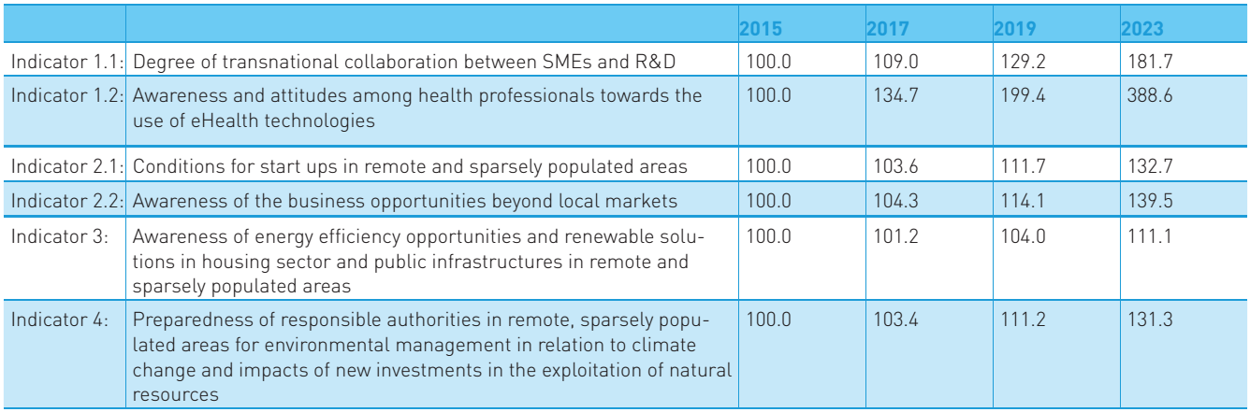
Baselines and targets

Slide 11
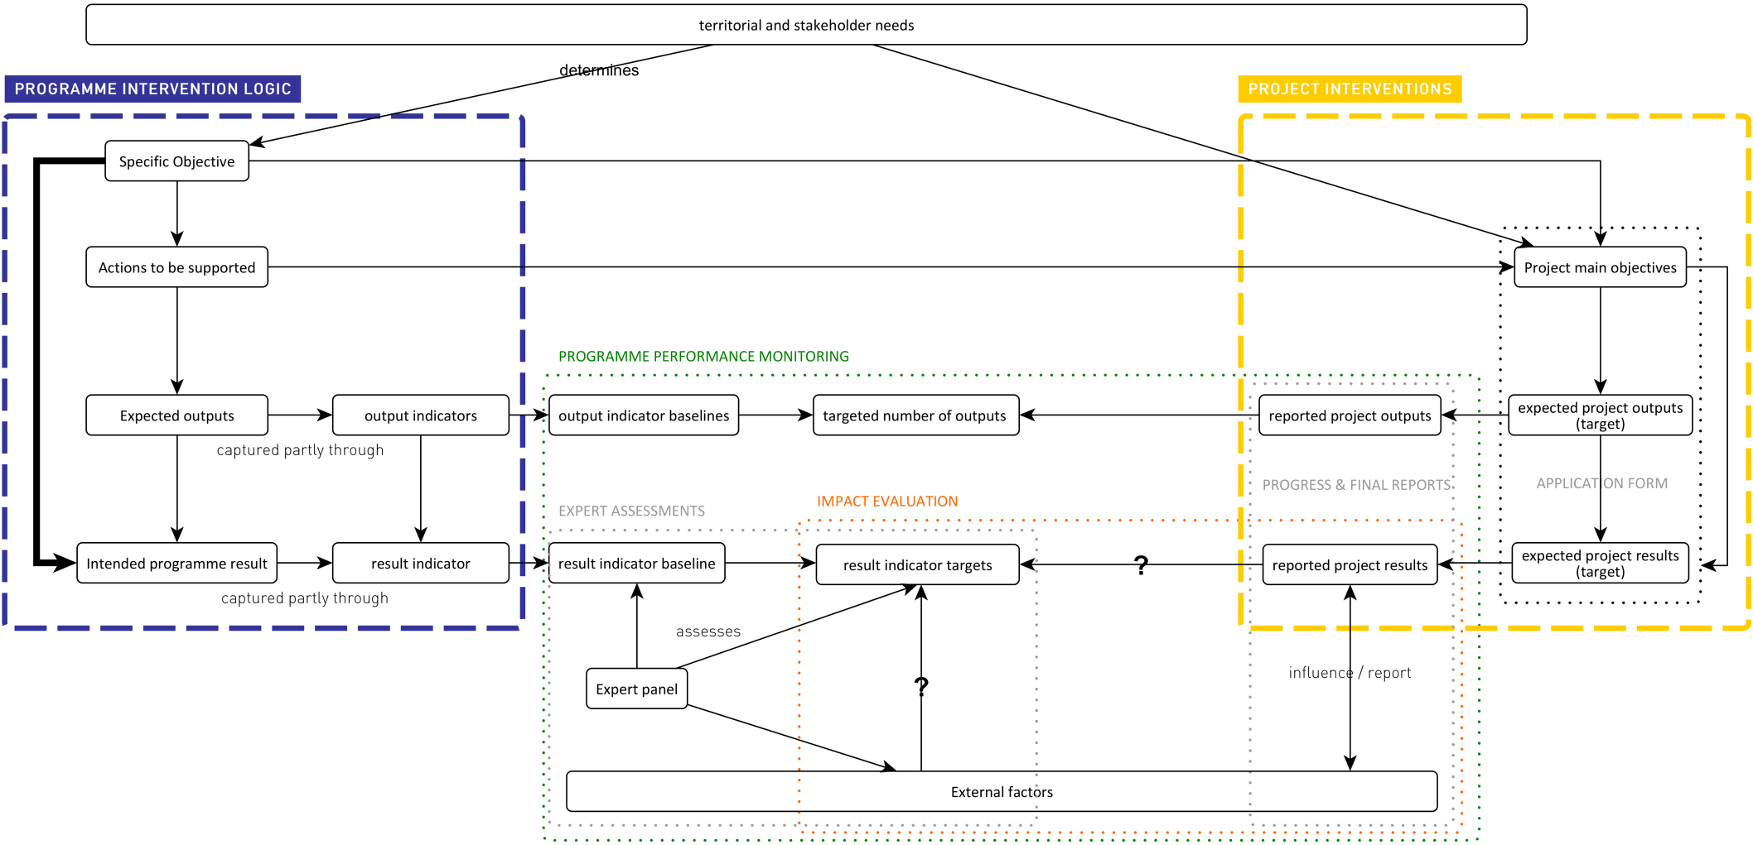
Programme logical framework

