Slide 1
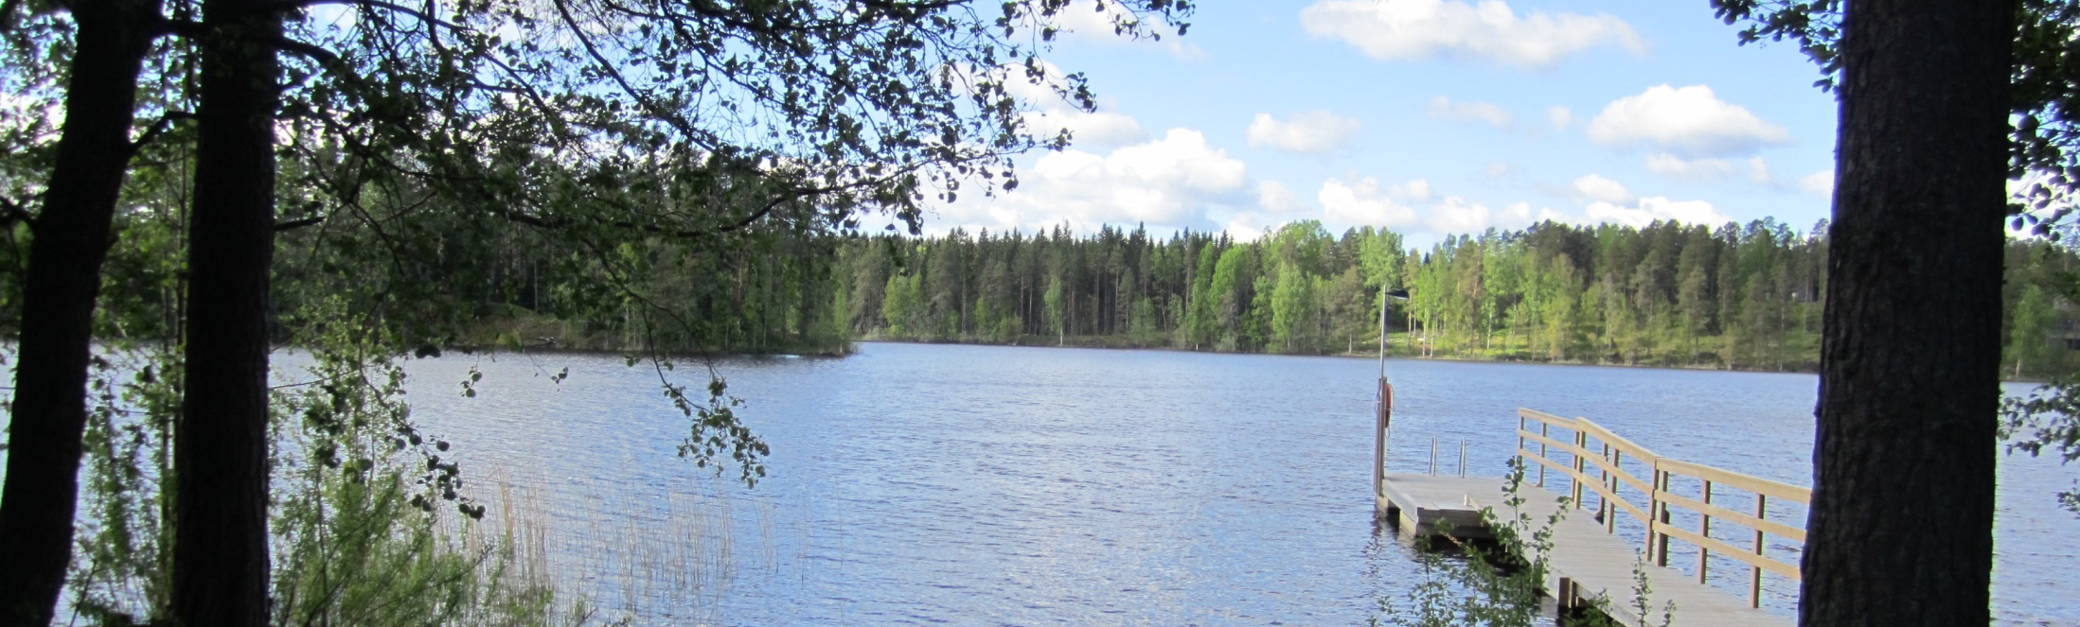
NPA ANNUAL CONFERENCE 2015
30th September 2015
Kuopio, Finland

Slide 2

Morning session
09:00-09:15 | Chair: Harry Ekestam, Ministry of Employment and the Economy, Finland Welcome address – Region Mayor Jussi Huttunen
Programme Results
09:15-09:30 | Synergies: the key to deliver better results – Joanna Kiryllo, Programme Manager – DG Regional and Urban Policy, European Commission
09:30-09:50 | How to measure results – Nathalie Wergles & Ole Damsgaard, Joint Secretariat
09:50-10:30 | Panel discussion – What is the meaning of the baselines and how can projects contribute?
Coffee break

Slide 3

Morning session
Coordination between Programmes
11:00-11:20 | Outcomes preparatory project Coordination Mechanism, regional policy coordination in the Arctic – Jim Millard, Scottish Government & Dr Irene McMaster, EPRC
11:20-11:40 | Coordination with other instruments – Päivi Ekdahl, Kolarctic ENPI CBC Programme
11:40-11:50 | Q & A with the audience
Programme Status
11:50-12:20 | NPA Programme Status – Kirsti Mijnhijmer, Joint Secretariat
12:20-12:30 | Introduction of afternoon programme - Joint Secretariat
Lunch break

Slide 4
Afternoon session
Workshop sessions
13:30-15:30 | Workshop for projects – plenary room | Workshop on coordination – Kallavesi room
 | Mind map exercise with projects to find thematic synergies and gaps, to promote greater awareness among projects of each other, and where they can make a contribution. | Panel discussion with representatives from several programmes. Identifying synergies and opportunities for coordination, potential barriers for a better integration.
Coffee break

Slide 5

Afternoon session
Closing session
16:00-16:20 | Report from workshop sessions - rapporteurs
16:20-16:30 | Launch of the Third Call – Christopher Parker, Joint Secretariat
16:30-16:50 | Key note speech: State of the Region – Aleksi Härkönen, Finland's Ambassador for Arctic Affairs, Ministry for Foreign Affairs
16:50-17:00 | Wrap up - Chair
Buses leave for dinner from the Scandic at 18:30

Slide 6
WELCOME ADDRESS
Region Mayor Jussi Huttunen
30th September – Kuopio, Finland

Slide 7
PANEL DISCUSSION
Expert panellists
30th September – Kuopio, Finland

Slide 8
SYNERGIES: THE KEY TO DELIVER BETTER RESULTS
Joanna Kiryllo, Programme Manager DG REGIO, European Commission
30th September – Kuopio, Finland

Slide 9
WORKSHOP ON COORDINATION
Rapporteur Jim Millard, Scottish Government
30th September – Kuopio, Finland

Slide 10
STATE OF THE REGION
Aleksi Härkönen, Finland's Ambassador for Arctic Affairs, Ministry for Foreign Affairs
30th September – Kuopio, Finland

