Slide 1
WORKSHOP FOR PROJECTS
Joint Secretariat team
30th September – Kuopio, Finland

Slide 2
Purpose
To promote greater awareness among projects of each other
To help inform the next calls for applications
To reflect on the input from the baseline experts and the programme status

Slide 3

Project groups
Group 1 | Innovation - food industries | CEREAL - SmartFish - URCHIN
Group 2 | Innovation - sustainable technologies | FREED - TARGET - SPARA2020 – Measurepolis - Savonia
Group 3 | Entrepreneurship - sustainability | Circular Ocean - GREBE - RYE Connect - (RECENT)
Group 4 | Creative industries, tourism | Craft Reach - Creative Momentum - SAINTS
Group 5 | Sustainable environment management | Drifting Apart - REGINA - WaterPro
Group 6 | Innovation - public service/health | eCAP - IMPROVE - RemoAge
Coffee break

Slide 4
Exercise 1 - Introductions
In your groups, please have a brief introduction round (5 mins)
Now, try to indentify similarities/links between the projects (10 mins)
Select a group rapporteur

Slide 5
Short Video on Mindmapping
https://www.youtube.com/watch?v=wLWV0XN7K1g

Slide 6
Exercise 2 – Mind mapping
Agree on a central image, symbolising the commonality/theme. Draw the central image (10 mins)
Agree on the main branches, e.g. One per project or one per main connection (10 mins)
Complete the mindmap with key words and images (10 mins)

Slide 7
Presentations of mind maps
Three rapporteurs have 5 minutes to present their mind map

Slide 8
Exercise 3 – Impacts
In your group, identify a common target group and write it at the centre of your page (5 mins)
On post-its, write the main impacts your projects will have on the target group (changes your projects will make) (10 mins)
Try to cluster the changes. Are there any overlaps? Are there any gaps? (5 mins)

Slide 9
Presentations of Impacts
The three remaining groups present their impacts (3x5 mins)

Slide 10
Final reflections by panellists

Slide 11
WORKSHOP FOR PROJECTS
Rapporteur Ewan Ramsay, IRRI
30th September – Kuopio, Finland

Slide 12
Exercises
Mind mapping: visualising the project connections
Impacts: what impacts will the projects make on the target groups (= changes)
Final reflections by expert panellists

Slide 13
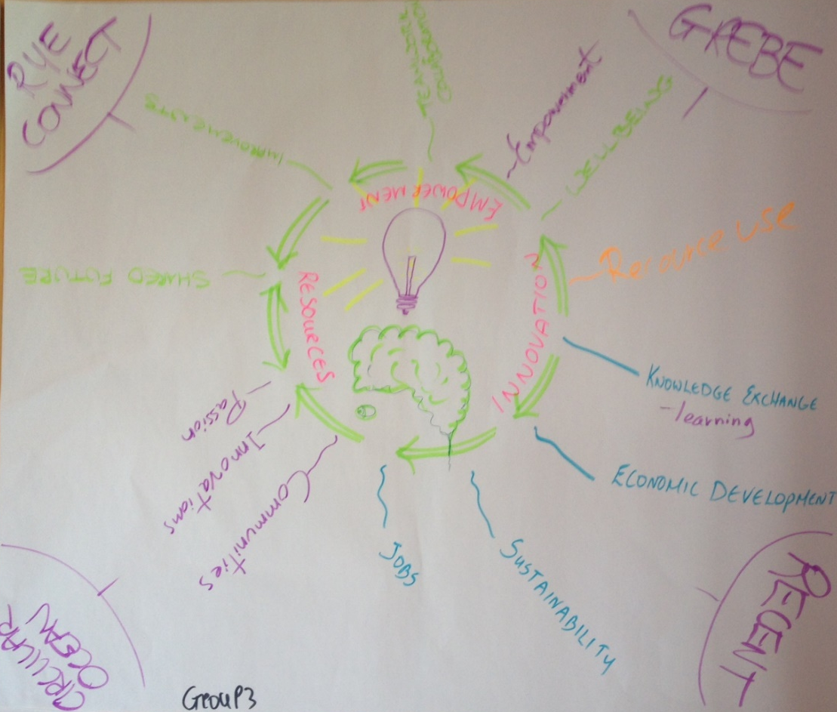
Mind map

Slide 14
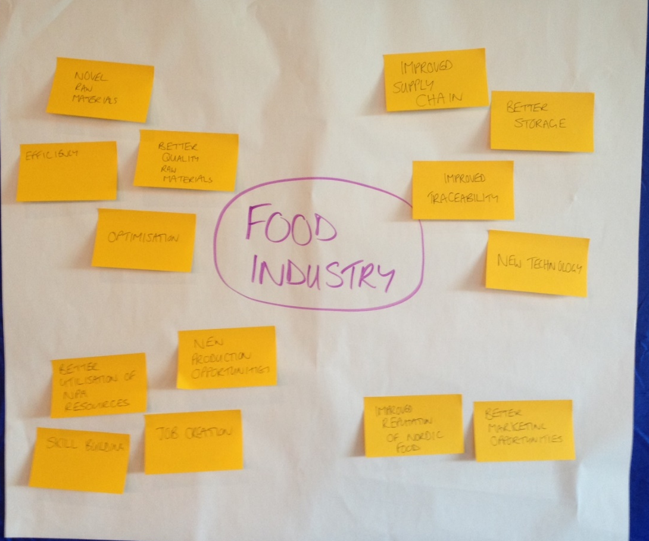
Impacts

Slide 15
Main conclusions
Instant effect: some projects immediately made connections and plans for cooperating
In some groups the similarities were less obvious; commonality is peoples’ perspective.
We need to ask the users about the quality of the services.

