Slide 1


@DavidMintondire
#ournwassembly

Slide 2
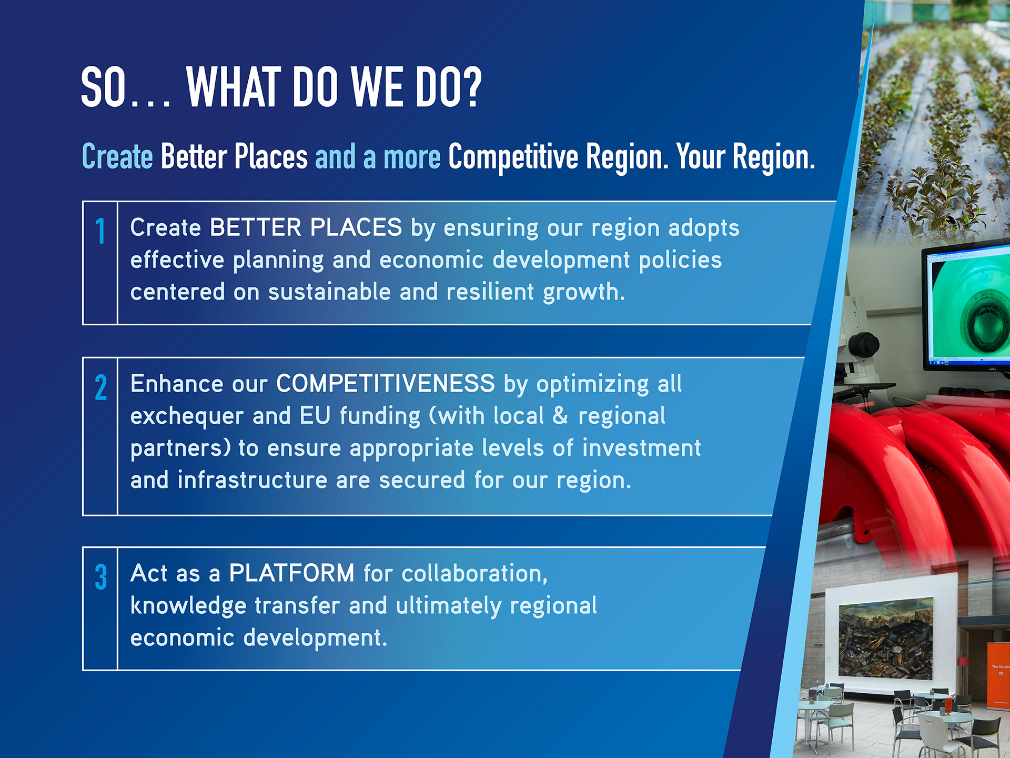

Slide 3
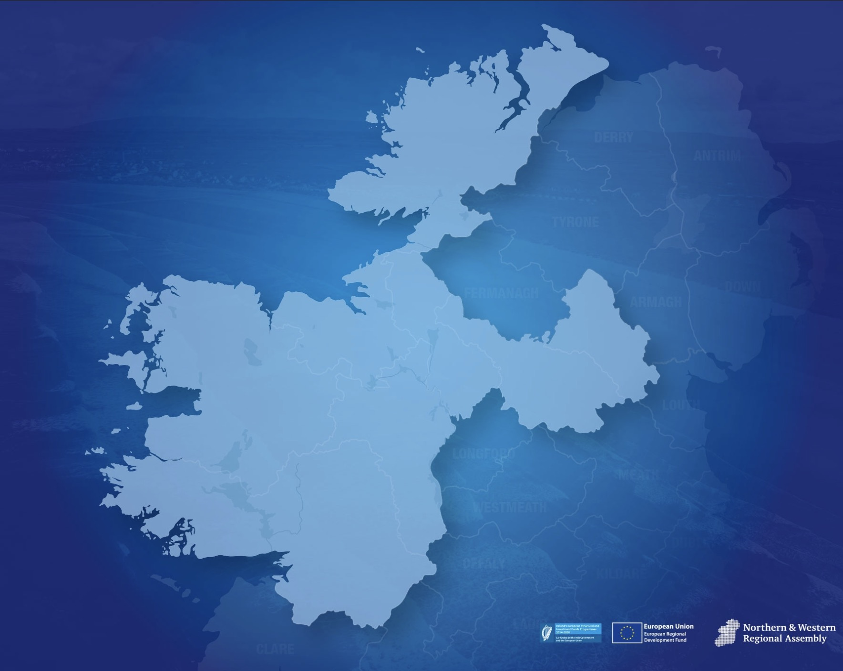





















ATLANTIC ECONOMIC CORRIDOR
HEALTHCARE
FINANCIAL SERVICES
NORTH WEST PARTNERSHIP
FIBRE OPTIC CABLE
SLIGO TO
ENNISKILLEN
CATCHMENT
ENGINEERING
MONAGHAN EAST COAST CONNECTION
AGRI-TECH
AGRI-TECH
KNOCK EQUITY
GROUP
LIFE SCIENCES
MARINE ECONOMY
ENGINEERING
UPPER ERNE ECONOMY PROJECT
AGRI-TECH
LIFE SCIENCES
BIO-PHARMA
ROSCOMMON
TO ATHLONE
CATCHMENT
SHANNON
CATCHMENT
TECHNOLOGY
AEROSPACE

Slide 4
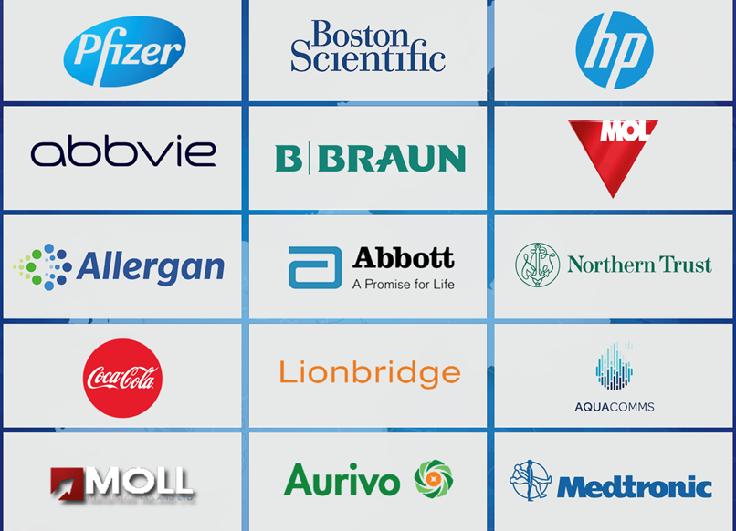

Slide 5
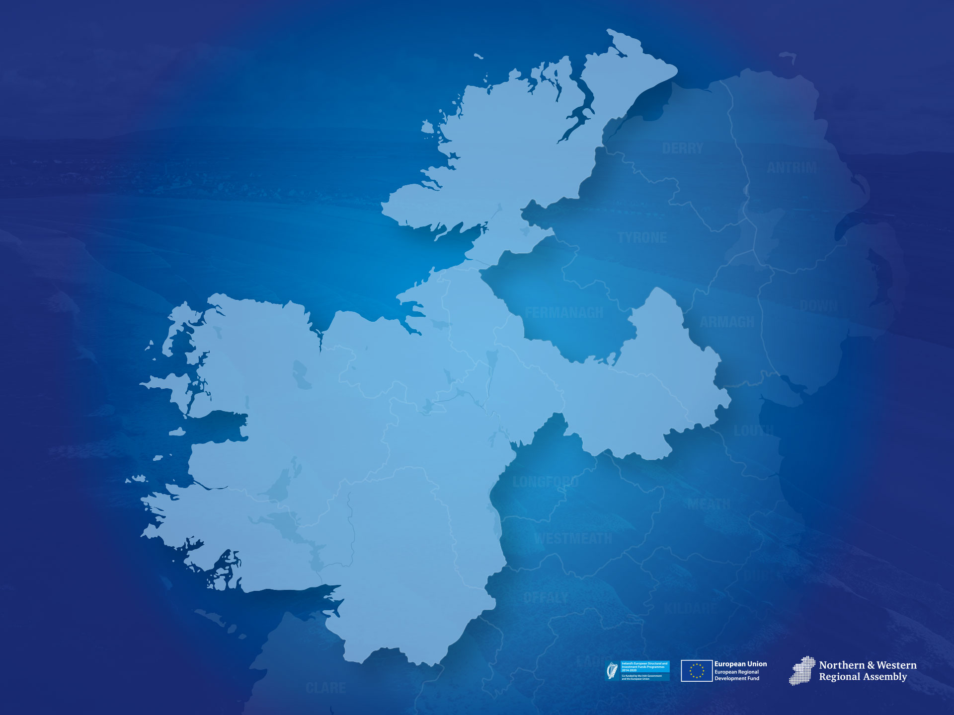






















Notes:
Tel Aviv list – engineering talent; active mentoring; technical infrastructure; start up culture; policy; government programmes
Tel aviv has 19 start ups per square km; ours are just more dispersed

Slide 6



Slide 7

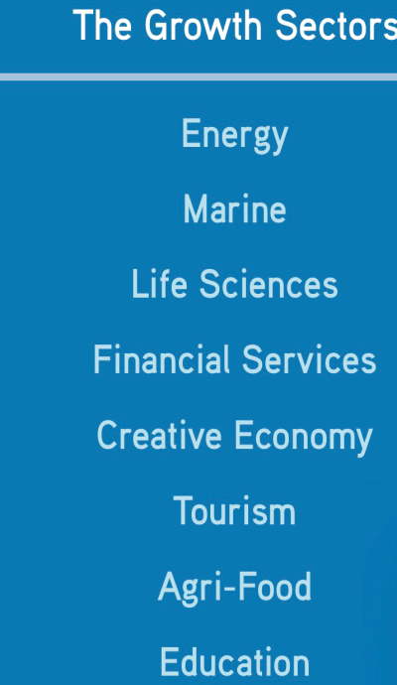










Slide 8
