Slide 1


Support Team for the Atlantic Action Plan
The Atlantic Strategy
Co-operation Opportunities with the NPA
Northern Periphery & Arctic Conference
Galway, 21st September 2017

Slide 2
Content For Today
Introduction to:
  The Atlantic Strategy
  The Atlantic Action Plan
The Support Team for the Atlantic Action Plan
Co-operation opportunities between the AAP and the NPA

Slide 3
The Atlantic Strategy
COM(2011) 782
Challenges and Opportunities facing the Atlantic Ocean Area:
Socially inclusive growth
Reducing Europe’s carbon footprint
Sustainable exploitation of the Atlantic seafloor’s natural resources
Responding to threats and emergencies
Implementing the Ecosystem Approach
Notes:
To help stimulate blue growth in the Atlantic ocean area, the Commission adopted the Atlantic Strategy in November 2011. It’s aim is to respond to the challenges of delivering growth, reducing the carbon footprint, using the sea’s natural resources sustainably, responding effectively to threats and emergencies and implementing an “ecosystem” management approach in Atlantic waters.

Slide 4
The Atlantic Action Plan
COM(2013) 279
Priority 1:
Entrepreneurship & Innovation
Priority 2:
Protect, secure and enhance the marine and coastal environment
Priority 3:
Accessibility and Connectivity
Priority 4:
Regional Development
Innovation, research and technology
Knowledge transfers, clusters, technology platforms
Improving skills in traditional and emerging sectors of the blue economy
Adaption and diversification of fisheries and aquaculture
Improving maritime safety and security
Exploring and protecting marine waters and coastal zones
Sustainable management of marine resources
Supporting marine environment protection, developing MPAs network, etc.
Climate change
MSP
Sustainable management of marine resources: seabed mining and marine biotechnology
Exploitation of renewable energy potential
Promoting cooperation between ports
Better knowledge of social challenges
Atlantic’s cultural heritage
Notes:
Then in March 2013, the Atlantic Action Plan was set up support the objectives of the Atlantic Strategy and to help revitalize the marine and maritime economy of Ireland, France, Spain, Portugal and the UK.
In order to do this, it set out 4 Priority areas under which the projects it got involved with must align. So as you can see…Priority 1….bla bla bla
ICZM – Integrated Coastal Zone Management

Slide 5
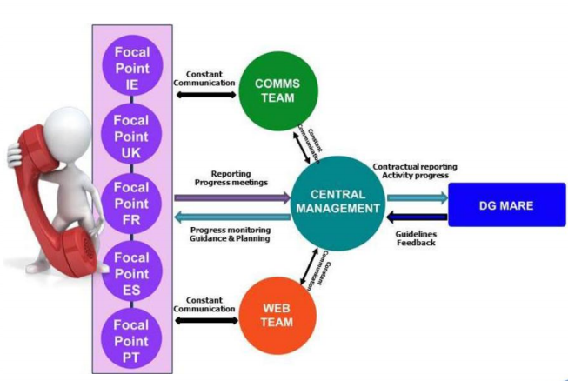
The Support Team of the AAP
Notes:
The support team, for which I am the national unit, was put in place in 2014 to bring the AAP to life.
Who are we?
It consists of a Brussels based team who are in charge of the central management of the project and provide a direct link to the European Commission. They also incorporate a communications and web team that are in regular contact with the NUs.
And 5 national units who provide a face to face service in each of the member states

Slide 6


What do we do?
  GUIDANCE
  • Updated information on AAP, its research and investment priorities
  • Tailor-made answers to queries and face to face support in each member state
  PRO-ACTIVE PROJECT DEVELOPMENT
  • Provides a “match-making” platform to find potential project partners
  • Advise on EU financial instruments for projects implementing the AAP
Notes:
In our roles as national units we have a number of tasks that occupy our day to day workloads, these include:
Providing Guidance to our stakeholders.
Staying constantly up to date with research and investment opportunities by working together with the other member states, regional and local authorities and the EU institutions
Provide tailor made answers to queries and provide a face to face support system for our stakeholders
Be Pro-Active in Project Development
Provide a “match-making platform” to our stakeholders whereby we suggest partners in any of the member states from our stakeholders database
This is a big one – as there in NO funding behind the strategy itself, we advise on the financial instruments available for projects implementing the AAP under the likes of ESIF, Horizon2020, LIFE, COSME, European Investment Bank, private investment etc

Slide 7

What do we do?
  OUTREACH
  • Website (www.atlanticstrategy.eu)
  • Attend 3rd party events
  • Roadshows
  • National Events
  • Atlantic Stakeholder Platform Conference
Notes:
And finally OUTREACH
I have a network of stakeholders that I keep in regular contact with to establish where they are with project ideas etc and see if I can help in any way. So how do I do this?
Our website….(next slide)
I attend as many 3rd party events that relate to our priorities as possible, these are always ideal networking opportunities and the most valuable contacts are usually made at these events
Provide roadshows – speak at as many 3rd party events as possible throughout the year – such as this one!
Each national unit must hold their own event each year with 50+ stakeholders present – ours is yet to be confirmed but is expected to take place this Nov/Dec so keep an eye out for that
And finally the Atlantic Stakeholder Platform Conference is held each year in a different member state and run by the Central Team. Last year it was held in Dublin and focussed on Priority ???? and this year is being held on the Nov 8th in Glasgow and is addressing Priority 4 of the plan. With about 300 people attending - the annual ASPC offers a great transnational publicity opportunity to deliver the AAP’s key messages and further promote awareness of its achievements. The annual conference is the central hub for stakeholders of the Atlantic Strategy to meet, seek ways of cooperation, share information and identify funding opportunities and partnerships for their projects.

Slide 8
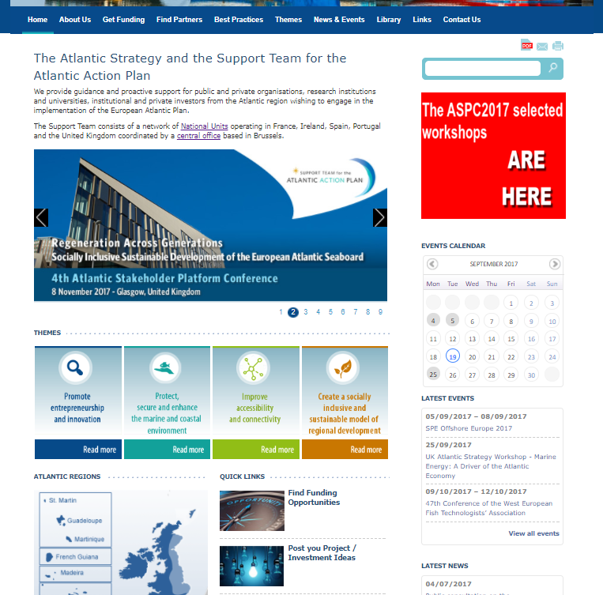
Notes:
We work continuously to keep our website up to date.
You’ll see the homepage now on screen
At the top is the usual's…about us, contact details etc,
But you’ll also see the GET FUNDING or FIND PARTNERS…under both of these you can fill out a form with your own project idea…giving as much or as little information as you like. From there it will be added to the online database where your details can be viewed by anyone browsing.
You will also see the Events calendar…again constantly updated…you will see AAP events (such as the ASPC) rotating on the banner.
LATEST NEWS – will link you straight into our Twitter Feed
So as you can see it’s a bit of a one stop shop for everything we could be helping with.

Slide 9


Co-operation
Opportunities???
Notes:
So by now you’re probably wondering where the AAP fits with the NPA

Slide 10
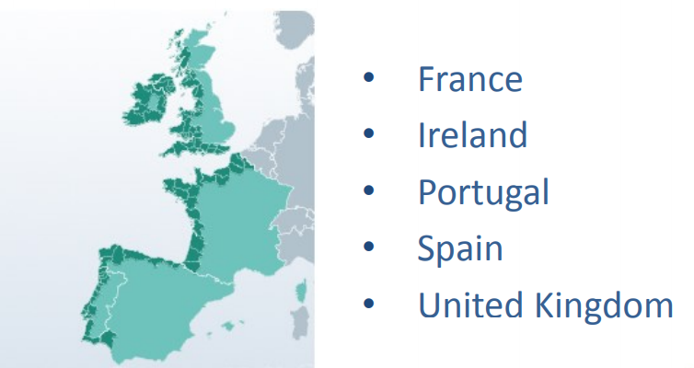
The Atlantic Action Plan
The “Challenge” – No financial instrument
COST
H2020
COSME
LIFE
Territorial Cooperation Programme
ERASMUS+
EU Structural and Investment Funds
Notes:
Well as I touched on before…the Atlantic Strategy, as well as all the other Sea Basin strategies, has one “challenge” in that it has no financial instrument attached to it. We must therefore ADVISE our stakeholders to how to draw down OTHER EU funds such as COST, H2020, LIFE or ESIF, which is obviously where Interreg NPA comes in….

Slide 11

The Atlantic Action Plan
COM(2013) 279
Interreg NPA
Priority 1:
Entrepreneurship & Innovation
Priority 2:
Protect, secure and enhance the marine and coastal environment
Priority 3:
Accessibility and Connectivity
Priority 4:
Regional Development
Innovation, research and technology
Knowledge transfers, clusters, technology platforms
Improving skills in traditional and emerging sectors of the blue economy
Adaption and diversification of fisheries and aquaculture
Improving maritime safety and security
Exploring and protecting marine waters and coastal zones
Sustainable management of marine resources
Supporting marine environment protection, developing MPAs network, etc
Climate change
MSP and ICZM
Sustainable management of marine resources: seabed mining and marine biotechnology
Exploitation of renewable energy potential
Promoting cooperation between ports
Better knowledge of social challenges
Atlantic’s cultural heritage
Priority 3
Through energy efficiency
Priority
4
Priority
1&2
Notes:
First of All – Common Priority Axes
So as I’ve gone through already you will see the AAP priorities on screen. Well if you take the NPA priorities and line them up beside them you will see a very similar setup.
Priority 1&2 of the NPA is all about using Innovation and Entrepreneurship to maintain and develop the programmes area, very similar to the AAPs priority on research and improving skills to tap into entrepreneurship and innovative opportunities
Priority 3 though slightly more focussed then the AAP’s priority 2, still looks at fostering energy-secure communities through promotion or exploitation of renewable energy and energy efficiency.
And finally Priority 4 is probably the most obvious in line with the AAP priorities in that it focusses on protecting, promoting and developing cultural heritage.

Slide 12
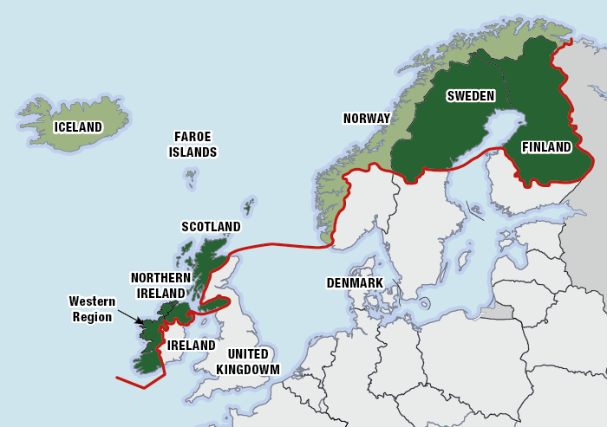
Common Ground!!!
Notes:
Secondly – Common Ground
While both the NPA and the AAP have their own large Member State areas, the common ground between us tends to be a bit smaller and is made up of the West coast of Ireland, Northern Ireland and Scotland. While territory issues possibly make it a lesser known road for Stakeholders of the AAP it should by no means rule it out.
To be successful for funding under Interreg NPA – the project must be made up of a minimum of 2 member state countries.

Slide 13
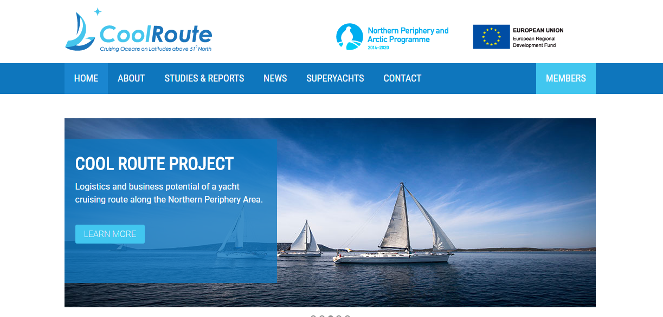
Relevance to AAP
Member States ✓
Alligned to Priorities ✓
Notes:
ONE EXAMPLE I HAVE PICKED TO OUTLINE IS:
The CoolRoute project, which I will only touch on as you will be hearing a lot more about it later today, is lead by Cork IT, with partners in Scotland, Derry, and Donegal and the Faroe Islands.
CoolRoute is a perfect example of how the Priorities of the AAP align with the NPA.
The project itself provides a bi-directional yacht cruising route…encompassing the offshore areas of all project partners. An eco-tourism product, it is based at SMEs in remote communities, explores the natural resources of the zone in a manner that is sustainable and environmentally viable, provides opportunities for spin off activities such as whale watching, walking tours, and trad events and ticks a lot of boxes under the priority axes – hitting on everything from entrepreneurship and innovation to regional development.
AND IS THE PERFECT EXAMPLE OF HOW WE CAN POINT OUR STAKEHOLDERS IN THE DIRECTION OF THE NPA FUNDS AND HOW TO ACCESS THEM

Slide 14



Follow us on the web!
Contact Me:
Joanne Laffey
National Unit IRELAND
nationalunitireland@atlanticstrategy.eu
Phone: +353 91 387200
@EUAtlantic
Support Team Atlantic Action Plan
Support Team For The Atlantic Action Plan
Notes:
I hope that gives you some insight on the work that we do and the possible ways of linking the Strategy with the Northern Periphery and Arctic.
I’ll be around for the day but should you want to get in touch after today, you can see my contact details on screen

Slide 15
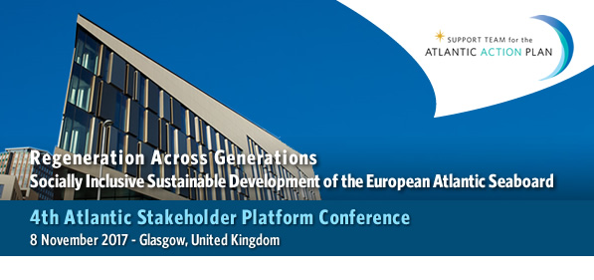
Thank You!!!
www.atlanticstrategy.eu

