Slide 1
Overview of the Marine Institute & EU Programme Engagement
Niall McDonough
Director, Policy Innovation and Research Support Services

Slide 2
Marine Institute
“to undertake, to co-ordinate, to promote and to assist in marine research and development and to provide such services related to marine research and development, that in the opinion of the Institute will promote economic development and create employment and protect the marine environment”
~ Marine Institute Act 1991

Slide 3
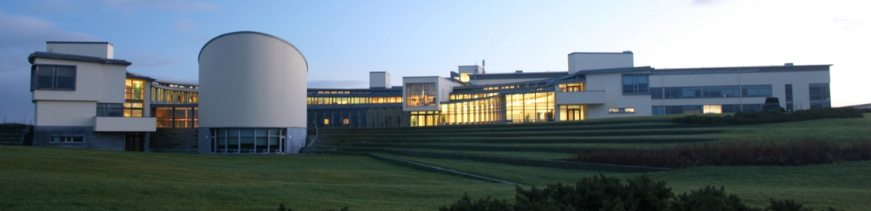
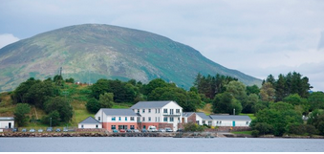
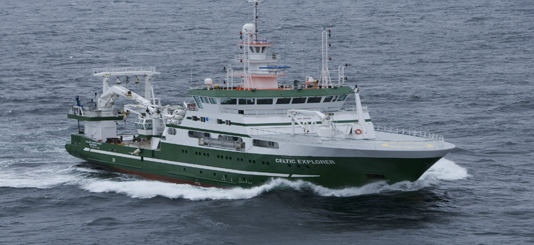
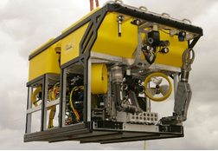
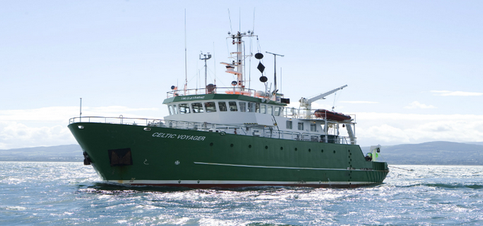
Facilities & Infrastructure
Marine Institute HQ - Oranmore
Newport Catchment Facilities
RV Celtic Voyager
Deepwater ROV Holland I
RV Celtic Explorer

Slide 4





Marine Institute – Six Service Areas
"a thriving maritime economy in harmony with the ecosystem and supported by the delivery of excellence in our services."
Fisheries and Ecosystem Advisory Services
Marine Environment and Food Safety Services
Ocean Science Services
Irish Maritime Development Office
Policy, Innovation and Research Support Services

Slide 5
Marine Institute – Roles of Service Areas
FEAS
MEFS
OSS
IMDO
PIRS
Monitor
Advise
Develop
Research

Slide 6
Marine Institute – Focus on Research
Research & Innovation
Research Performer & Partner
Catalyst for Research
Research Funder
Research Supporter
Research Policy Advisor

Slide 7
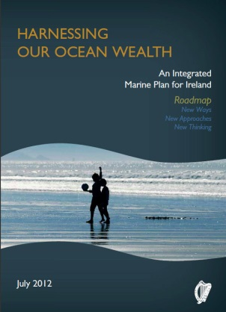
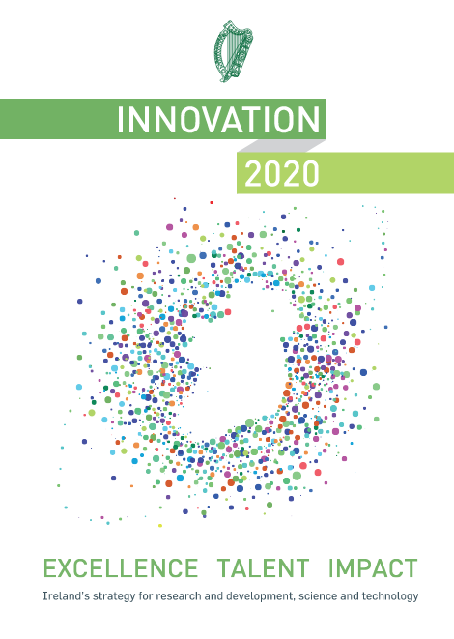
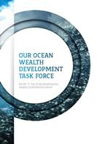
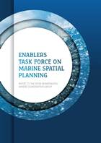
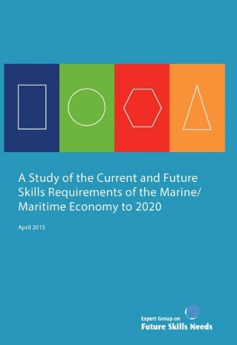


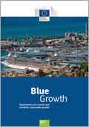
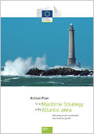
Key Policies & Plans
www.ouroceanwealth.ie

Slide 8
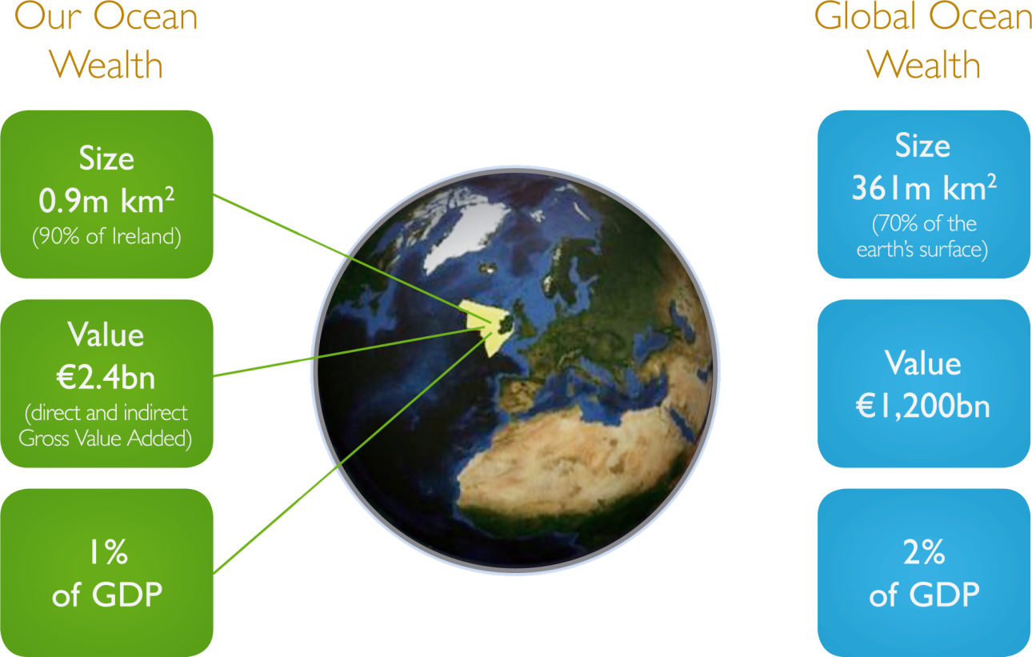
Size
0.9m km²
(90% of Ireland)
Value 1.8bn (Gross Value Added)
0.9% GDP

Slide 9
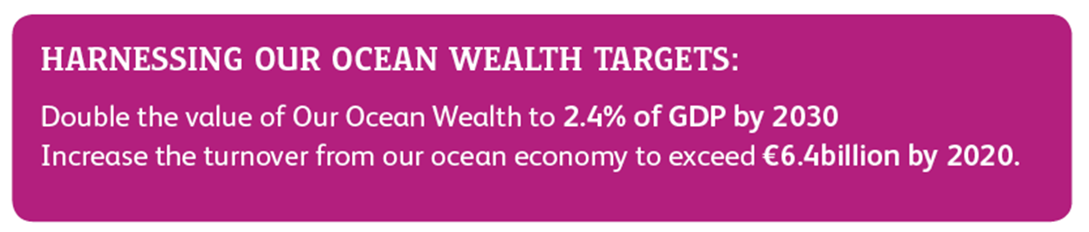
2012: Ireland’s Integrated Marine Plan

Slide 10
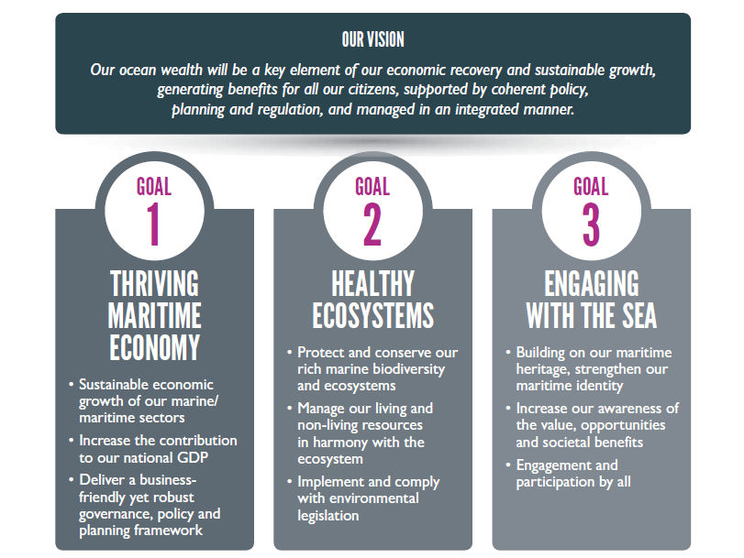

Slide 11
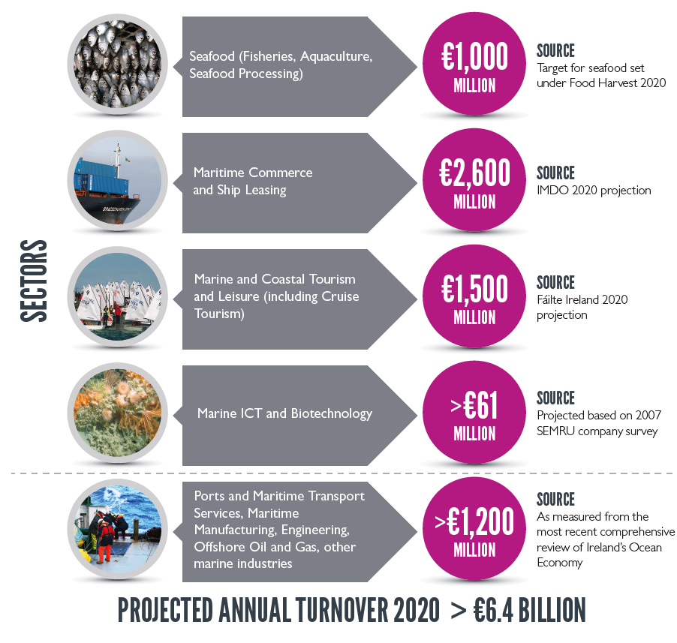
Other relevant documents/reports

Slide 12
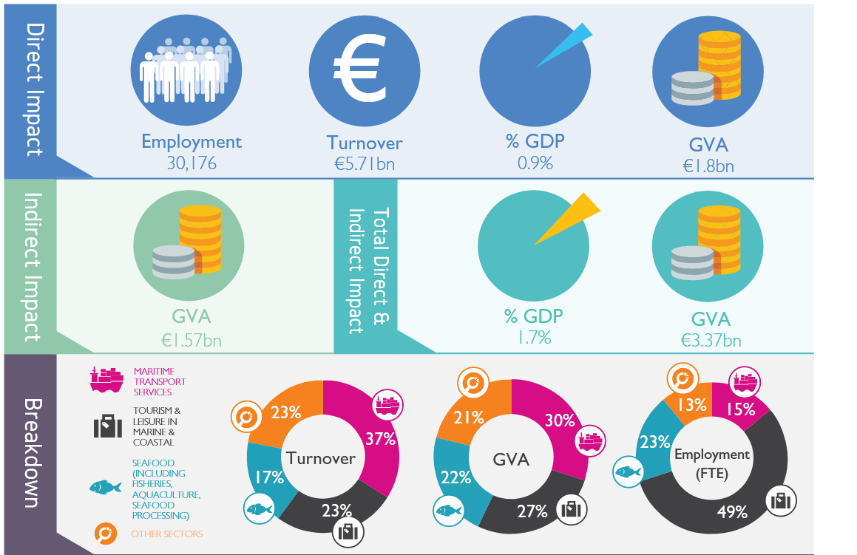
Ireland’s Ocean Economy 2017

Slide 13
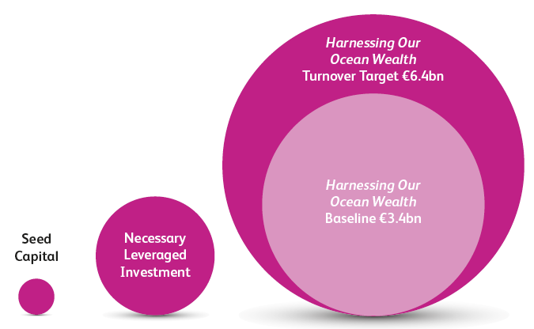
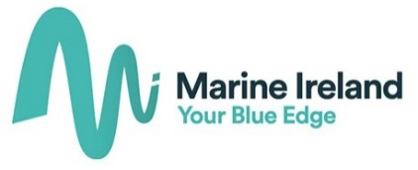
Scale of Investment Required to Achieve National Targets
Information from the Our Ocean Wealth Development Task
Force Report

Slide 14
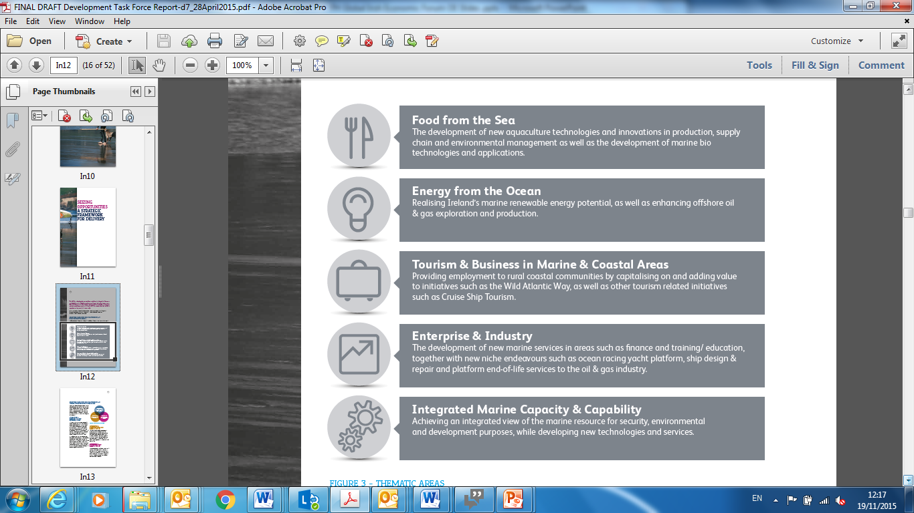
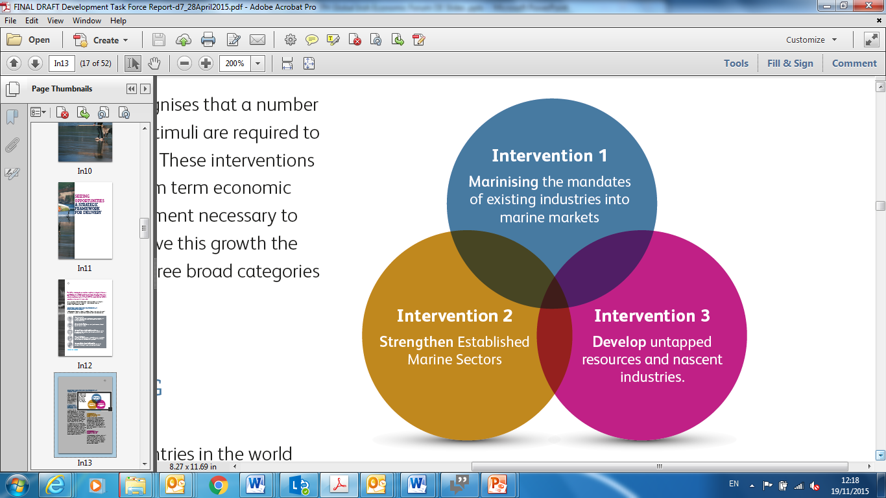
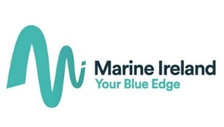
Five Thematic Areas & Three Interventions

Slide 15
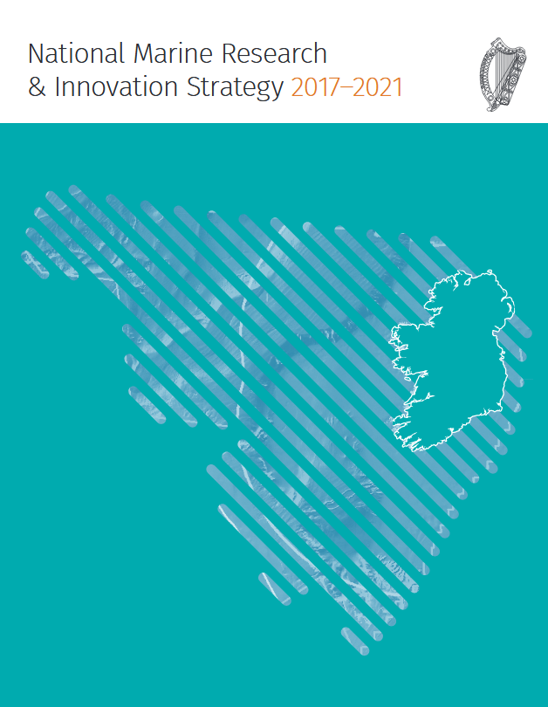
Marine Research and Innovation Strategy
Fifteen major research themes
Research Capability Maturity Assessment for each theme
Review of relevant policies, and sectoral plans, for each theme
Identification of key research requirements and gaps in capability
Provide a guide to all funding agencies nationally

Slide 16
Goals of Marine R&I Research Strategy
to raise the research capacity across all themes
that research funding should be targeted to topics matching requirements articulated in state policies and sectoral plans
that there should be coherence in the approach to marine research by the various state actors involved in funding marine research.

Slide 17
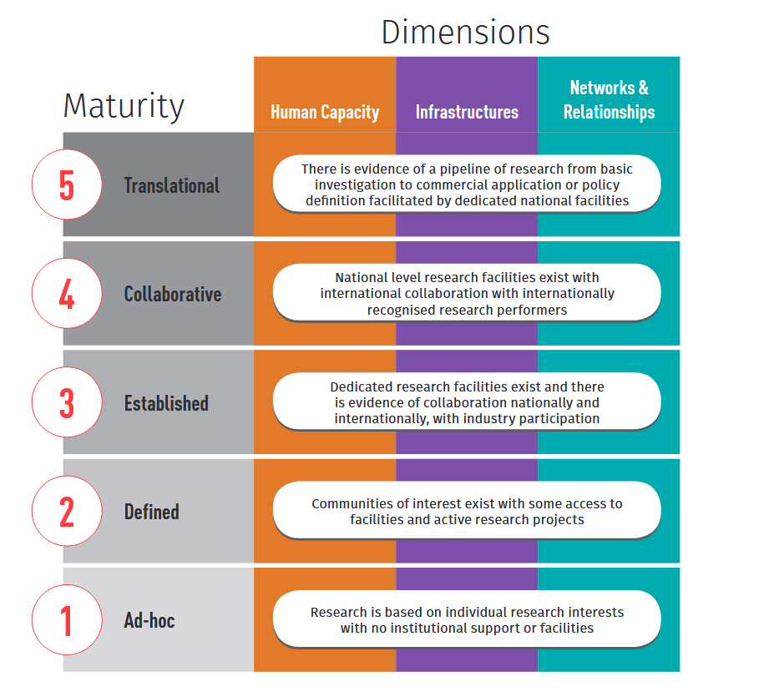

Slide 18
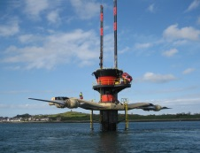
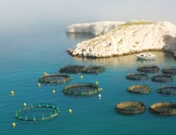
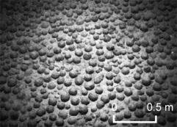
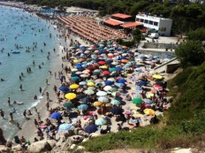
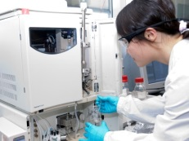
EU Context – Blue Growth Strategy
Blue energy
Aquaculture
Raw Materials
Maritime tourism
Marine biotechnology
(EC COM(2012)494 final) - (maritime component of the Europe 2020 strategy)

Slide 19
Marine Institute - Participation in EU Programmes
In the period 2010-17 MI staff have participated in over 65 EU funded projects
Through project participation, Ireland is represented in EU-wide Networks of Excellence & adds to our national ‘knowledge bank’
Participation provides the opportunity to engage with EU colleagues to share & exchange knowledge/techniques /protocols /best practice/standards
Projects engaged in are always complimentary to our statutory role as a national marine agency

Slide 20
Marine Institute - Participation in EU Programmes, cont/d..
Currently active in over 30 EU funded projects:
40% Horizon 2020
33% Interreg (mainly Atlantic Area)
10% FP7
7% EPA JPI Water & JPI Ocean
6% DAFM FIRM (EMFF)
4% EASME tenders
Further 10 proposals in development

Slide 21
MI Participation in EU Programmes
Disciplines represented:
Climate services/ Oceanographic Modelling/ Ocean Observations / Ocean Technology Seabed Mapping/ Vessel Fleet Mgmt / Data Management / Fisheries / Catchment Mgmt / Aquaculture/ Chemistry / Biotoxins / Fish Disease / Water Quality / Marine Biotechnology / Ports & Shipping / Water Quality / Pollution Modelling & Mgmt/ Marine Spatial Planning
Leading AORA H2020 Project
Irish National Contact Point for Atlantic Action Plan

Slide 22

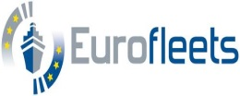
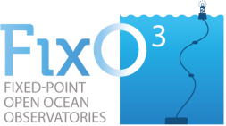

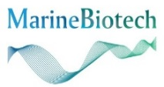
Sample of MI FP7 projects (end 2017)
Project | Title | MI Funding | Funding Instrument
 | Strengthening cooperation in European research on sustainable exploitation of marine resources in the seafood chain- ERA NET | €20K | FP7-ERANET-2012-RTD
 | New operational steps towards an alliance of European research fleets | €465K | FP7-INFRASTRUCTURES-2012-1
 | Fixed Point Open Ocean Observations Network | €138K | FP7-INFRASTRUCTURES-2012-1
 | Benthic ecosystem fisheries Impact Study | €158K | FP7-KBBE-2012-6
 | Marine Biotechnology ERA-NET | €130K | FP7-ERANET-2013-RTD

Slide 23




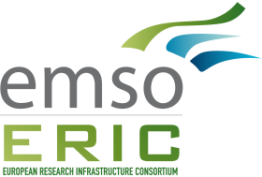
Sample MI H2020 projects
Project | Title | MI Funding | Funding Instrument
 | Atlantic Ocean Research Alliance Support Action | €1.265M | H2020-BG-2014-1
 | Optimizing and Enhancing the Integrated Atlantic Ocean Observing System | €328K | H2020-BG-2014-2
 | Strategies for the gradual elimination of discards in European fisheries | €275K | H2020-SFS-2014-2
 | EMSO implementation and operation: DEVelopment of instrument module | €200K | H2020-INFRADEV-1-2015-1
 | EMSO-Link - Implementation of the Strategy to Ensure the EMSO ERIC’s Long-term Sustainability | €429K | H2020-INFRADEV-2016-1

Slide 24



Sample MI H2020 projects
Project | Title | MI Funding | Funding Instrument
MARITEC-X | Marine and Maritime Research, Innovation, Technology Centre of Excellence | €65K | H2020- WIDESPREAD-04-2017-TeamingPhase1
 | Maritime and Marine Technologies for a New ERA | €472K | H2020-BG-2016-1
 | Fostering Innovation and Creativity in Europe through Public Administration Modernization towards Supplying and Exploiting Linked Open Statistical Data | €117K | H2020-EURO-6-2015
 | Tools for Assessment and Planning of Aquaculture Sustainability | €543K | H2020-SFS-2015-2
Debs rqstd | VIVALDI - Preventing and mitigating farmed bivalve diseases | €118K | H2020-SFS-2015-2

Slide 25
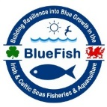

Sample MI INTERREG 2014-20 projects
Project | Title | MI Funding | Funding Instrument
 | Building Resilience into Blue Growth in the Irish & Celtic Seas Fisheries & Aquaculture | €1.1M | Interreg Ireland/Wales
 | Collaborative Oceanography and Monitoring for Protected Area and Species | €1.6M | Interreg Northern Ireland/Ireland/ Scotland
6 new Interreg Atlantic Area projects with MI commencing November 2017
 | Alertox-NET | €190K | Interreg Atlantic
 | CleanAtlantic |  | Interreg Atlantic
 | iFADO |  | Interreg Atlantic
 | MoniTOOL (Associate) | T&S only | Interreg Atlantic
 | MyCoast |  | Interreg Atlantic
 | PRIMROSE | €517K | Interreg Atlantic

Slide 26
JPI projects awarded 2017
Project | Title | MI Funding | Funding Instrument
WATexR | Integration of climate seasonal prediction and ecosystem impact modeling for an efficient adaptation of water resources management to increasing climate extreme events | €239K | European ERA4CS Joint Call for Transnational Collaborative Research Projects 2016 (JPI)
CoClime | Co-development of Climate Services for adaptation to changing Marine Ecosystems | €325K | European ERA4CS Joint Call for Transnational Collaborative Research Projects 2016 (JPI)

Slide 27
EU Programme Engagement – Atlantic Action Plan
Launched in 2013 to identify key investment and research priorities along the EU's Atlantic seaboard which could help both mature and emerging sectors in the marine and maritime economy to flourish.
Aims to:
Promote entrepreneurship and innovation
Create a socially inclusive and sustainable model of regional development
Protect, secure and develop the potential of the Atlantic marine and coastal environment
Improve accessibility and connectivity
Joanne Laffey – Support Team for the Atlantic Action Plan (speaking at12.00)

Slide 28

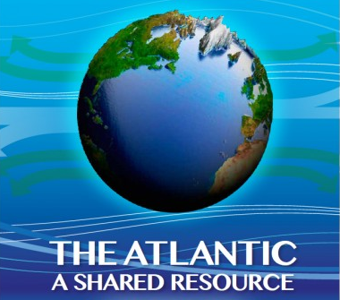
Galway Statement on Atlantic
Ocean Cooperation

Slide 29
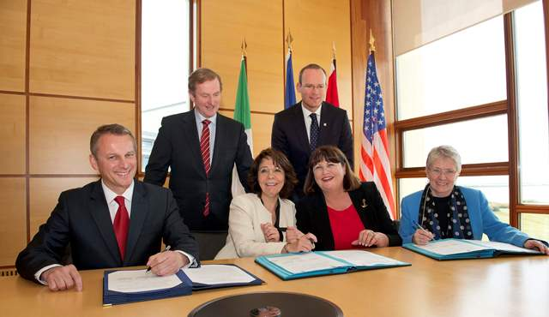
The Galway Statement (2013)
Signing of the Galway Statement, Irish Marine Institute, 24 May 2013. Back row L-R, An Taoiseach, Enda Kenny and Minister for Agriculture Fisheries and Food, Simon Coveny TD.; Front Row (L-R): Edward Fast, Minister of International Trade, Canada, Maria Damanaki, EU Commissioner for Maritime Affairs & Fisheries, Maire Geoghegan-Quinn, EU Commissioner for Research, Science & Innovation ,and Kerri-Ann Jones, Asst. Secretary of State for Oceans and International Environmental & Scientific Affairs, USA.

Slide 30

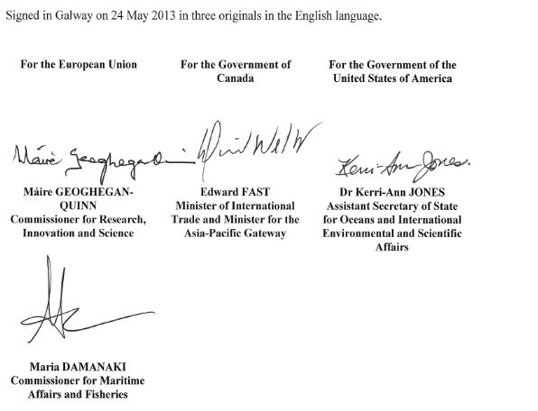
The Galway Statement & Atlantic Ocean Research Alliance
Overarching Objectives
Improve ocean health and stewardship
Promote sustainable management of resources
Improved ecosystem assessments and forecasts and deeper understanding of vulnerabilities and risks, including climate change
Generate new tools to increase resilience, conserve rich biodiversity, manage risk and determine social, environmental, and economic priorities

Slide 31
The Galway Statement & Atlantic Ocean Research Alliance
Priority Areas of Cooperation:
Atlantic Seabed Mapping and Characterization
Aquaculture
Ocean Literacy, including Information Management and Dissemination
Ocean Health and Stressors
Ocean Observation and Prediction
Marine Microbial Ecology (EU-US)
Tri-lateral Working Groups:
Aquaculture
Ocean Literacy
Atlantic Seabed Mapping
Ecosystem Approach to Ocean Health & Stressors
Establishment of formal working groups in remaining areas of research cooperation evolving

Slide 32
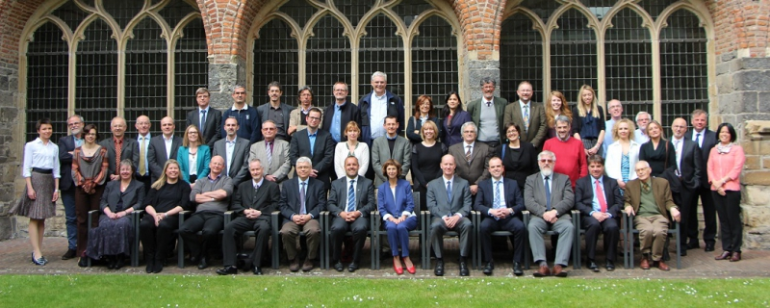
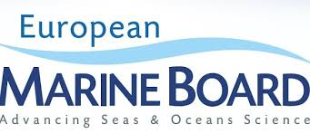
EU Programme Engagement – European Marine Board
National representative on the European Marine Board with the Irish Universities Consortium
The European Marine Board (EMB) is the leading European think tank in marine science policy.
It provides a platform to advance marine research and to bridge the gap between science and policy

Slide 33
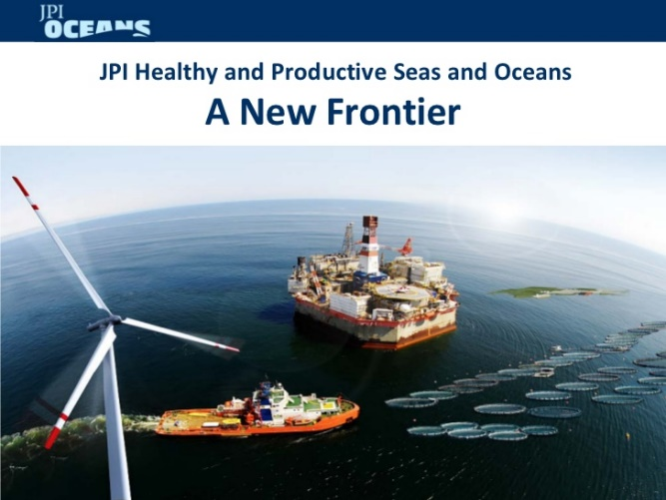

EU Programme Engagement – JPI Oceans
The Joint Programming Initiative Healthy and Productive Seas and Oceans (JPI Oceans) is a coordinating and integrating platform, open to all EU Member States and Associated Countries.
In its role as a coordination platform, JPI Oceans focuses on making better and more efficient use of national research budgets. One of JPI Oceans’ goals is to develop joint research programmes in which countries can be involved on a voluntary basis (variable geometry), e.g. through ERA Nets & Co-funds.

Slide 34
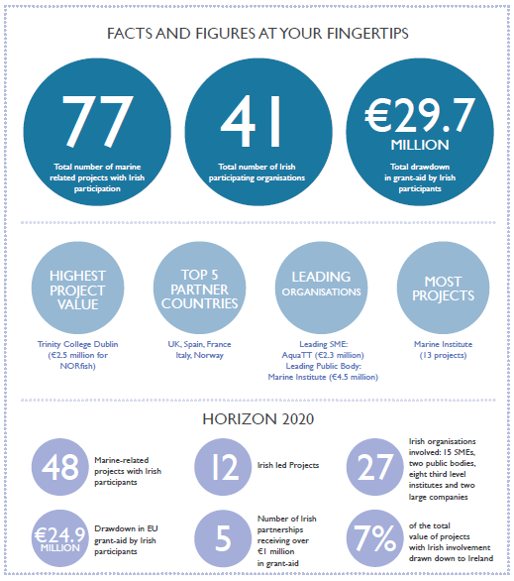
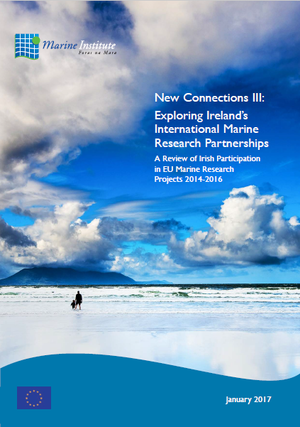
Ireland’s success in EU programmes
www.marine.ie/Home/site-area/research-funding

Slide 35
Concluding remarks
Ireland has a strong marine research capacity underpinned by a proactive national policy framework
The Marine Institute is a key player, working with government and other state agencies, to promote and build the base for Research, Technology Development and Innovation (RTDI)
The Interreg programmes are extremely important to support sustainable development of marine resources and blue growth – allowing neighbouring countries to address shared challenges
Need to examine opportunities for improved participation in NPA programme
www.marine.ie/Home/site-area/research-funding

Slide 36
Thank you

