Slide 1
5th Call
20th September – 28th February
Ole Damsgaard
Head of Joint Secretariat
Galway, September 21st, 2017

Slide 2
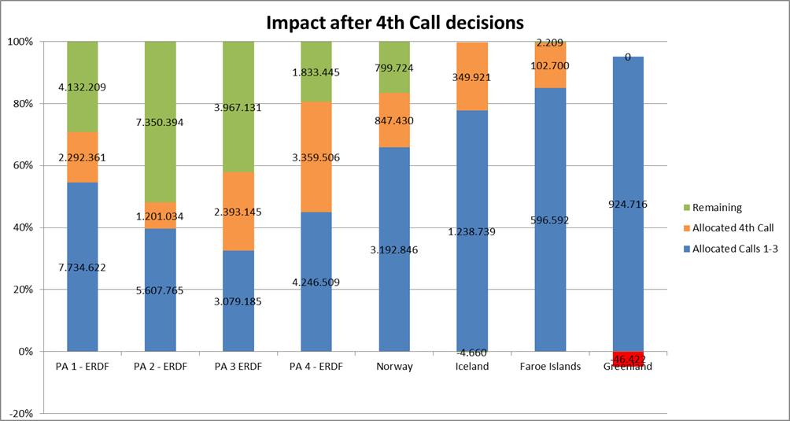


Slide 3
Frames for the 5th Call
31% of funding left
However, uneven distributed between priority axis and funding sources
Targeted call where certain themes have high priority

Slide 4
Priority Axis 1, innovation
1 project in 1.1 & 3 projects in 1.2
Clustering of SMEs in relation to R&D
Business networks across borders, diversify and broaden regional economic base
Solutions addressing viability in public service provision

Slide 5
Priority Axis 2, entrepreneurship
2 projects in 2.1 & 6 projects in 2.2
Realising place-based opportunities for SMEs and start ups
Marketing models and solutions for SMEs, - beyond local and regional borders
Clusters and networks to meet larger scale or more complex demands

Slide 6
Priority Axis 3, energy efficiency
6 projects
Use of renewable energy sources suitable for cold climate and dispersed settlements
Use of ICT technologies, energy efficiency, smart energy management

Slide 7
Priority Axis 4, suistanable environmental management
1 project
Pooling competences transnationally among public authorities
Sharing concepts for sustainable environmental management

Slide 8
For all applicants
Involvement of users
Involvement of underrepresented groups
How to Apply seminars 21st November and 18th January in Copenhagen

Slide 9
Two new project types
Clustering projects, cross programme option within Arctic and Atlantic areas
Micro projects, addressing under represented groups in specific within the Arctic

Slide 10
Frames and conditions
6 – 12 month projects
Clustering 45.000 EUR, Micro 65.000 EUR
Targeted calls for Clustering and open call for Micro projects
See specified Terms of Reference

Slide 11
5th Call
Northern Ireland
Perspective
Declan McGarrigle
Regional Contact Point - NI
Galway, September 21st, 2017

Slide 12
Regional Challenges
  Smaller & less competitive economy
  Low population density
  Dispersed business base
  Public service delivery
  Environmental Challenges

Slide 13
Opportunities
  Largely young population in rural and border region / Skilled workforce
  SMEs base makes a larger contribution than elsewhere in UK
  Job creation potential of maritime environment; ‘’Blue Economy’’
  High Quality Research / University Sector

Slide 14
5th Call - Blue Growth
  NI Economic Strategy
  Harnessing the natural / coastal environment
  Renewable energy focus
  Marine tourism / place based opportunities
  Need for sustainable development
Notes:
Low Levels ofd Entrepr

Slide 15

Project Development: Fit with Region
Relevance?
Added Value?
Is it innovative for the region?
Regional Policy / Strategies?
How well does it align?

Slide 16

Project Development
Review Projects already approved under the programme
Engage with key stakeholders regionally and transnationally
Review your project idea carefully against the selection criteria
Talk to your Regional Contact Point (RCP)

Slide 17
Regional Contact Point Network
Visit the Programme Website:
http://www.interreg-npa.eu/contact/regional-contact-points/

Slide 18
Ole Damsgaard ole.damsgaard@interreg-npa.eu www.interreg-npa.eu
Thanks for your attention
DECLAN MCGARRIGLE
declan.mcgarigle@seupb.eu
www.seupb.eu

