Slide 1

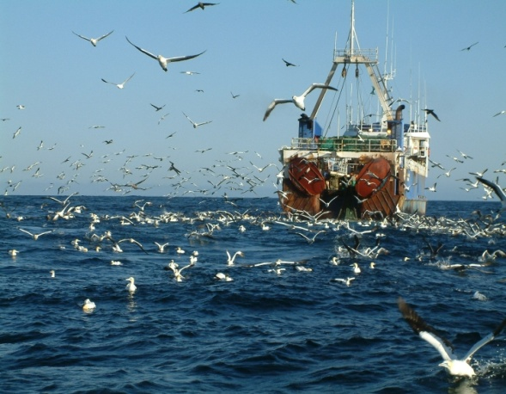
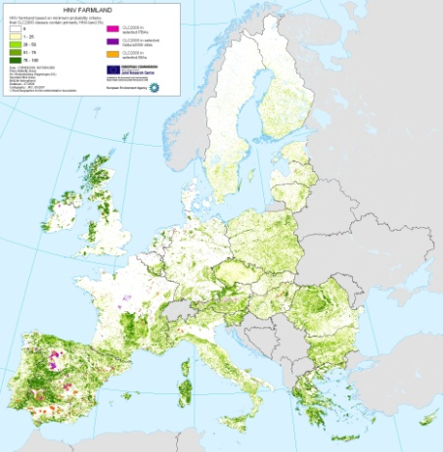
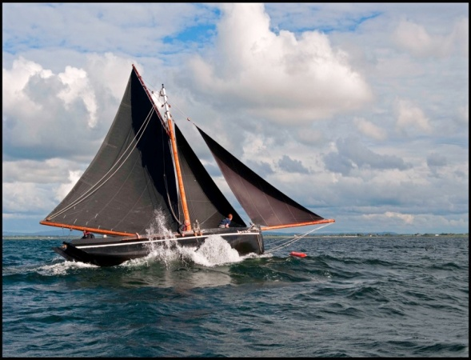
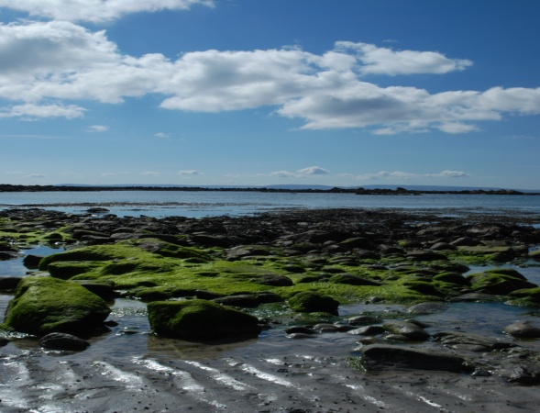

Measuring the Value of the Atlantic Marine Economy: An Irish Perspective

Slide 2
Overview
Ireland's Ocean Economy
  Provide estimates for turnover, GVA and employment FTE for the 2008-2016 period
  Assist in monitoring progress of a number of targets set out in the IMP-HOOW
Ireland's Blue Economy
  Marine ecosystem service benefit values

Slide 3
Some Definitions
The ocean economy includes any economic activity that directly or indirectly uses the sea as an input or produces an output for use in a sea-specific activity.
Marine processes, functions and structure provide marine ecosystem services that directly or indirectly contribute to societal welfare, health and economic activities
The blue economy results when ocean economic activity is in balance with the long-term capacity of marine ecosystems to deliver their services
  This implies the ecosystems remain resilient and healthy.

Slide 4
Multiple Lenses on the Blue Economy
Ecosystem Service Accounts
Environment & Ecosystem Accounts
National Income Accounts
Ocean Economy
Natural Capital
Accounts
Ecosystem Stocks and Flows
Provisional, Regulating, Cultural
Environmental
Expenditures
Blue Economy
Adapted from Colgan (2016)
Notes:
Environmental Service Expenditures
– Pollution control; Remediation; Conservation; Self-generated energy
• Resource Management; Internal Expenditures

Slide 5
Ireland’s Ocean Economy
Latest SEMRU report on Ireland’s Ocean Economy
  Launched in June 2017
  Funded under the Marine Research Sub-Programme PBA/SE/16/01 Valuing and Understanding the Dynamics of Ireland’s Ocean Economy
Annual update including analysis of trends and changing dynamics.
Builds on MARNET methodology

Slide 6
Trends 2014-2016
Ireland’s Ocean Economy 2014-2016
 | 2014 | 2016 | Change | HOOW Target
Direct GVA: | €1.49 billion | €1.79 billion | 20% | -
Direct %GDP: | 0.8% | 0.9% | 0.1% | -
Direct and Indirect % GDP: | - | 1.7% |  | 2.4%
Turnover: | €4.65 billion | €5.7 billion | 23% | €6.4 billion
Employment: | 27,391 FTE | 30,176 FTE | 10% | No Target

Slide 7
Ireland’s Ocean Economy
 | 2012 | 2014 | % Change 2012-2014 | 2016 | % Change 2014-2016
GVA | €1.2 billion | €1.5 billion | 19% | €1.8 billion | 20%
% GDP | 0.8% GDP | 0.9% GDP |  | 0.9% GDP
Turnover | €4.7 billion | €4.6 billion | -2% | €5.7 billion | 23%
Employment | 25,523 FTEs | 27,391 FTEs | 7% | 30,176 FTEs | 10%
Ireland’s ocean economy keeps performing on average better than the general economy

Slide 8
Direct Turnover, GVA and Employment by Category
2016 | Turnover € Millions | GVA € Millions | Employment (FTEs)
Shipping & Maritime Transport | 2,123.27 | 533.15 | 4,666
Marine Commerce | 140.73 | 41.76 | 342
Tourism in Marine and Coastal Areas | 1,304.29 | 489.65 | 14,891
International Cruise | 25.94 | 9.76 | …
Sea Fisheries | 279.80 | 187.00 | 2,536
Marine Aquaculture | 167.17 | 71.53 | 1,030
Seafood Processing | 537.11 | 140.46 | 3,029
Marine Advanced Technology | 139.68 | 60.63 | 695
Marine Biotechnology and Bio-products | 43.61 | 16.99 | 453
Oil and Gas Exploration and Production | 597.28 | 71.67 | 265
Manufacturing, Construction and Engineering | 132.23 | 70.99 | 1,023
Marine Retail Services | 162.38 | 63.89 | 790
Marine Renewable Energy | 59.00 | 38.10 | 454

Slide 10
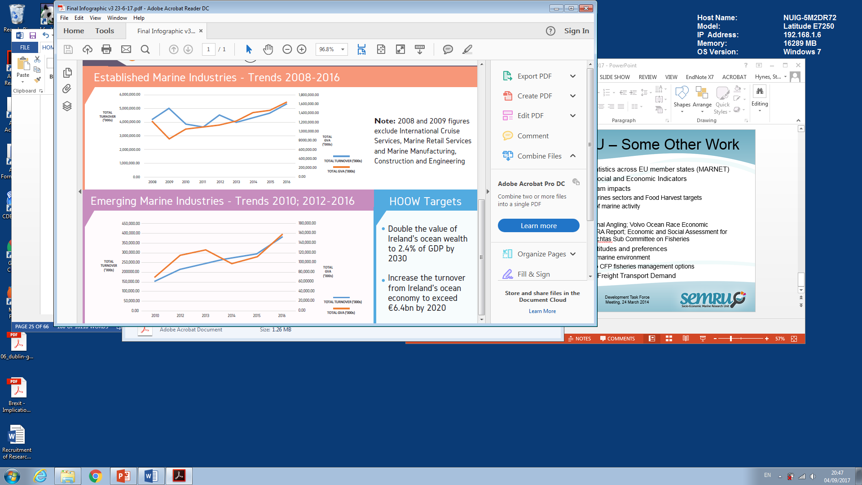

Slide 11
International Comparisons
Country | Year | Direct Ocean GDP (€ billions) | % National GDP | % National Employment
USA | 2013 | 262.28 | 2.17 | 2.2
Canada | 2006 | 12.42 | 1.2 | 1.1
Iceland* | 2010 | 0.88 | 10.2 | 5.1
South Korea | 2014 | 30.34 | 3.02 | 2.8
China | 2016 | 571 | 5.8 | 4.7
UK | 2006 | 67.62 | 4.2 | 3
New Zealand | 2013 | 2.48 | 1.9 | 1.3
France | 2013 | 35.5 | 1.73 | 1.7
Ireland | 2016 | 1.8 | 0.9 | 1.5
Australia | 2014 | 28.52 | 2.7 | 2.1

Slide 12
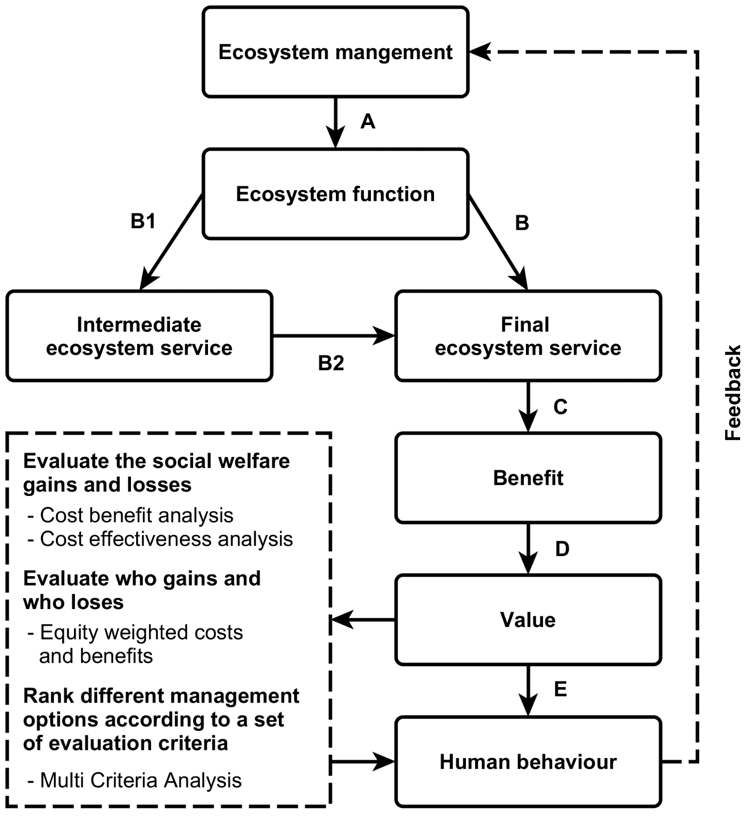

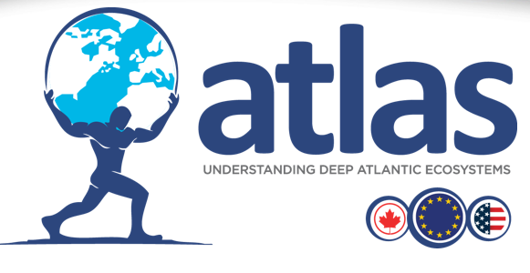
Valuing Marine Ecosystem Service Benefits

Slide 13
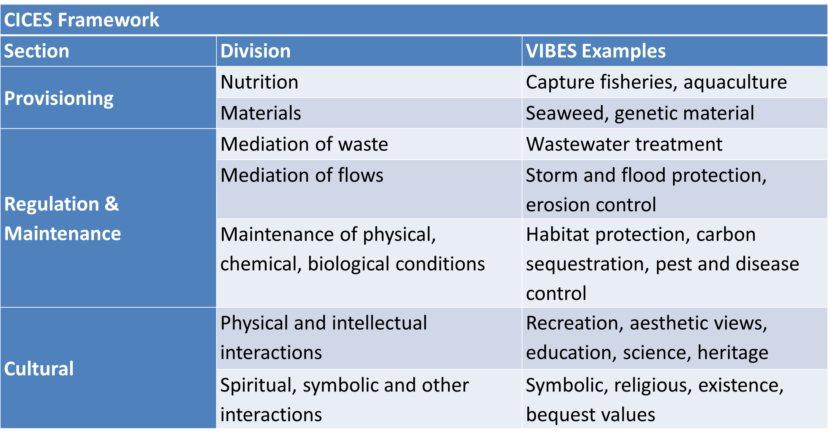
Common International Classification of Ecosystem Services (CICES) framework

Slide 14
Valuing Irish Blue Ecosystem Services
Ecosystem Service | CICES Classification | Quantity of ES
Off shore capture fisheries | Wild Animals | 449,848 tonnes
Inshore capture fisheries | Wild Animals | 17,102 tonnes
Aquaculture | Aquaculture | 35,627 tonnes
Plants and algae | from Aquaculture | 29,500 tonnes
Water for non-drinking purposes | Surface water non-drinking purposes | 1,019,692,399m³
Urban wastewater discharges | Mediation of waste | 14,465,519 kg organic waste
 |  | 6,207,986 kg nitrogen
 |  | 1,276,828 kg phosphorous
Habitat protection | Lifecycle and habitat | 773,333 ha of CME inclusive SACs
Storm protection | Moderation of flows | c. 350km protected by saltmarsh
Carbon sequestration | Climate regulation | c. 47,000,000 tCO2 sequestered

Slide 15
Conclusions
Ocean Economy: Compared to 2014, 2016 saw a:
  23% increase in turnover, 20% increase in gross value added (GVA), 10% increase in employment.
Emerging marine industries ahead in terms of growth – 39% growth in turnover during 2014 - 2016.
2020 HOOW target of turnover of €6.4bn – now at €5.7bn
Factoring marine ecosystem service values into ocean economy account frameworks may help to ensure a sustainable “blue economy” for Atlantic area by making sure that growth in the ocean economy does not exceed the carrying capacity of the marine environment.

