Slide 1
Results Focus
Kirsti Mijnhijmer, Joint Secretariat
20th October 2015, Copenhagen, Denmark

Slide 2
Some terminology
Result: what is intended to be changed in the programme area
Outputs: direct products of the programme, intended to contribute to results. They are mainly developed at project level (products/services).
Results orientation: for the 2014-2020 period, the focus is shifting from only measuring outputs (products/services) to measuring the results that they contribute to (change in the programme area).

Slide 3
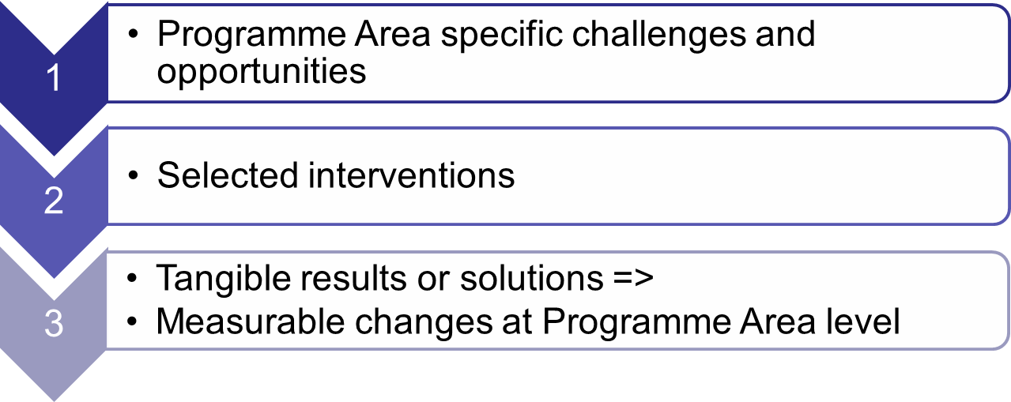
Intervention logic

Slide 4
Intervention logic at programme level
Vision: what does the programme want to achieve
Thematic objectives: 4 themes form the basis for the 4 priorities
Specific objectives: how the programme plans to meet the vision
Results sought: what changes the programme wishes to see, e.g. raised awareness, improved entrepreneurial climate, raised preparedness

Slide 5
Intervention logic at programme level
Result indicators: how the changes will be measured
Actions supported: examples of interventions to help achieve the results sought, including examples of target groups and partners
Output indicators: quantifying the outputs that are developed
Performance framework: accountability for outputs, finances

Slide 6
What does it mean for projects?
Project result: what change does the project hope to achieve?
  Qualitative contribution to programme result indicators (neutral/positive)
Project objectives: how will the project achieve its chosen result?
Project outputs: products/services, i.e. the solutions to meet the chosen objectives and result
  Quantitative contribution to output indicators

Slide 7
What does it mean for projects?
Deliverable: by-product in developing the main outputs
Budget and spending target: Contribution to the programme financial targets

Slide 8
Quality Objectives - Purpose
Bridge the gap between the project outputs and programme results
Indicate the type of projects the programme aims to support; those delivering meaningful change.
Form a reference point for evaluating project applications – basis for selection criteria

Slide 9
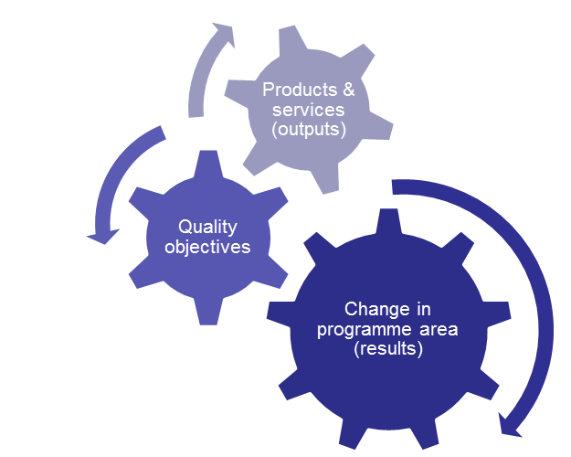
Quality Objectives
Concrete
Innovative
Focused
Relevant
Responsible
Viable
Transnational
Strategic
Value-for-money

Slide 10
Quality Objectives
Concrete
Innovative
Focused
Relevant
Responsible
Viable
Transnational
Strategic
Value-for-money

Slide 11
Quality Objectives – Innovative & Relevant
Innovative: the project output is new or innovative to the partner organisations, the partner countries, or the Programme area.
Relevant: Project outputs take into account relevant conditions in each part of the project’s target area. This means that the project outcomes:
  Demonstrate a high relevance for the development needs and opportunities in the target area.
  Take into account the current situation for the sector/each part of the target area.
  Demand-driven: The development of project outputs is based on demonstrable stakeholder demand and include stakeholder involvement (interface)

Slide 12
Quality Objective – Viable
Viable: project outputs are supported by appropriate business and dissemination models that allow the project output to become self-sustaining when the project support ends.
  Marketing plans for the project output to reach identified relevant target groups. Note: branding should focus on project outcomes, not the project.
  Realistic provision/delivery models. For example, ensuring that that the project output is delivered by organisations with the right competences, and well integrated, etc.

Slide 13
Quality Objective – Transnational
Transnational: the design of project outputs clearly draws on the results of transnational cooperation.
  E.g. transferring models/knowledge/technology from one region to another, partners complementing each others’ competences and resources, combining different regional skill sets, gaining a critical mass, etc.

Slide 14
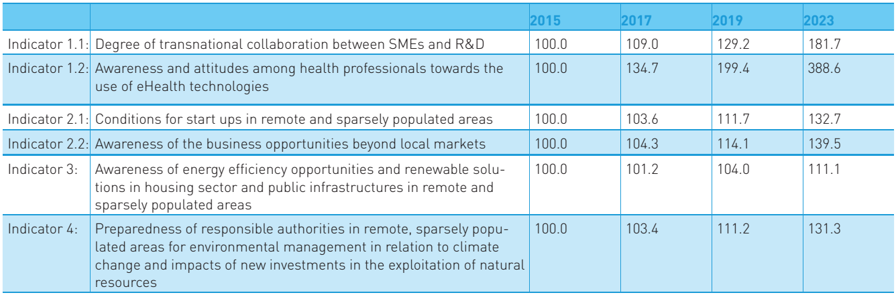
Result indicators – Programme level
Text

Slide 15
Output indicators – Project level
Example Priority axis 3

Slide 16
Thank you for listening
Kirsti Mijnhijmer
Email:
kirsti.mijnhijmer@interreg-npa.eu
www.interreg-npa.eu

