Slide 1
General overview
Ole Damsgaard, Joint Secretariat
Copenhagen, Denmark - September 1st, 2016

Slide 2
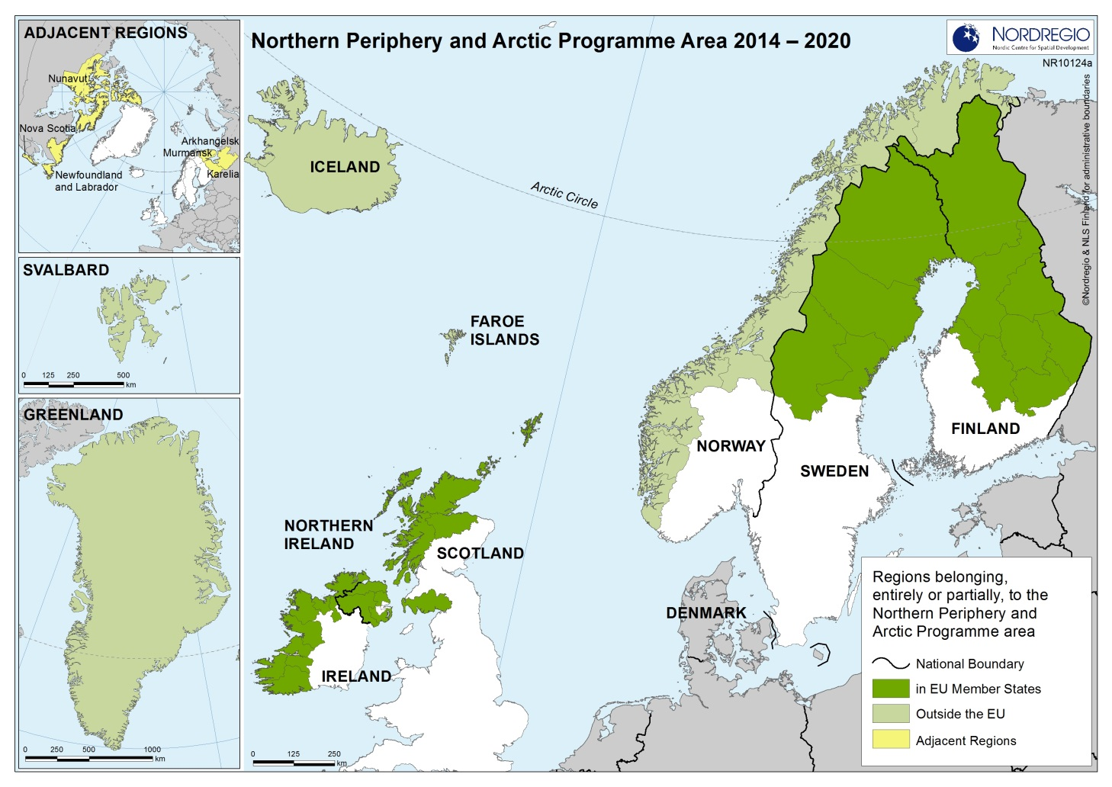

The Programme Area

Slide 3
Vision
To counteract the overwhelming challenges, the Programme will help to generate vibrant, competitive and sustainable communities by harnessing innovation, expanding the capacity for entrepreneurship, and seizing the unique growth initiatives and opportunities of the Northern and Arctic regions in a resource-efficient way.

Slide 4
The Programme Mind-set
= Intervention logic
1
Programme Area specific challenges and opportunities
2
Selected interventions
3
Tangible results or solutions =>
Measurable changes at Programme Area level

Slide 5
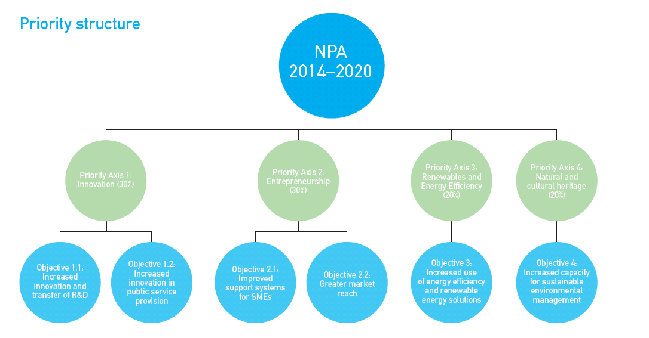

Slide 6
For the individual Priority Axis
The Programme states
Objective
Results sought
Actions supported (have been further narrowed down for the 4th Call)
Main target groups and end users
Types of partners

Slide 7
Approved Projects
1. Call: 13 projects approved
2. Call: 7 projects approved
3. Call: 5 projects approved
Preparatory call: 28 projects approved

Slide 8
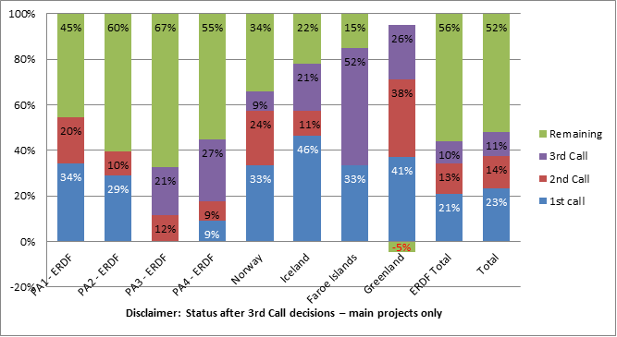
Distribution by theme & source

Slide 9
Impact of Brexit?
24th June, Joint statement from Tusk & Juncker; Business as usual until Art. 50 is triggered
12th August, UK Treasury statement; Already funded projects with UK-partners will continue also beyond Brexit, new (ERDF) applications have to be considered case by case

Slide 10
Ole Damsgaard ole.damsgaard@interreg-npa.eu www.interreg-npa.eu
Thanks' for your attention

