Slide 1
Results Focus
Rachel Burn, Joint Secretariat
1st September 2016 – Copenhagen, Denmark

Slide 2
Some terminology
Result: what is intended to be changed in the programme area
Outputs: direct products of the programme, intended to contribute to results. They are mainly developed at project level (products/services).
Results orientation: for the 2014-2020 period, the focus is shifting from only measuring outputs (products/services) to measuring the results that they contribute to (change in the programme area).

Slide 3
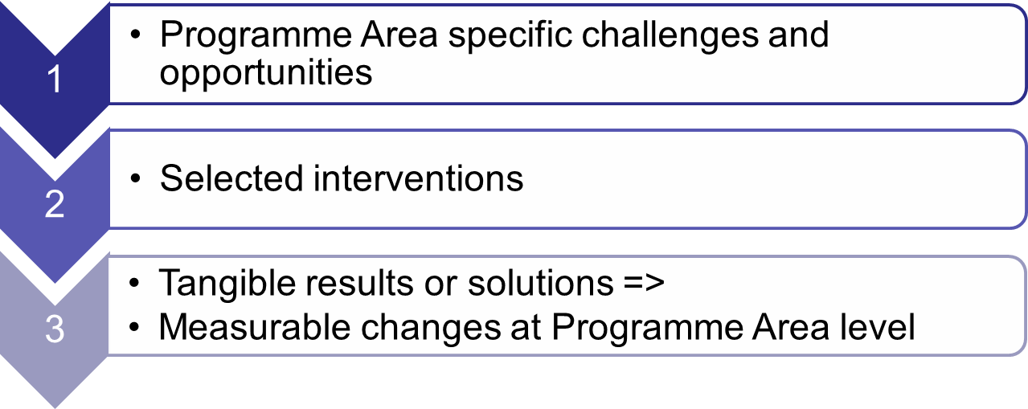
Intervention logic

Slide 4
Intervention logic at programme level
Vision: what does the programme want to achieve
Thematic objectives: 4 themes form the basis for the 4 priorities
Specific objectives: how the programme plans to meet the vision
Results sought: what changes the programme wishes to see, e.g. raised awareness, improved entrepreneurial climate, raised preparedness

Slide 5
Intervention logic at programme level
Result indicators: how the changes will be measured
Actions supported: examples of interventions to help achieve the results sought, including examples of target groups and partners
Output indicators: quantifying the outputs that are developed
Performance framework: accountability for outputs, finances

Slide 6
What does it mean for projects?
Project result: what change does the project hope to achieve?
  Qualitative contribution to programme result indicators (neutral/positive)
Project objectives: how will the project achieve its chosen result?
Project outputs: products/services, i.e. the solutions to meet the chosen objectives and result
  Quantitative contribution to output indicators

Slide 7
What does it mean for projects?
Deliverable: by-product in developing the main outputs
Budget and spending target: Contribution to the programme financial targets

Slide 8
Quality Objectives - Purpose
Bridge the gap between the project outputs and programme results
Indicate the type of projects the programme aims to support; those delivering meaningful change.
Form a reference point for evaluating project applications – basis for selection criteria

Slide 9
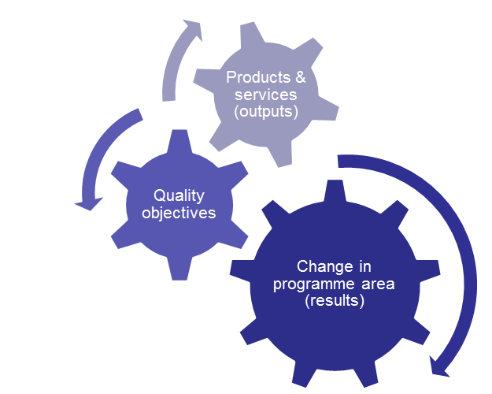
Quality Objectives
Concrete
Innovative
Focused
Relevant
Responsible
Viable
Transnational
Strategic
Value-for-money

Slide 10
Quality Objectives
Concrete
Innovative
Focused
Relevant
Responsible
Viable
Transnational
Strategic
Value-for-money

Slide 11
Quality Objectives – Innovative & Relevant
Innovative: the project output is new or innovative to the partner organisations, the partner countries, or the Programme area.
Relevant: Project outputs take into account relevant conditions in each part of the project’s target area. This means that the project outcomes:
  Demonstrate a high relevance for the development needs and opportunities in the target area.
  Take into account the current situation for the sector/each part of the target area.
  Demand-driven: The development of project outputs is based on demonstrable stakeholder demand and include stakeholder involvement (interface)

Slide 12
Quality Objective – Viable
Viable: project outputs are supported by appropriate business and dissemination models that allow the project output to become self-sustaining when the project support ends.
  Marketing plans for the project output to reach identified relevant target groups. Note: branding should focus on project outcomes, not the project.
  Realistic provision/delivery models. For example, ensuring that that the project output is delivered by organisations with the right competences, and well integrated, etc.
  Related to the concepts of durability and transferability of outputs

Slide 13
Quality Objective – Transnational
Transnational: the design of project outputs clearly draws on the results of transnational cooperation.
  E.g. transferring models/knowledge/technology from one region to another, partners complementing each others’ competences and resources, combining different regional skill sets, gaining a critical mass, etc.

Slide 14
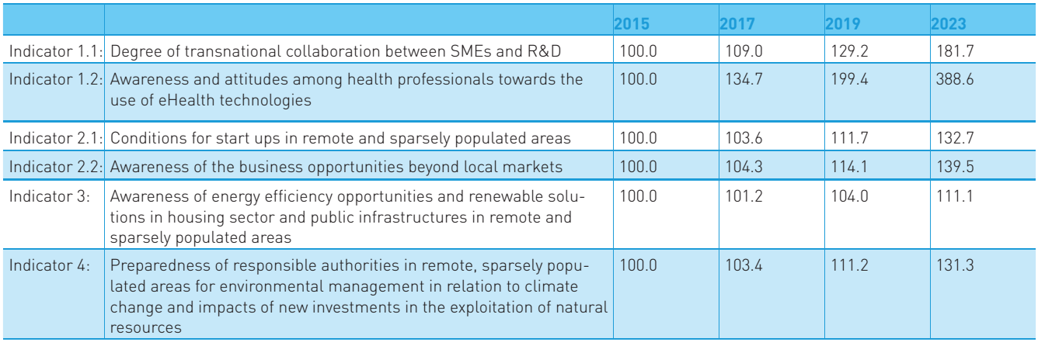
Result indicators – Programme level
Text

Slide 15
Output indicators – Project level
Example Priority axis 3

Slide 16
Output indicators – Project level
Quantify contribution to the output indicator.
  This is a target value for the entire project. Note: one product or service delivered in several programme partner countries is still considered as one, please do not double count!
Please see the Programme Manual for expected targets on programme level. Be realistic!

Slide 17
Thank you for listening
Rachel Burn
Email:
rachel.burn@interreg-npa.eu
www.interreg-npa.eu

