Slide 1
General overview
Ole Damsgaard, Joint Secretariat
Copenhagen, Denmark - November 23rd, 2017

Slide 2
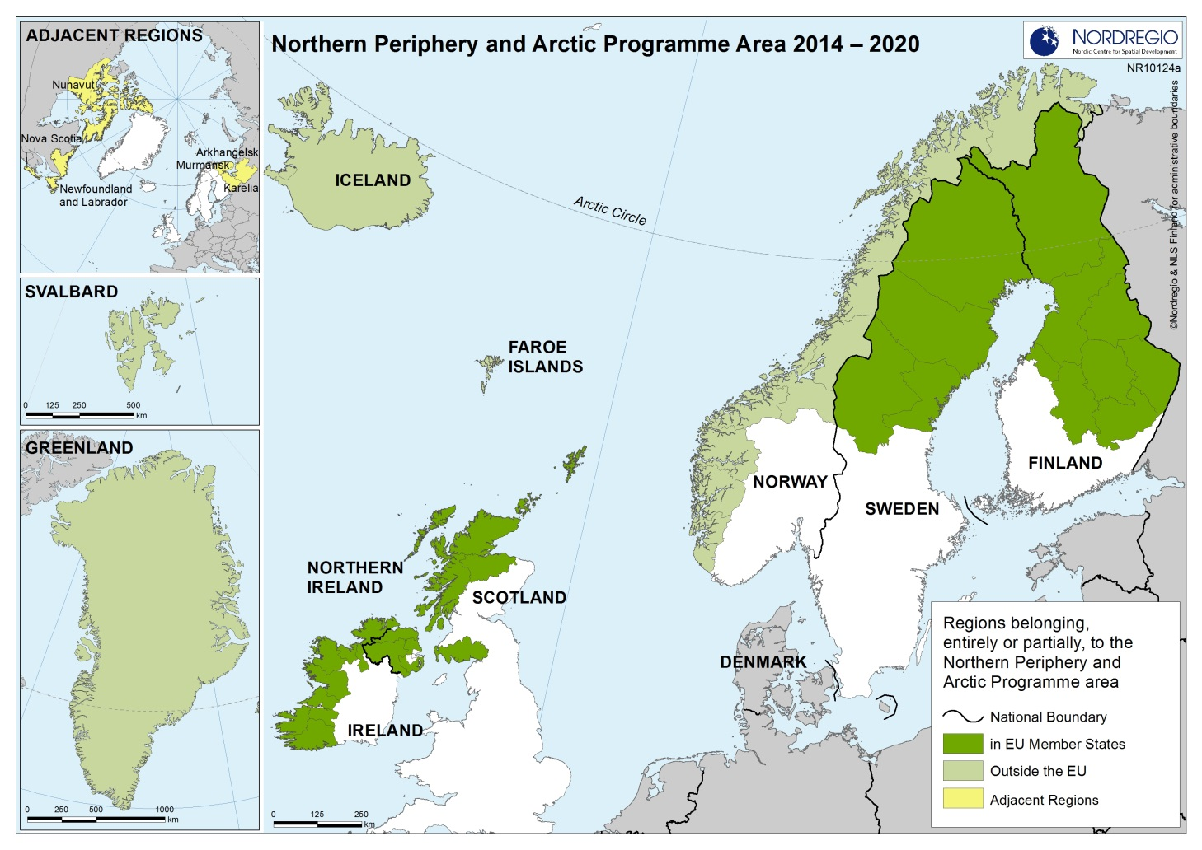
The Programme Area

Slide 3
Vision
To counteract the overwhelming challenges, the Programme will help to generate vibrant, competitive and sustainable communities by harnessing innovation, expanding the capacity for entrepreneurship, and seizing the unique growth initiatives and opportunities of the Northern and Arctic regions in a resource-efficient way.

Slide 4
The Programme Mind-set = Intervention logic
1
Programme Area specific challenges and opportunities
2
Selected interventions
3
Tangible results or solutions =>
Measurable changes at Programme Area level

Slide 5
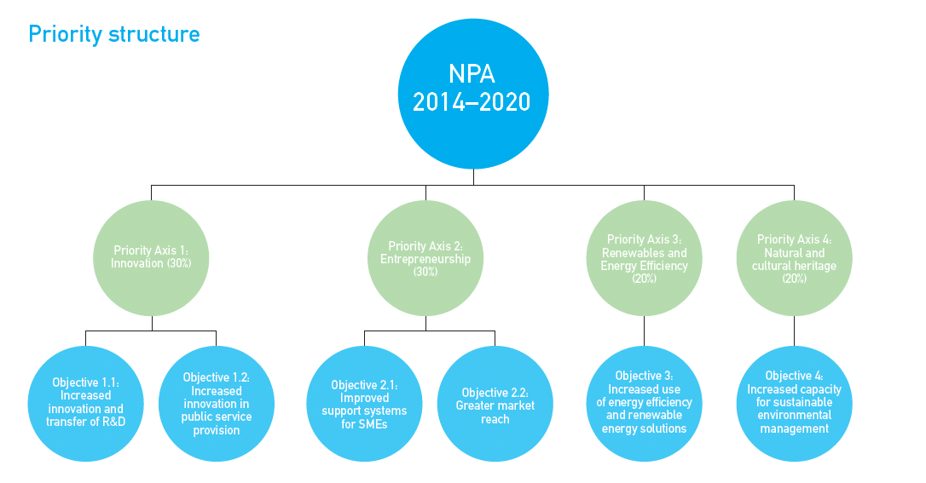

Slide 6
For the individual Priority Axis The Programme states
Objective
Results sought
Actions supported (further narrowed down for the 5th Call)
Main target groups and end users
Types of partners

Slide 7
Approved Projects
1. Call: 13 projects approved
2. Call: 7 projects approved
3. Call: 5 projects approved
4. Call: 10 projects approved
Preparatory call: 36 projects approved

Slide 8
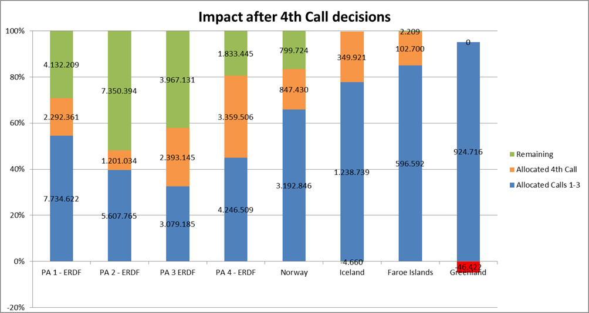
Distribution by theme & source

Slide 9
Ole Damsgaard ole.damsgaard@interreg-npa.eu www.interreg-npa.eu
Thanks' for your attention

