Slide 1

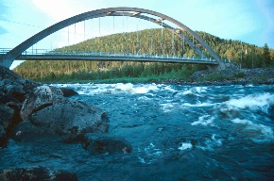
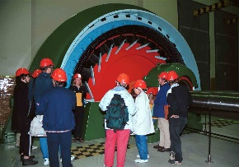

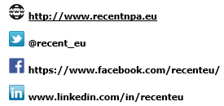


Renewable Community Empowerment in Northern Territories

Slide 2
Renewable Community Empowerment in Northern Territories
RECENT – Policy Influencing Best Practice
Previous Experience of NPP Projects as Lead Partner
Steep Learning Curve
Benefits of communication and stakeholder involvement – lessons learned
Integration with RCP’s, Scottish RAG and Secretariat
Brussels – key decision made in previous projects

Slide 3
Renewable Community Empowerment in Northern Territories
RECENT – Policy Influencing
Developing relationships with key Policy Influencers
SMALLEST – Regional Parliamentary workshops
WARES Final Conference
Scottish Government Hydro Nation
Ongoing communication post project

Slide 4
Renewable Community Empowerment in Northern Territories
RECENT – Policy Influencing
RECENT – Project Concept was a challenge but also hugely important for the Policy side of the project
What is RECENT going to offer that hasn’t already been done?
Pre-application stage vital for Policy Influencing
If the project doesn’t fit with regional, national policy, should we be putting in an application…..?

Slide 5
Renewable Community Empowerment in Northern Territories
RECENT – Policy Influencing
Policy Roadshows around the regions to hear the views of the communities and residents
Understand key issues and challenges from the pilot projects
Engagement with local, regional and national governments
Links to MEP’s, EC Directorates
RECENT Virtual Learning Campus, Mentoring Programme all link in to Policy Influencing Programme

Slide 6
Renewable Community Empowerment in Northern Territories
RECENT – Policy Influencing Final Thoughts
Really work on your relationships with public agencies
Understand regional policies and goals
Build on previous project credibility and relationships
More integrated process – RECENT invited and included in some policy meetings in the regions’
Liase with Policy Influencers throughout the whole project lifecycle, not just at the end of the project like in SMALLEST and WARES.
Be agile, thinking 3 years ahead and be close to stakeholders

