Slide 1
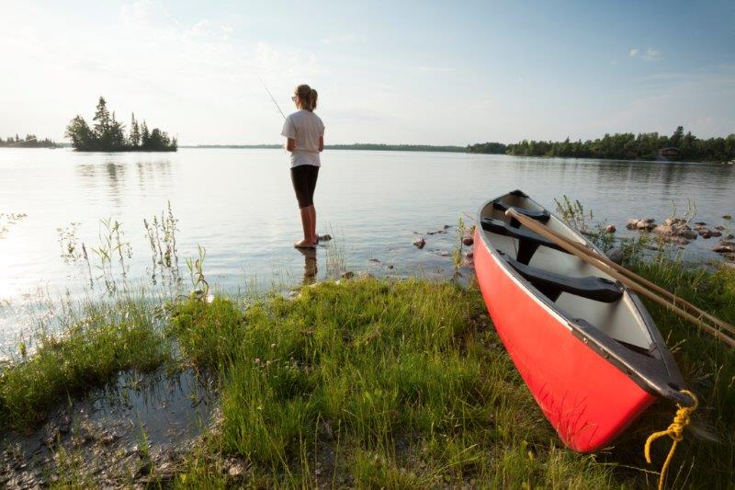


Slow Adventure in Northern Territories
Sara Bellshaw, University of the Highlands and Islands

Slide 2

Key Project Objectives
Define slow adventure in a business context
Help SMEs to extend their marketing reach
Create new collaborative tourism products through clustering models
Attract high-value consumers to wild, nature-rich destinations
Create memorable experiences for the consumer
Create a transnational cluster of ‘slow adventure’ ambassadors
Develop an enduring ethos as part of a global movement to slow down journeys, experiences and tourism

Slide 3

What is Slow Adventure?

Slide 4
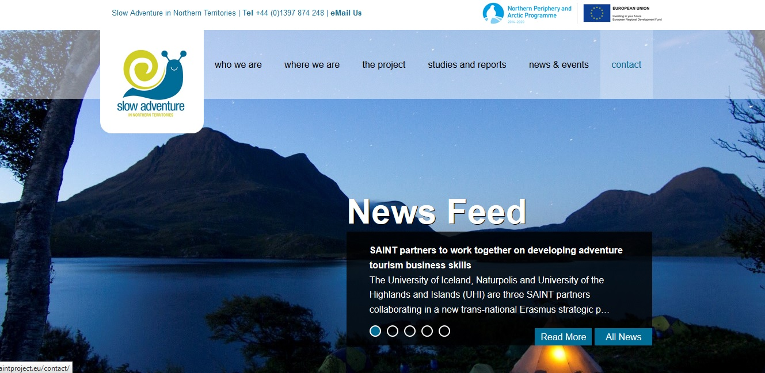
www.saintproject.eu

Slide 5
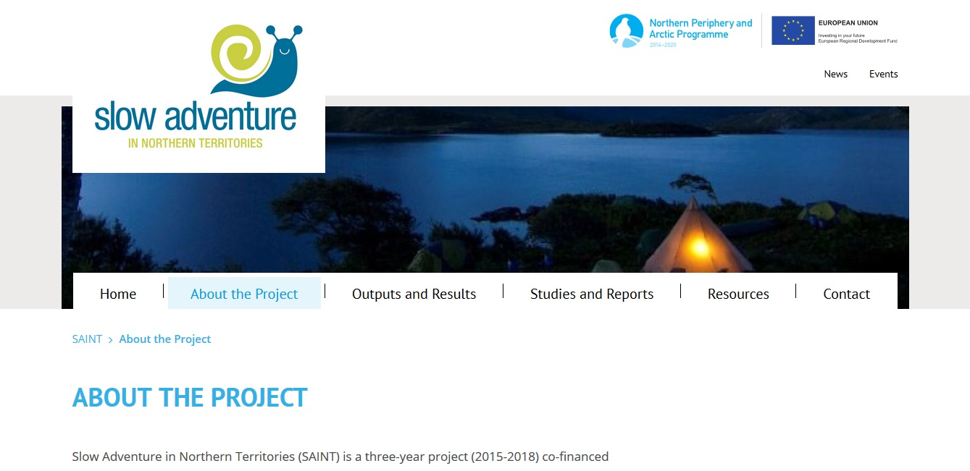
http://saint.interreg-npa.eu

Slide 6
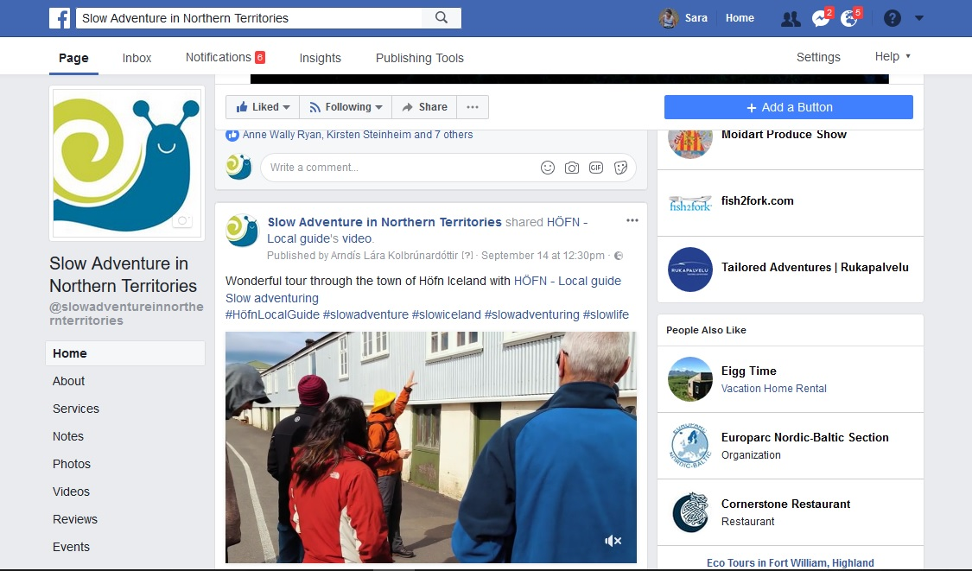
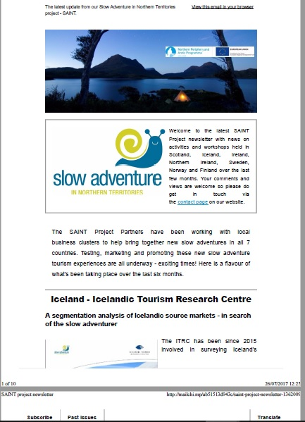
SAINT Project Facebook & Newsletter

Slide 7
Who is the end user for this project? Who is the slow adventure consumer? What is the slow adventure product? How do we create a legacy?

Slide 8
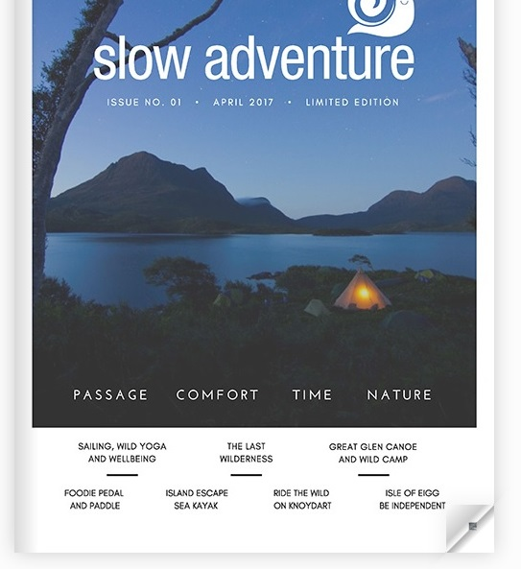
SAINT regional case studies

Slide 9
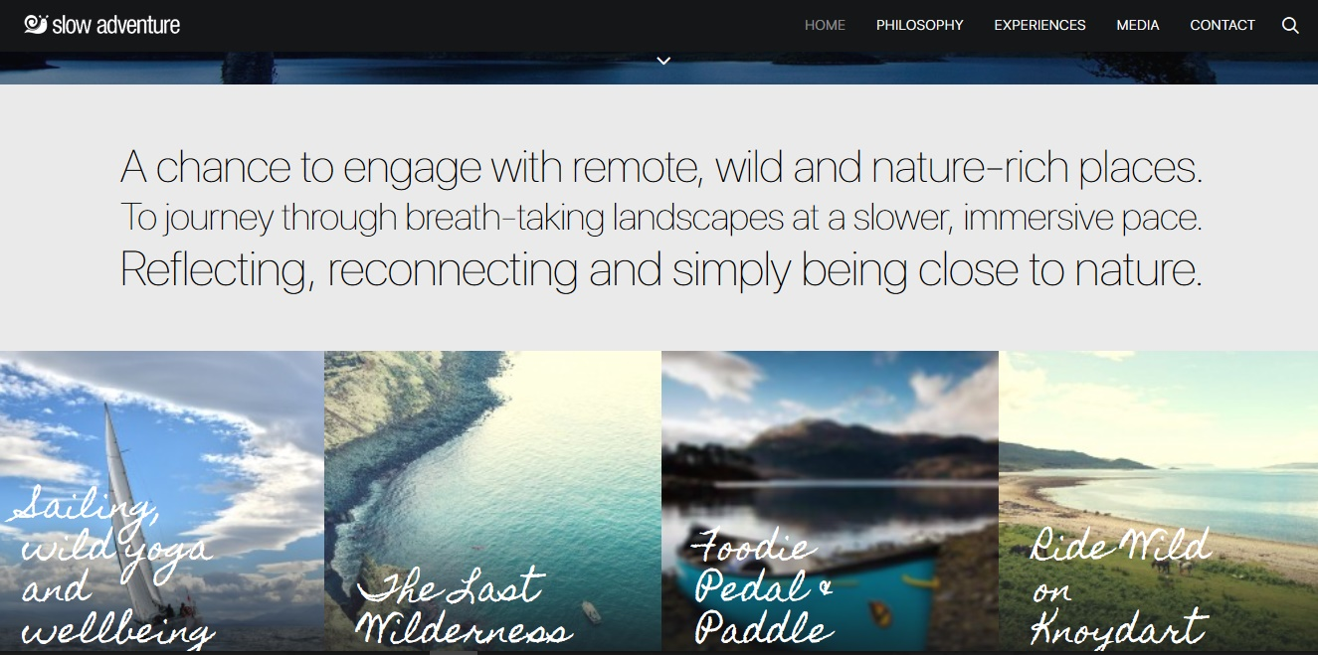
SAINT regional case studies

Slide 10
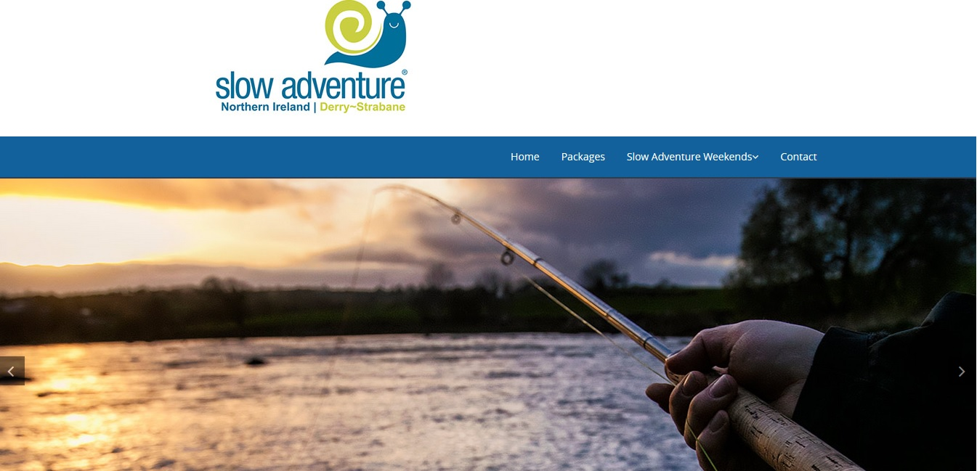
SAINT regional case studies

Slide 11
SAINT – developing a transnational consumer-facing marketing campaign
#slowadventuring

Slide 12
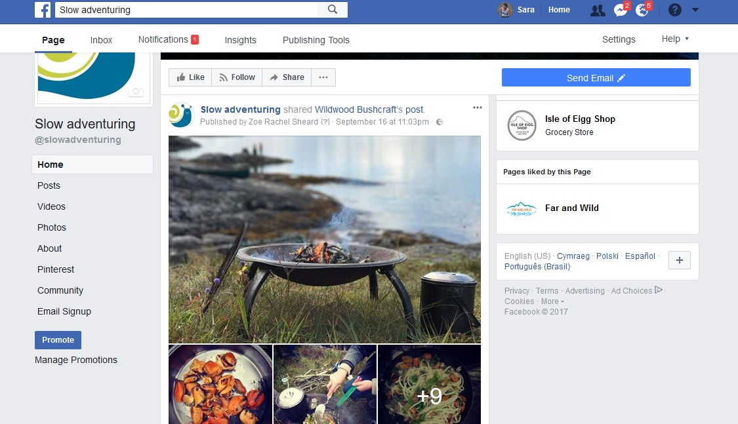
SAINT – slow adventuring Facebook

Slide 13
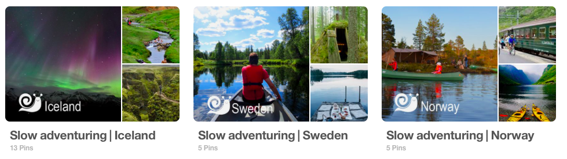
SAINT – slow adventuring pinterest

Slide 14
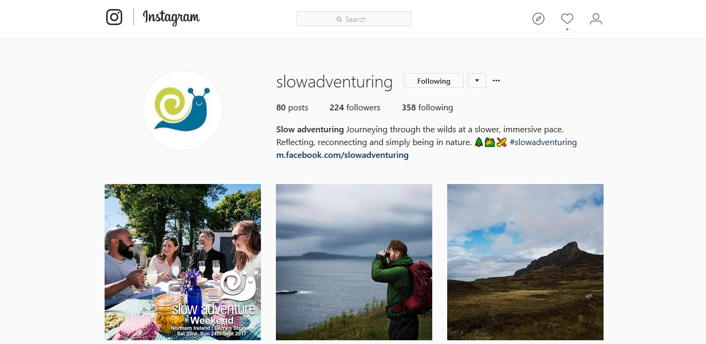
SAINT – slow adventuring instagram

Slide 15
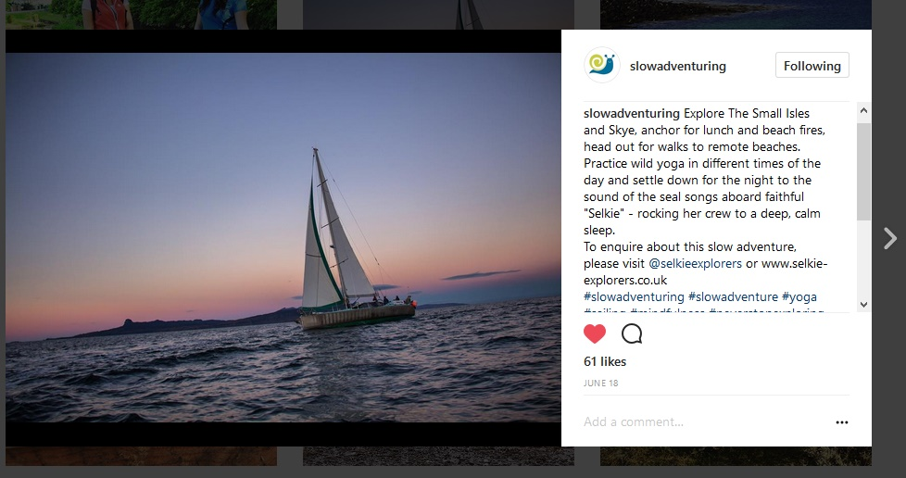
SAINT – slow adventuring instagram

Slide 16
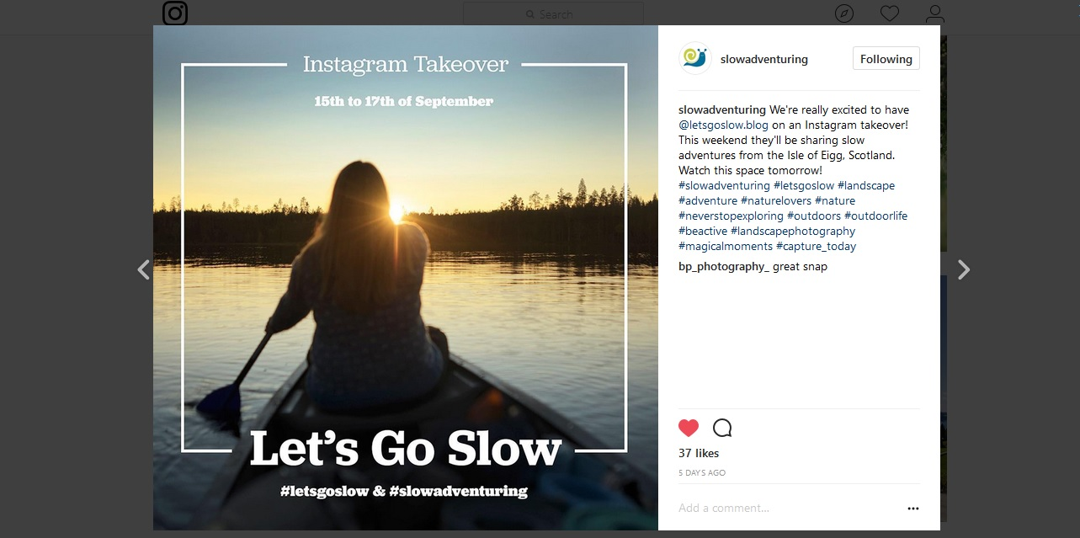
SAINT – slow adventure ambassadors

Slide 17
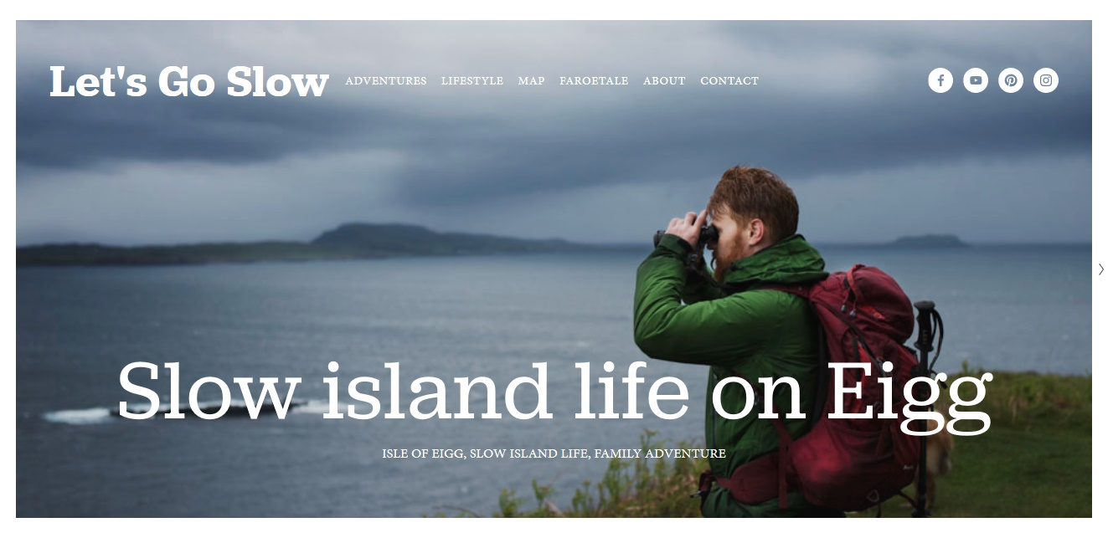
SAINT – slow adventure ambassadors

Slide 18
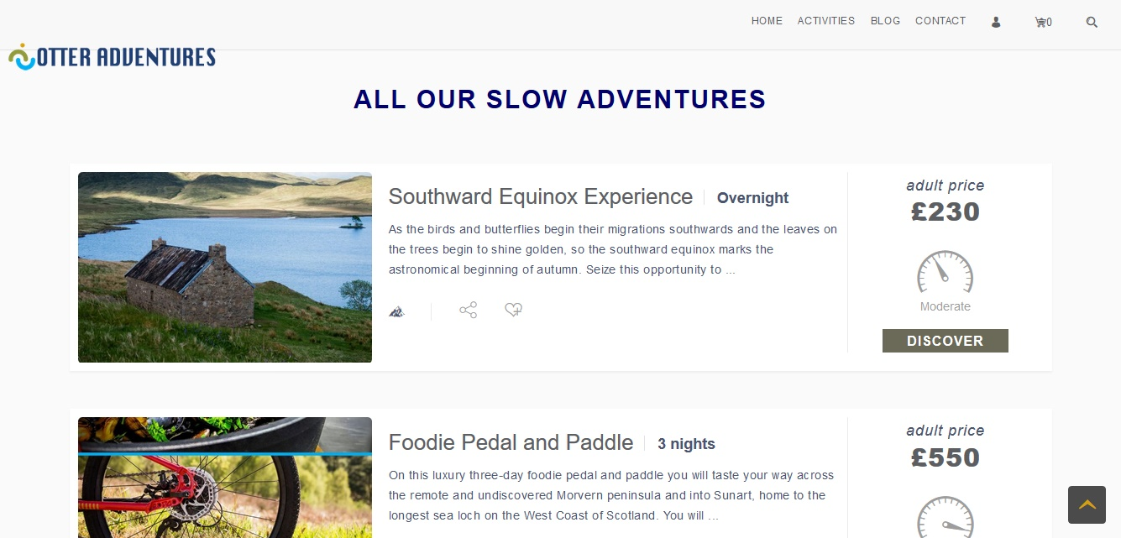
SAINT – slow adventure ambassadors

Slide 19

Trademarking Slow Adventure Logo

Slide 20
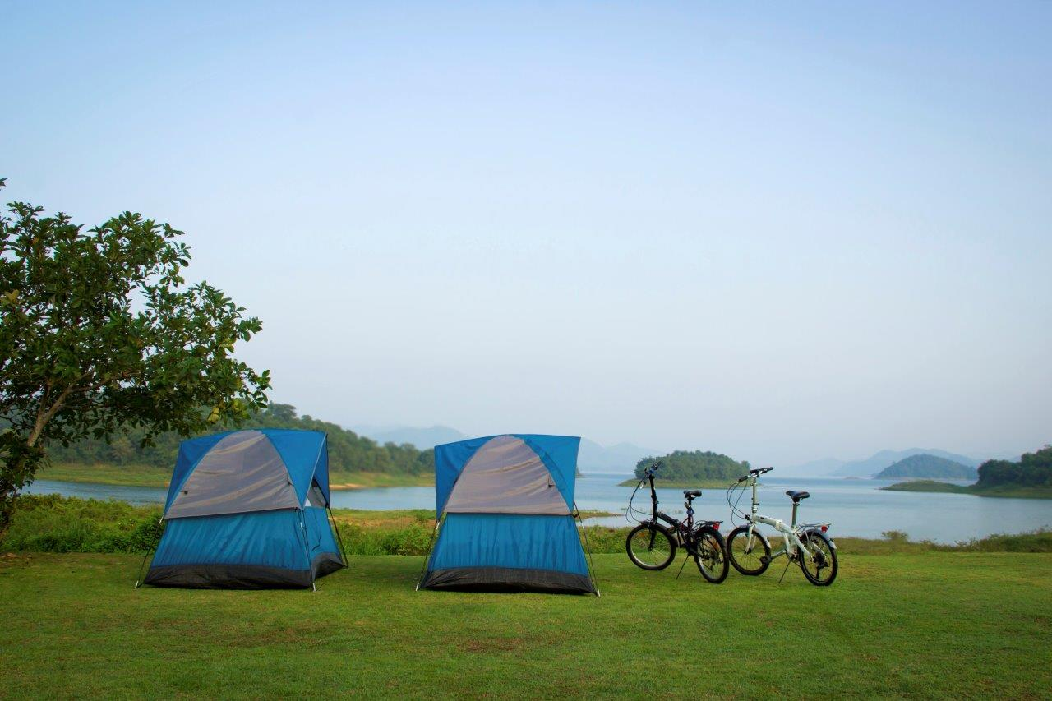

Thank you!

