Slide 1
NPA 2014-2020 eMS application – Project Information
Michela Gaifami, Joint Secretariat
January 18th, 2018 – Copenhagen, Denmark

Slide 2
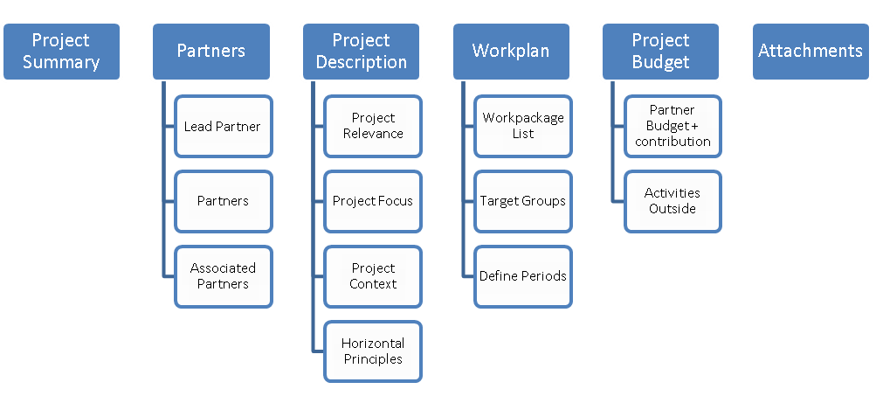
Workflow

Slide 3
Input Data
Project summary
Partners
Project description
Work plan
Project budget
Attachments

Slide 4
Getting started
We are going to work in the real eMS system. Link: ems.interreg-npa.eu
Note: you cannot delete an application in eMS!!
If you have already registered in eMS and have started inputting your application you are welcome to access your application.

Slide 5
Project Summary
Indicate Priority Axis, specific objective
Project title and acronym
Project duration ≤ 36 months (33 months for implementation + 3 months for final reporting)
Project summary in English and another EU language
Save to create the application!

Slide 6
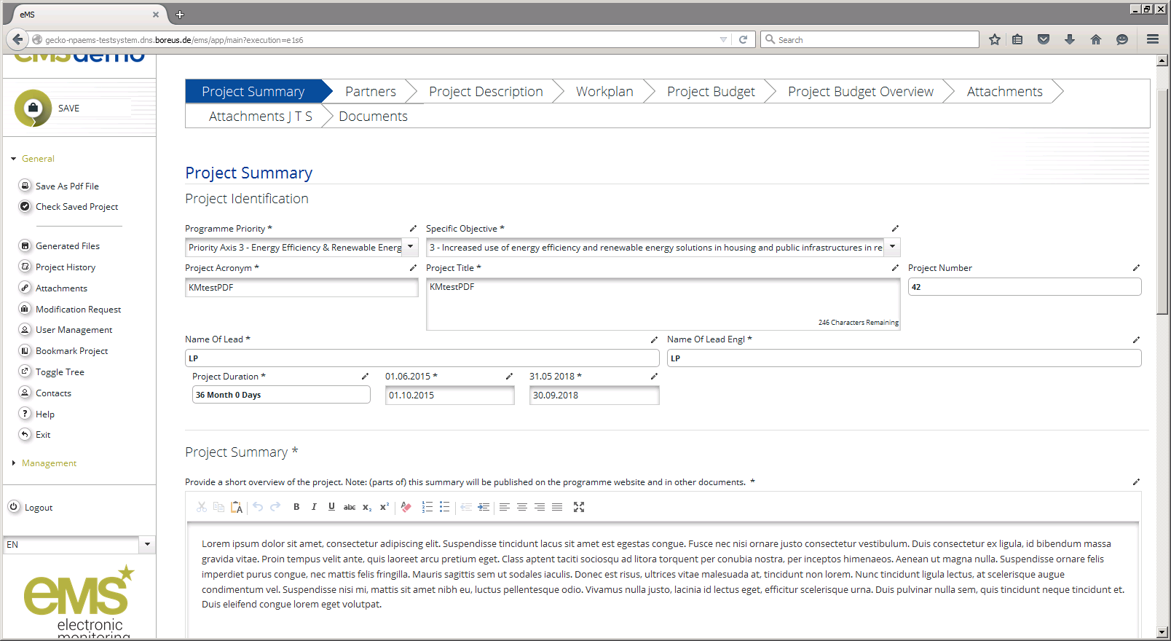
Project Summary

Slide 7
Partners
Partner role: Lead Partner, project partner, sub partner; associated partner
Partner name, address, contact details
Type and legal status (use template)
Choose correct funding source and %
Experience relevant to the project
VAT & public procurement status: yes/no

Slide 8
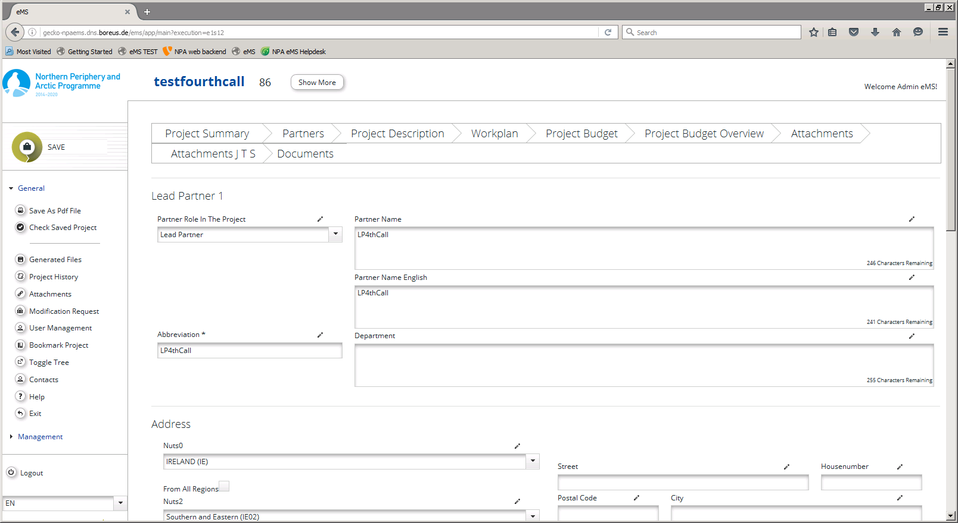
Partners

Slide 9
Project Description
Project relevance: territorial challenges, project approach, cooperation reason
Project focus: contribution to changes sought, link to the programme result, project main result and objectives, durability & tranferability.

Slide 10
Project Description
Project context: synergies with strategies and other EU projects
Horizontal principles: contributions to horizontal principles, and whether your project is neutral or positive to all three principles – Sustainable development, Equal opportunity, and equality between men and women.

Slide 11
Project Focus
1. Specific Objective
Select relevant specific objective (out of 6 available)
2. Programme result
Relevant programme result indicator is preselected
3. Project main result
Describe project main result(s)
Describe how project result(s) contribute neutral/positive to programme result
4. Project objectives
5. Products & services (outputs)
They should be in line with project main result(s)
Select relevant output indicator and quantify the project’s contribution
Describe products & services and their relevant components (quality objectives)
Should correspond with project objectives
Describe project objectives
Choose if project contribution is neutral/positive

Slide 12
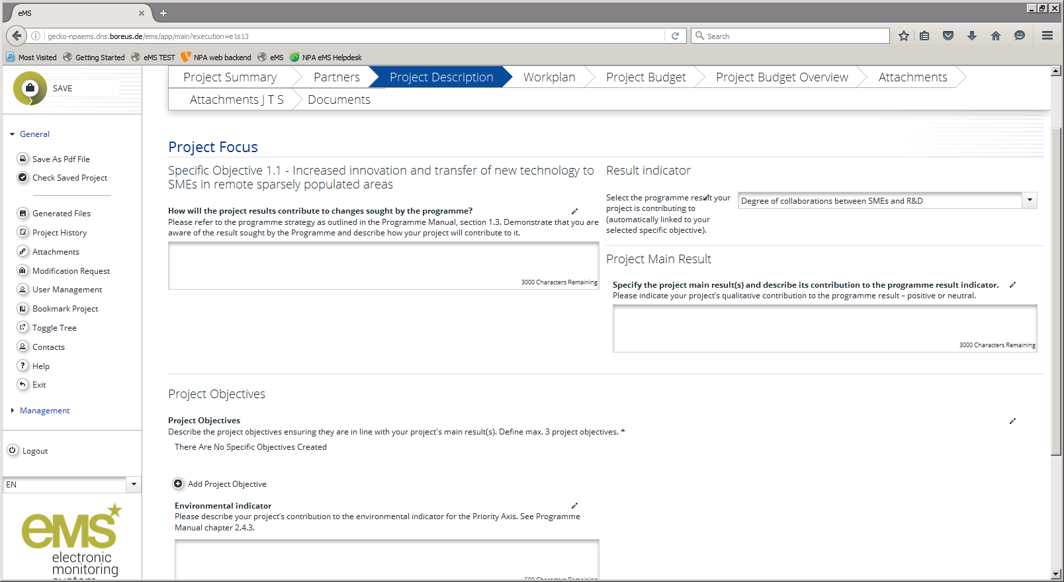
Project Focus

Slide 13
Work Packages
Two predefined work packages:
Project Management: operational and strategy activities → no deliverables needed
Communication Activities: external communication → mandatory communication tools in Programme Manual
Implementation work packages (T1, T2,…) for all other project activities.

Slide 14
Work Packages
Title, duration, partners involved
Link to project objectives
Main outputs (products & services) and output indicators, target groups, durability & transferability
Activities and their deliverables
Partner roles, and fit with other WPs.

Slide 15
Work Packages
In WP Management, no outputs, only deliverables
In WP Communication, define communication objectives corresponding to the project objectives, e.g. raising awareness, changing attitudes, etc.
Automatic Gantt chart

Slide 16
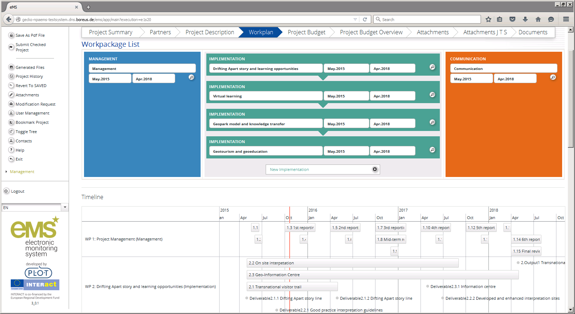
Work Packages

Slide 17
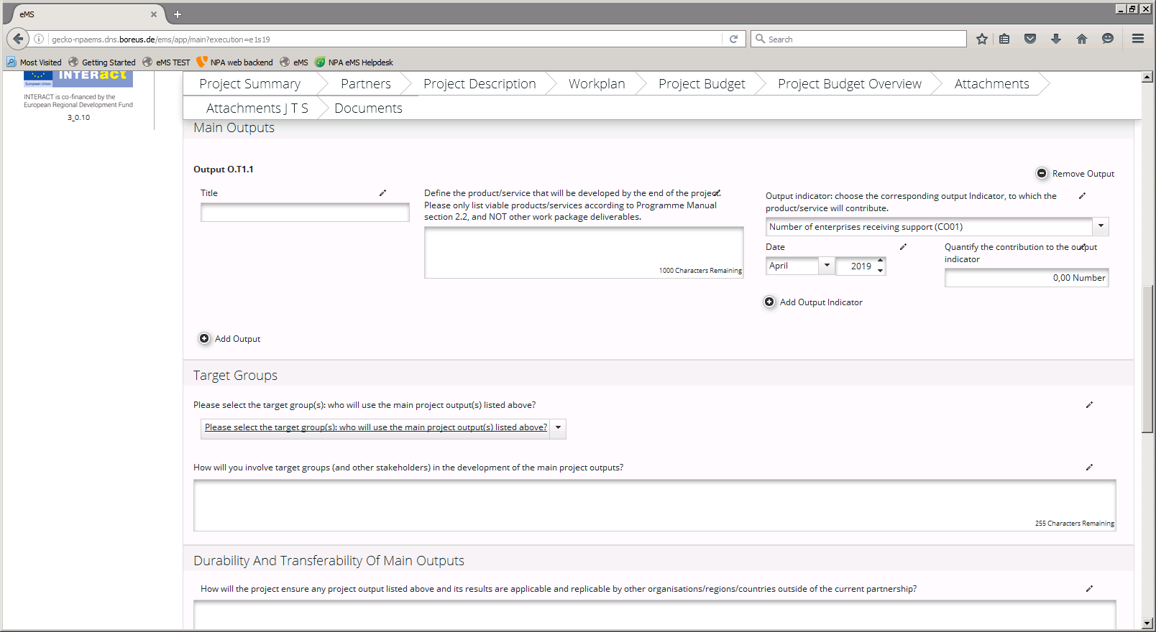
Work Packages

Slide 18
Work Packages - Communication
Do not under/over estimate your communication activities
Project communication to have an impact: show don’t tell
Predefined objectives and activities in the WP to help you
Few mandatory requirements: Programme Manual section 3.6

Slide 19
Work Plan – other tabs
Target Groups: taken from WPs, possibility to specify and quantify targets
Define periods: 6-monthly periods. Recalculate if changing start/end date

Slide 20
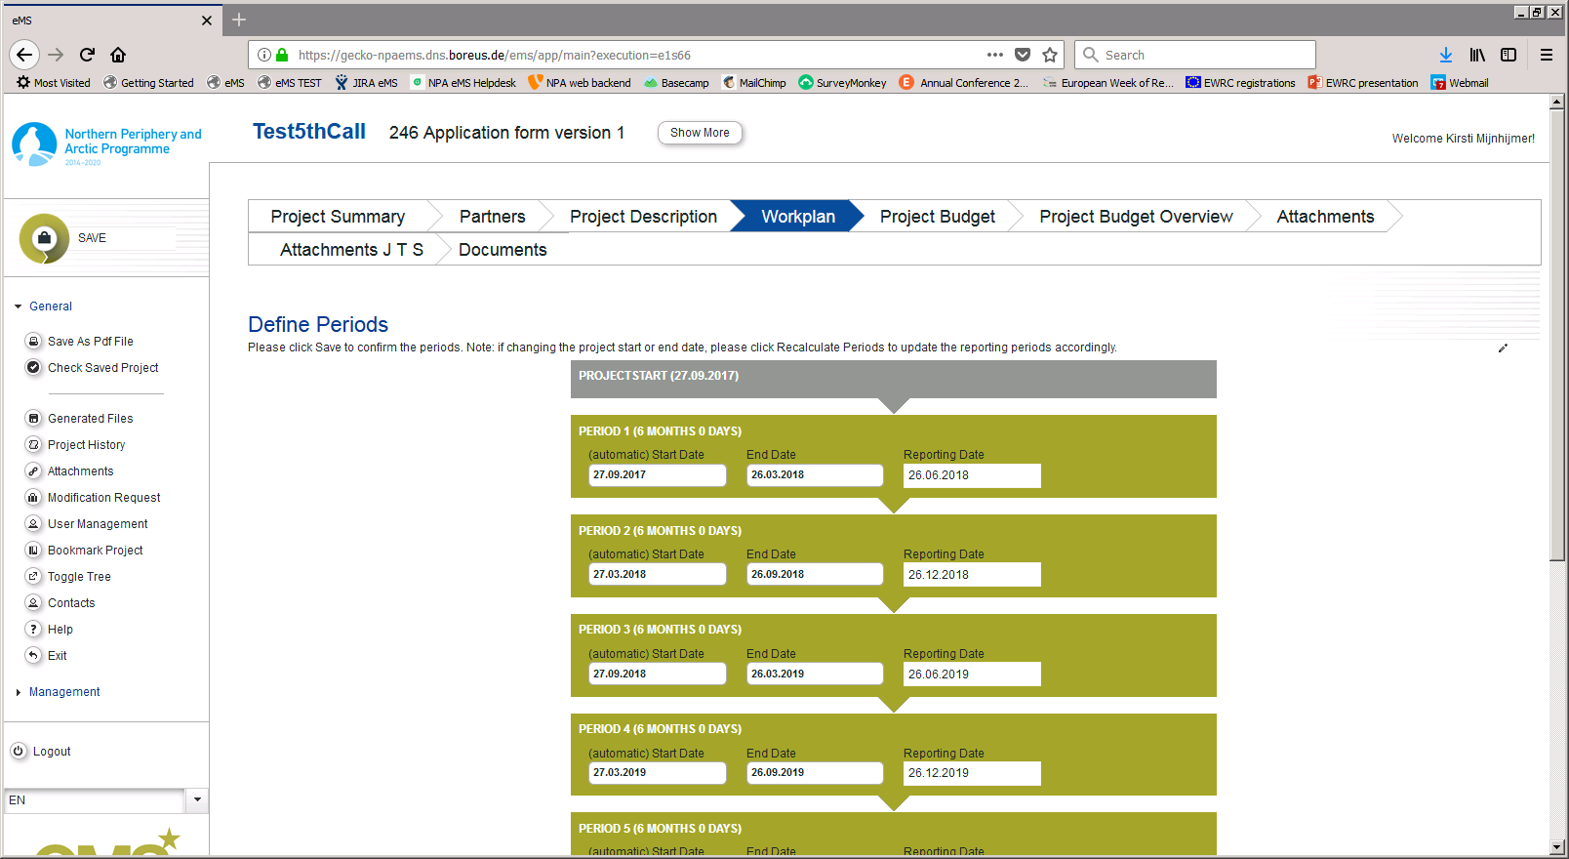
Define Periods

Slide 21
Attachments
Mandatory (available on website + eMS):
Signed match funding commitments – in EUR, clearly linked to partner or cover page
Signed legal status assessment templates
Signed Lead Partner Signature Template
VAT statements if unable to recover VAT
Optional:
Supplementary info, e.g. graphs, Gantt charts, Letters of Intent.

Slide 22
After Inputting data
Final check:
After completing the application form and attaching all necessary supporting documents, save your application
We recommend to save it as a Pdf File.
It is your responsibility to ensure that the data is correct according to the Programme Manual.
Click on “Check saved application”

Slide 23
After Inputting data
Only after all checks are ok, you will be able to submit your application by pushing the “Submit checked project” button.
After submission, the Lead Applicant will receive an automatic email confirmation.
NB. Once submitted you are not able to make further changes to your application.

Slide 24
Thank you for listening

