Slide 1
NPA 2014-2020 eMS application –
Budget
Christopher Parker
24th October, 2018 – Copenhagen, Denmark

Slide 2
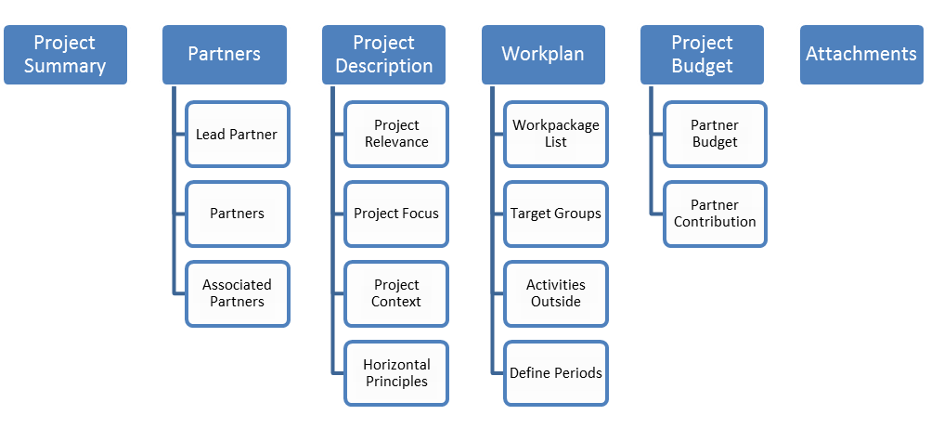
Workflow

Slide 3
Input data
Project summary
Partners
Project description
Work plan
Project budget
Attachments

Slide 4
Inserting budget data
Each partner should define both their budget and match-funding (contribution)
Costs and finance should be in balance!
Check this in the tab “Project budget overview”
All costs must be entered per period and work package. Note: periods should be set up in order to enter the budget!

Slide 5
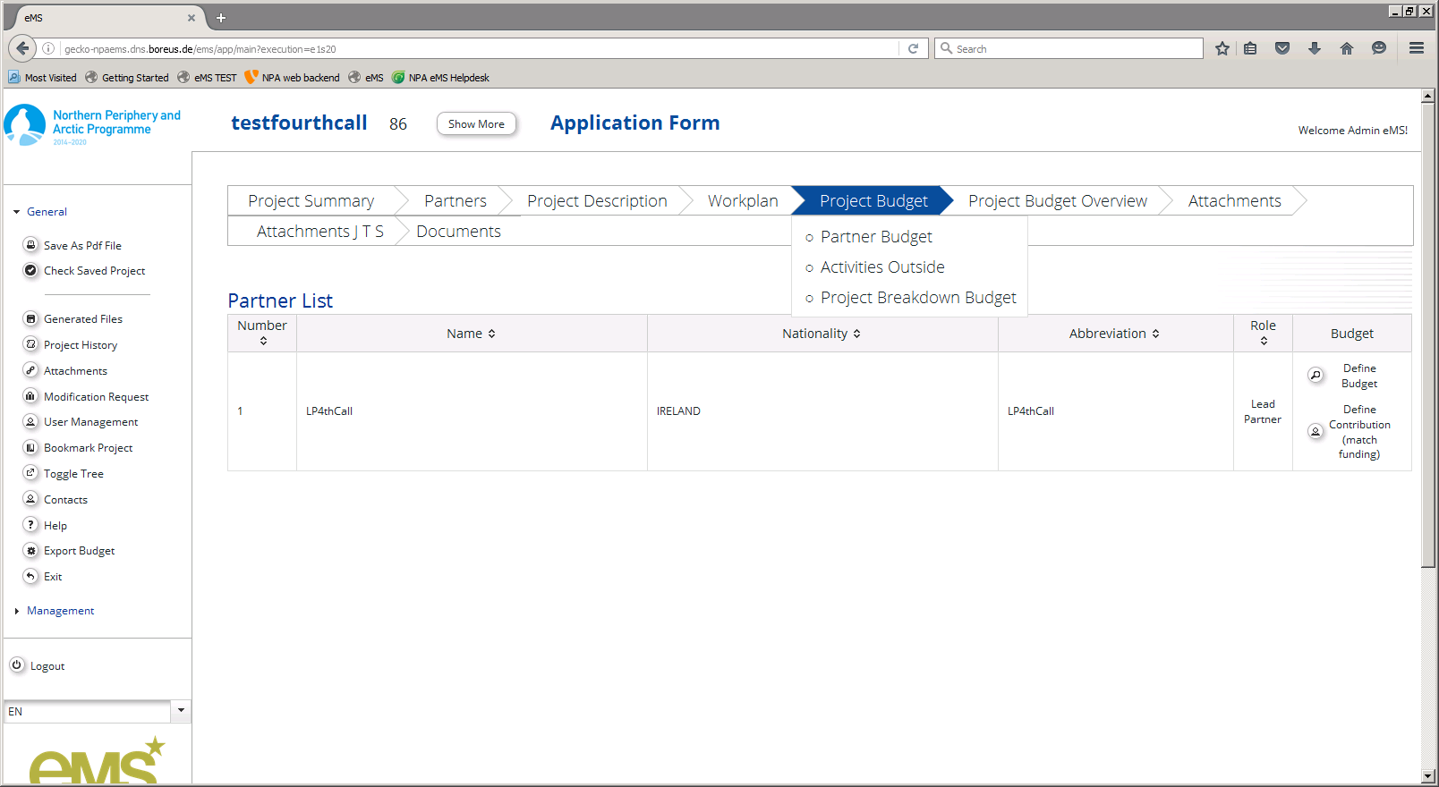
Define budget

Slide 6
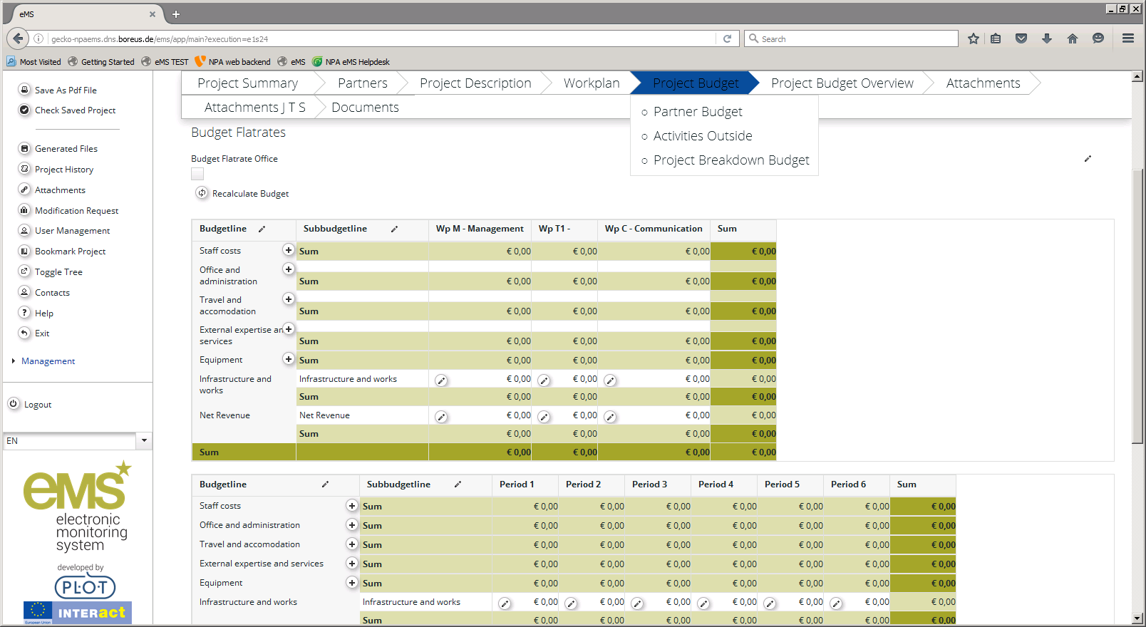
Define budget

Slide 7
Define budget
For consistency, perhaps only by LP
Enter the budget per WP or per period
Specify each budget line by clicking +
Don’t use the line Infrastructure & Works
Enter any in-kind costs under the relevant cost category, e.g. staff costs. Indicate clearly that the costs are in-kind.

Slide 8
Specifying Staff costs
Please make a new line for each staff function.
For fulltime staff and part time staff with a fixed percentage, please select the unit type month. Enter number of months for each period under “Unit”, i.e. 6 months. Enter monthly amount.
For part time staff with flexible number of hours or staff contracted on an hourly basis, please select the unit type hour.
Enter number of hours for each period under “Unit”, e.g. 860.
Then enter the hourly rate calculated according to the instructions in the fact sheet. Note: you need to use the standard 1720 hours.

Slide 9
Specifying Office costs
If using the 15% flat rate, no specification is needed. Simply tick the tick box and accept that existing sub budget lines will be hidden. Click “recalculate” if changing the staff costs.
If using direct costs, please select from the cost categories in the Application Instructions to specify the costs. Then describe a relevant unit, e.g. monthly costs, the number of units and the price per unit.

Slide 10
Specifying Travel costs
Please make a new line for each cost category, e.g. flights, accommodation, daily allowances.
Then describe a relevant unit, e.g. number of people travelling, the number of units and the price per unit.
Please use the comments box to provide details, e.g. purpose, and location.

Slide 11
Specifying External expertise and services costs
Please make a new line for each category of service, e.g. external consultant, meeting venues and catering, First Level Controller, etc.
Then describe a relevant unit, e.g. daily rate, the number of units and the price per unit.

Slide 12
Specifying Equipment costs
Please make a new line for each category of equipment, e.g. laptop computers.
Then describe a relevant unit, e.g. a device, the number of units and the price per unit.
Please use the comment box to specify if the equipment is purchased, rented or leased.

Slide 13
Define Contribution

Slide 14
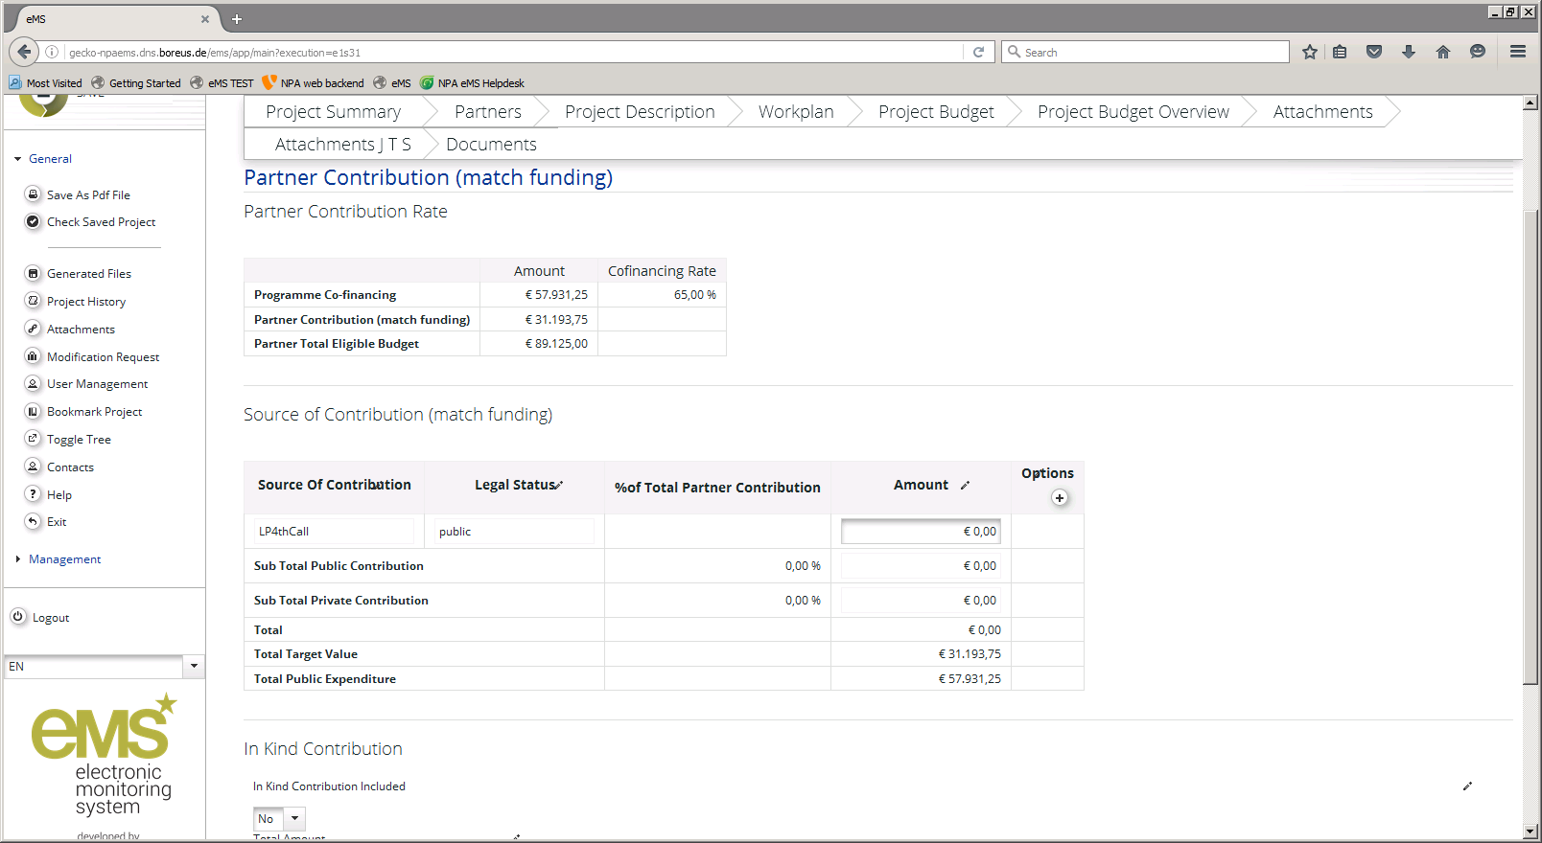
Define Contribution

Slide 15
Define Contribution
Enter one or multiple sources of match funding (partner name is pre-filled). Note: switching between sources → change to application.
Select if the source is public/private
Enter the amount in Euros (match target)
In case of in-kind contribution, select Yes under in-kind and describe the source
Support with match funding commitment.

Slide 16
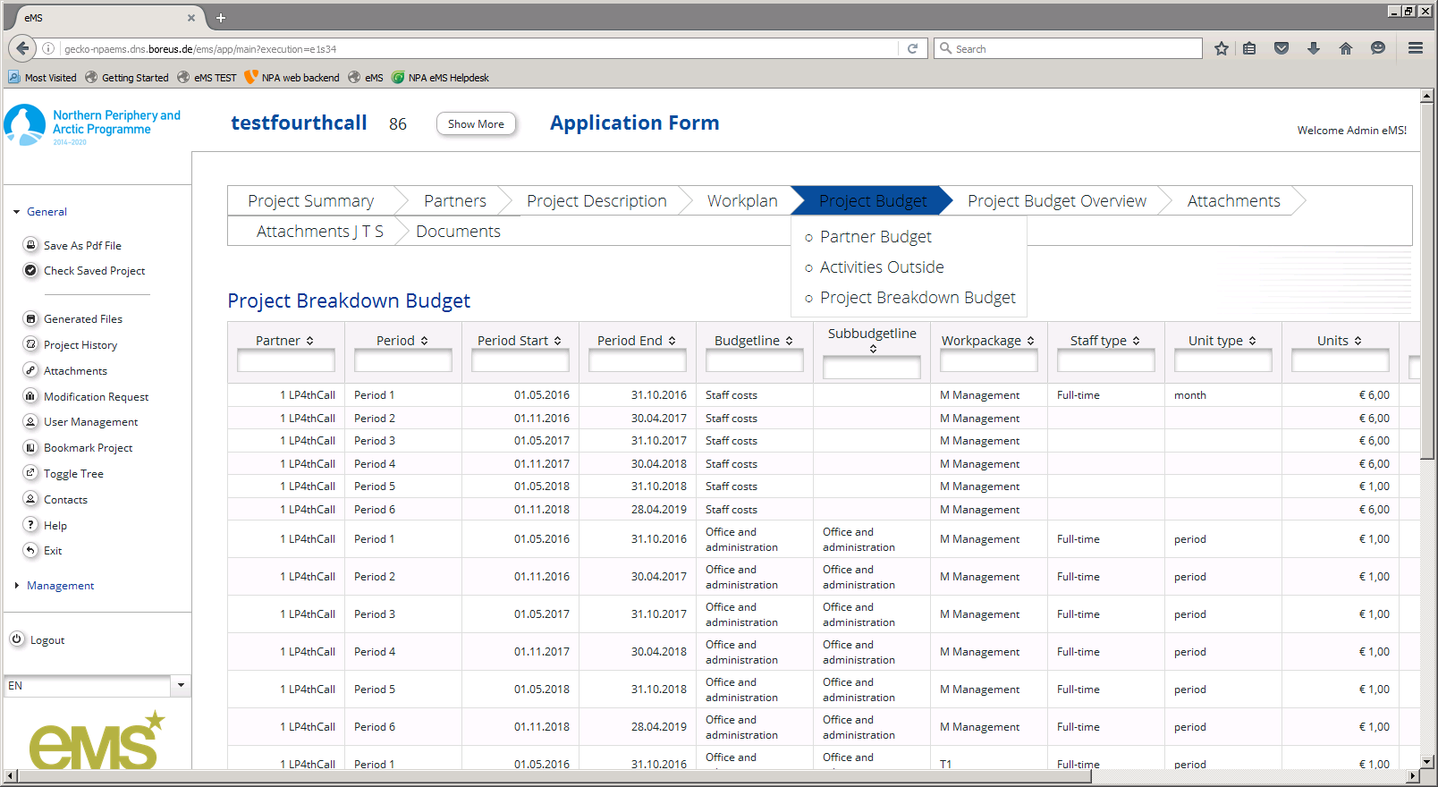
Check the budget: Project budget breakdown

Slide 17
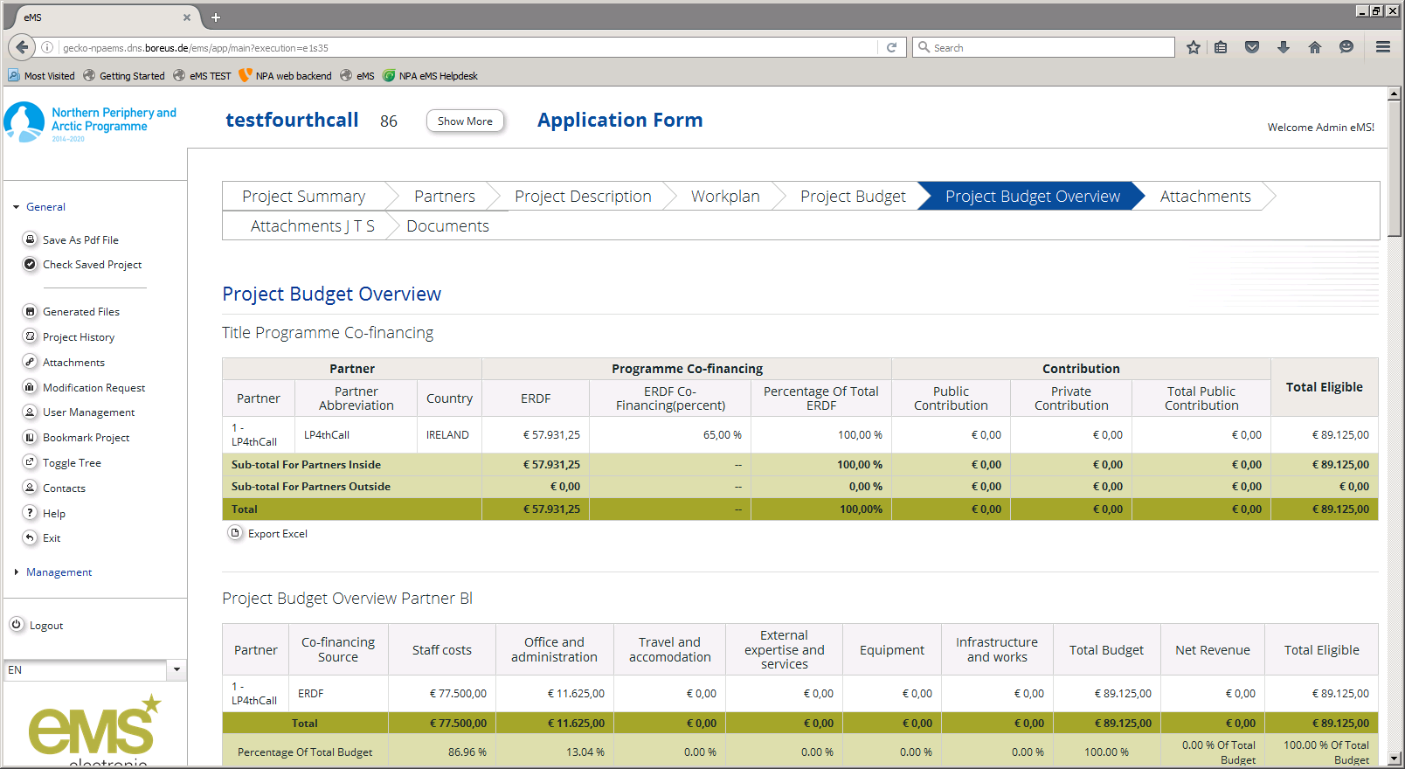
Check the budget: Project budget overview

Slide 18
Thank you for listening

