Slide 1
General overview
Kirsti Mijnhijmer, Joint Secretariat
18th January 2018 - Copenhagen, Denmark

Slide 2
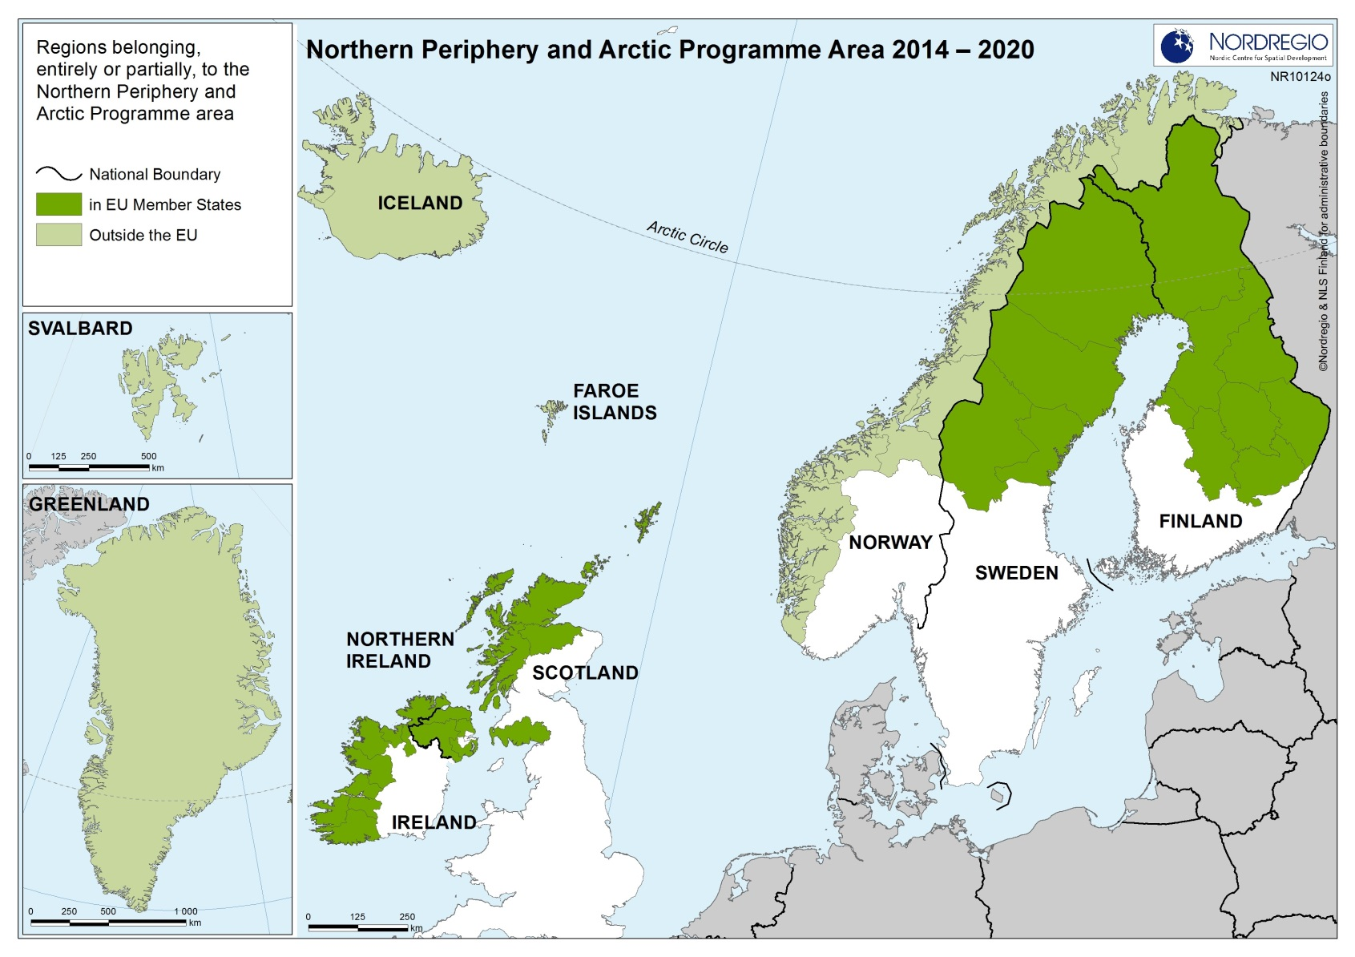

Slide 3
Vision
To counteract the overwhelming challenges, the Programme will help to generate vibrant, competitive and sustainable communities by harnessing innovation, expanding the capacity for entrepreneurship, and seizing the unique growth initiatives and opportunities of the Northern and Arctic regions in a resource-efficient way.

Slide 4
The Programme Mind-set = Intervention logic
1
Programme Area specific challenges and opportunities
2
Selected interventions
3
Tangible results or solutions =>
Measurable changes at Programme Area level

Slide 5
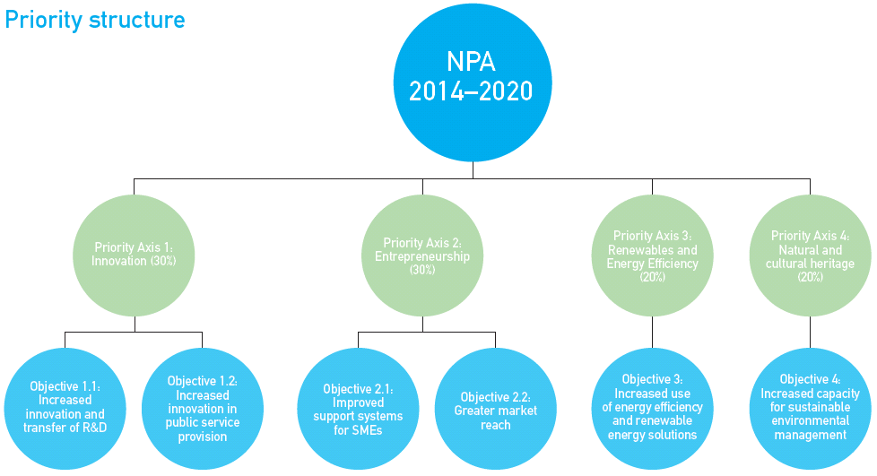

Slide 6
For each Priority Axis the following is defined:
Specific Objective
Results sought
Actions supported (further narrowed down for the 5th Call)
Main target groups and end users
Types of partners

Slide 7
Approved Projects
1st Call: 13 projects approved
2nd Call: 7 projects approved
3rd Call: 5 projects approved
4th Call: 10 projects approved
Total 35 main projects
Preparatory call: 43 projects approved

Slide 8
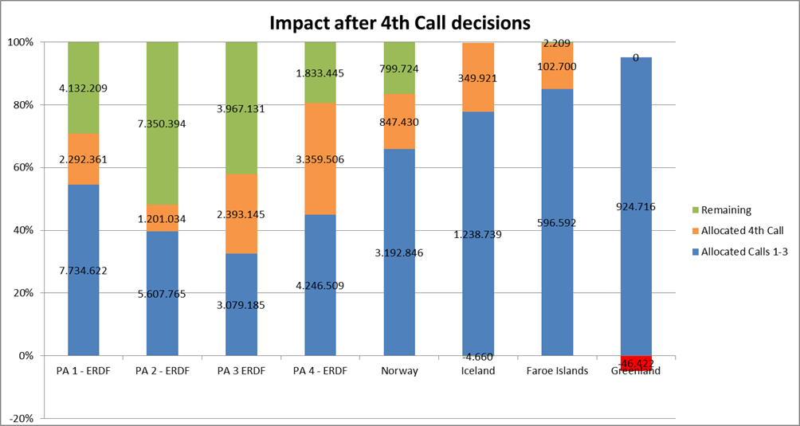
Distribution of funding

Slide 9
NMS funding
Iceland: extra allocation of 1.122.794 EUR (after last call -4.660 EUR)
Faroes: extra allocation of 33.855 EUR (after last call +2.209 EUR)
Greenland: extra allocation of 49.249 EUR (after last call -46.422 EUR)
MC can decide to use ERDF 20% source

Slide 10
Thank you for listening
Kirsti Mijnhijmer
Email: kirsti.mijnhijmer@interreg-npa.eu
www.interreg-npa.eu

