Slide 1
Results Focus
Kirsti Mijnhijmer, Joint Secretariat
18th January 2018 - Copenhagen, Denmark

Slide 2
Some terminology
Result: what is intended to be changed in the programme area
Outputs: direct products of the programme, intended to contribute to results. They are mainly developed at project level (products/services).
Results orientation: for the 2014-2020 period, the focus is shifting from only measuring outputs (products/services) to measuring the results that they contribute to (change in the programme area).
Notes:
An example of a intended change could be i.e. improved conditions for start ups in remote and sparsely populated areas.
An example of output: assistance given to an enterprise through a match making service designed to connect traditional and creative industries, so the output is classed as the product or service, in this example the output is a web portal which acts as a match maker service.
What we man by results that contribute to change is that we now have baselines which we measure from, and to at the end of the programme period basically where we are at and where we want to get to, an intended programme results are at the core of the 2014- 2020 programming .
Result orientation- is a step change on a meta level for the programme. Previously we were focused more on quantified out puts now we look for projects to fit hollistically into the wider programme picture.

Slide 3
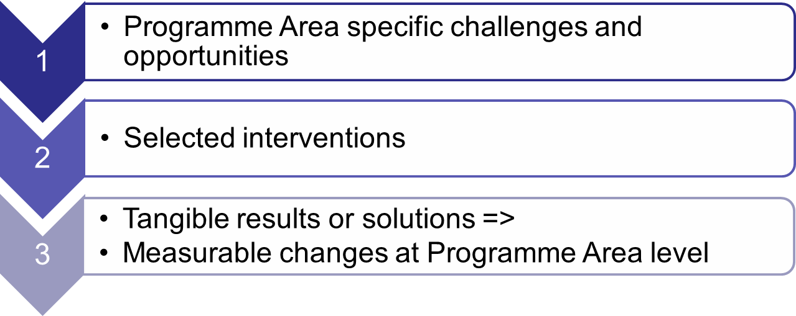
Intervention logic
Notes:
We are going beyond outputs and to do this the programme has applied an intervention logic to create change. The logic and its application will be explained a bit more on the next slide.
But to take this slide we look at 1 + 2 + 3
Example of a specific challenge: Long internal distances, while an opportunity could be un spoilt environment.
When looking at the intervention needed it should meet a strength, weakness, opportunity or threat for the NPA area, the intervention needs to make a step change and this is a funded project i.e. a telemedicine project which develops a remote dialysis service.
Your project needs to have results or solutions i.e. products and services where we can measure at a higher level, for instance a project may contribute to an increased awareness among health professionals towards the use of eHealth technologies

Slide 4
Intervention logic at programme level
Vision: what does the programme want to achieve
Thematic objectives: 4 themes form the basis for the 4 priorities
Specific objectives: how the programme plans to meet the vision
Results sought: what changes the programme wishes to see, e.g. raised awareness, improved entrepreneurial climate, raised preparedness
Notes:
To Break down the logic a bit further one can view the logic like an inverted triangle going from our programme vision, secondly how the programme choose the thematic objectives, and within these the specific objectives. The results sought are able to be captured though project reporting on designed common or specific output indicators.
Programme Vision in our programme strategy.
Officially the vision is: The NPA 2014- 2020 aims to expand regions’ horizons, building on concrete outcomes and enabling the NPA area to be a first class region in which to live, study, work, visit and invest.. To counteract the overwhelming challenges the Programme will help generate vibrant competitive and sustainable communities by harnessing innovation, expanding the capacity for entrepreneurship, and seizing the unique growth initiatives and opportunities of the Northern and Arctic regions in a resource- efficient way.
Thematic objectives: P1 Innovation (30%) P2 Entrepreneurship (30%), P3 Renewables and Energy Efficiency (20%), P4 Natural and Cultural Heritage (20%).
Specific objectives: 1.1 Increase innovation and transfer of R & D.
1.2- Increased innovation in public service provision
2.1- Improved support systems for SMEs
2.2- Greater Market reach
3- Increased use of energy efficiency and renewable energy solutions.
4- Increased capacity for sustainable environmental management.

Slide 5
Intervention logic at programme level
Result indicators: how the changes will be measured
Actions supported: examples of interventions to help achieve the results sought, including examples of target groups and partners
Output indicators: quantifying the outputs that are developed
Performance framework: accountability for outputs, finances
Notes:
Following on from
Result indicator example: From P1 (Innovation)- Degree of transnational collaboration between SMEs and R & D
Actions supported: From P1 (Innovation)- Transfer and development of models or solutions enabling R & D support for SME demand-.driven innovation.
Output indicators quantified (the likely number of achievements the project will achieve), this would be part of the project application and quantified in the implementation WPs.
Performance Framework- reporting of what we need to deliver to EC.

Slide 6
What does it mean for projects?
Project result: what change does the project hope to achieve?
  Qualitative contribution to programme result indicators (neutral/positive)
Project objectives: how will the project achieve its chosen result?
Project outputs: products/services, i.e. the solutions to meet the chosen objectives and result
  Quantitative contribution to output indicators
Notes:
How can we apply programme logic through projects?
A project can be seen as a practical way to interprete the intervention logic where we use project and fit it in to the wider programme picture.
Project Result: The likely step change i.e. a project wishes to increase collaboration between the creative industries and R & D. i.e. is it likely a project makes a positive impact or not.
With regards to neutral and positive- NOT ALL PROJECTS MEEET THE RESULT INDICATOR, do you think you are neutral of positive.
Project objectives- it is possible to have three in eMS where it is possible by the end of a project to measure if objectives on a project level have been met. Could see result as an aim and objectives as more detailed break down of an aim.
Project outputs- to achieve the result of collaboration between creative industries and R & D a project could (for example either enhance or develop an online portal offering a service match making database). Or a back office umbrella type organisation providing the administrative capacity for micro companies to engage with larger organisations. Project really needs to define the outputs. Also need to ensure how output contributes to ouput indicator and choose the most appropriate indicator by quantifying.
A clear project can should project logic as well as how they fit with the programme overall.

Slide 7
What does it mean for projects?
Deliverable: by-product in developing the main outputs
Budget and spending target: Contribution to the programme financial targets
Notes:
Deliverable- in eMS these are part of the workplan and workpackage list, in the implementing WPs. An example of a deliverable could be 1. Report on Mentoring in Internationalisation , or Skills Development Survey .
Budget and spending target. It is important to achieve spending thresholds at an approriate agreed rate, since the spending of a project has direct relevance to the programmes financial targets. I guess some of you are aware of something called N + 3 rule.
Rule in a nutshell: At the beginning of each programming period annual financial allocations are made to each Programme. Programmes are then required to spend funds by the end of the second year following the year in which they are allocated. These targets are called the N+3 rule.
Failure to meet the annual spending targets means that money will be returned to the Commission budget and therefore lost to the Programme.
So project spending is IMPORTANT.

Slide 8
Quality Objectives - Purpose
Bridge the gap between the project outputs and programme results
Indicate the type of projects the programme aims to support; those delivering meaningful change.
Form a reference point for evaluating project applications – basis for selection criteria
Notes:
The NPA has a number of quality objectives, the Programme wants to ensure that developed products and services contribute to the change the programme seeks, we are looking for a certain quality standard. These quality objectives form the basis of project selection. For prospective project applicants they are defined in the Programme Manual.
Examples of quality objectives for products and services:
Concrete, Innovative, Focused, Relevant, Viable, Value for Money.
In the phase of project selection, it is one way of having a stronger basis for our intervention logic.

Slide 9
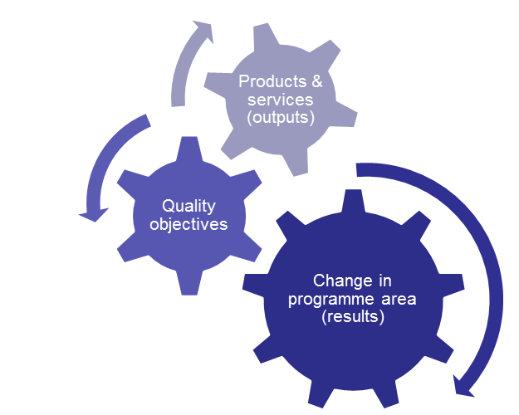
Quality Objectives
Concrete
Innovative
Focused
Relevant
Responsible
Viable
Transnational
Strategic
Value-for-money
Notes:
KM has put the quality objectives on the OUTPUTS. This is the focus.
Examples of what we mean by the quality objectives:
Concrete: the outputs are recognisable as a tangible solution, and they contribute to increased awareness, attitude change or behaviour change.
Innovative: the outputs go beyond existing practice in the sector/programme area/participating countries, or adapt or transfer already developed solutions.
Focused: the outputs contribute to the result sought for the selected specific objective.
Relevant: the development of the outputs is based on target group demands. Also, the outputs take into account the current situation in each partner area.
Viable: the outputs are supported by appropriate marketing plans and realistic delivery/provision models that allow the project output to become durable and selfsustaining when the project support ends. Also, the outputs are applicable and replicable, e.g. transferable to other areas than the partner areas.
Value-for-money: the development and implementation of the outputs is proportional to the challenge or opportunity addressed and the expected benefit/impact/return on investment. If applicable, the money generating or money saving aspect can be demonstrated

Slide 10
Quality Objectives
Concrete
Innovative
Focused
Relevant
Responsible
Viable
Transnational
Strategic
Value-for-money
Notes:
Innovative: the outputs go beyond existing practice in the sector/programme area/participating countries, or adapt or transfer already developed solutions.
Relevant: the development of the outputs is based on target group demands. Also, the outputs take into account the current situation in each partner area
Viable: the outputs are supported by appropriate marketing plans and realistic delivery/provision models that allow the project output to become durable and selfsustaining when the project support ends. Also, the outputs are applicable and replicable, e.g. transferable to other areas than the partner areas

Slide 11
Quality Objectives – Innovative & Relevant
Innovative: the project output is new or innovative to the partner organisations, the partner countries, or the Programme area.
Relevant: Project outputs take into account relevant conditions in each part of the project’s target area. This means that the project outcomes:
  Demonstrate a high relevance for the development needs and opportunities in the target area.
  Take into account the current situation for the sector/each part of the target area.
  Demand-driven: The development of project outputs is based on demonstrable stakeholder demand and include stakeholder involvement (interface)

Slide 12
Quality Objective – Viable
Viable: project outputs are supported by appropriate business and dissemination models that allow the project output to become self-sustaining when the project support ends.
  Marketing plans for the project output to reach identified relevant target groups. Note: branding should focus on project outcomes, not the project.
  Realistic provision/delivery models. For example, ensuring that that the project output is delivered by organisations with the right competences, and well integrated, etc.
  Related to the concepts of durability and transferability of outputs

Slide 13
Quality Objective – Transnational
Transnational: the design of project outputs clearly draws on the results of transnational cooperation.
  E.g. transferring models/knowledge/technology from one region to another, partners complementing each others’ competences and resources, combining different regional skill sets, gaining a critical mass, etc.

Slide 14
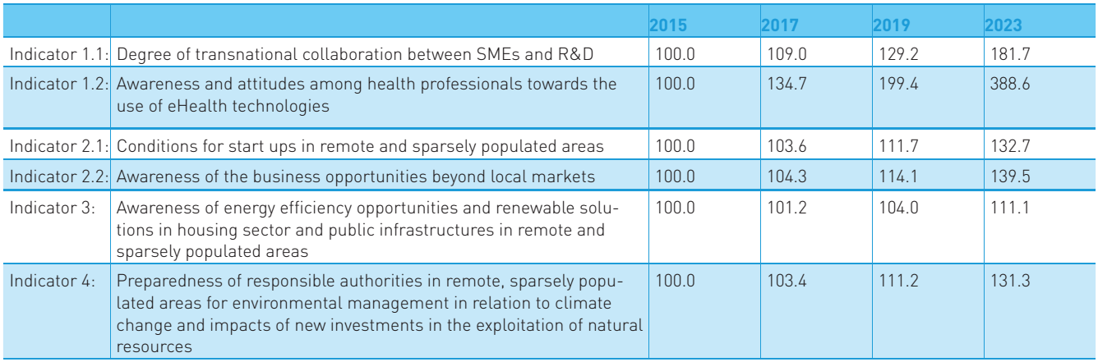
Result indicators – Programme level
Text
Notes:
As mentioned earlier in this presentation, intended programme results are at the heart of 2014- 2020 programming. The targets presented here have been devised from a baseline of what is the current position, and where are we going to. Our programme baseline was established through qualitative and quantative terms, and we will be assisted by regional panels made up of a sample of 3 regions defined on a NUTS3 Level, so in Scotland this would be on the level of i.e. Shetland Islands, or Dumfries and Galloway. Progress towards
Projects don’t need to worry about the numbers their step
No statistics.

Slide 15
Output indicators – Project level
Example Priority axis 3
Notes:
Project level contributions have a variety of ways to measure the output achievement.
Within the Programme output indicators there are two different types:
Common Output indicators are collected at project level and reported to the European Commission at difference time intervals during the programme’s implementation for European wide statistical and implementation purposes. THE PROGRAMME HAS ONLY ESTABLISHED TARGETS FOR THE COMMON INDICATORS SINCE THESE ARE REPORTED TO THE COMMISSION, in the case of P3 common indicator the programme aims to have 250 houses with in an improved energy consumption classification, this works out at around 23 per expected project.
Specific Output indicators are collected at project level and designed to demonstrate a project’s progress towards its outputs. Made up by the Programme. It isn’t. If in doubt the Specific ones have been designed to be more product/ orientated, thus maybe 1st option is to choose a specific.
In the manual their a definition for each indicator so the project should read.
.

Slide 16
Output indicators – Project level
Quantify contribution to the output indicator.
  This is a target value for the entire project. Note: one product or service delivered in several programme partner countries is still considered as one, please do not double count!
Please see the Programme Manual for expected targets on programme level. Be realistic!
Notes:
Example of double counting: development of a remote toxin testing solution for fishermen of the NPA. It is only 1 solution, even if it is implemented in Faroes, Scotland, and Iceland it is not 3 different products it is 1.
We are generally looking for 1 or two high quality products or services per project.

Slide 17
Thank you for listening
Kirsti Mijnhijmer
Email: kirsti.mijnhijmer@interreg-npa.eu
www.interreg-npa.eu

