Slide 1
Introduction to eMS application
Michela Gaifami, Joint Secretariat
January 18th, 2018 – Copenhagen, Denmark

Slide 2
What is eMS?
eMS is a programme monitoring system with a communication portal, which allows programmes to collect and store all necessary project and programme information and communicate with beneficiaries electronically via a secure online communication portal. INTERACT has developed this software for the benefit of all ETC programmes.

Slide 3
What does it mean for projects?
Online applications
Project Reporting in eMS → from project partner, via FLC, to LP and on the NPA side, from JS, to MA & CA
Change (modification) requests
(Formal communication with Desk Officer through eMS)

Slide 4
eMS access and registration
eMS is accessible on: ems.interreg-npa.eu
To use eMS, you must first register on the welcome page.
As the user, you will then be asked to provide a set of credentials.
To activate your account, you must click the link in the validation email.

Slide 5
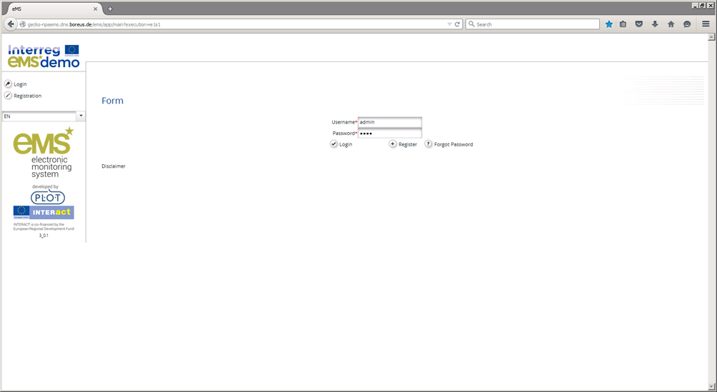
eMS access and registration

Slide 6
eMS access and registration

Slide 7
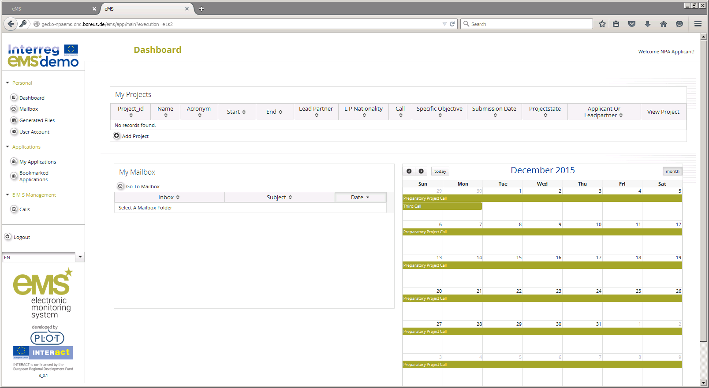
eMS access and registration

Slide 8
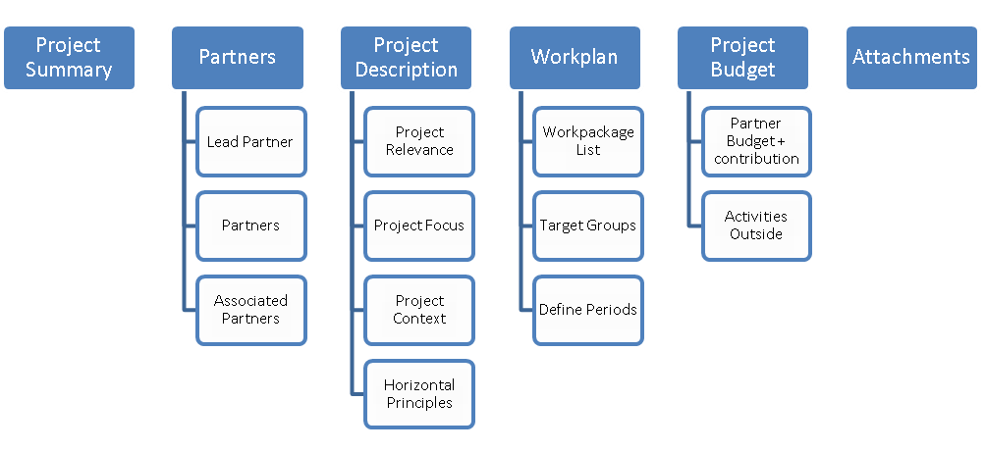
Workflow

Slide 9
Workflow
Create application
Assign users
Input data
Attach files
Check application
Submit application

Slide 10
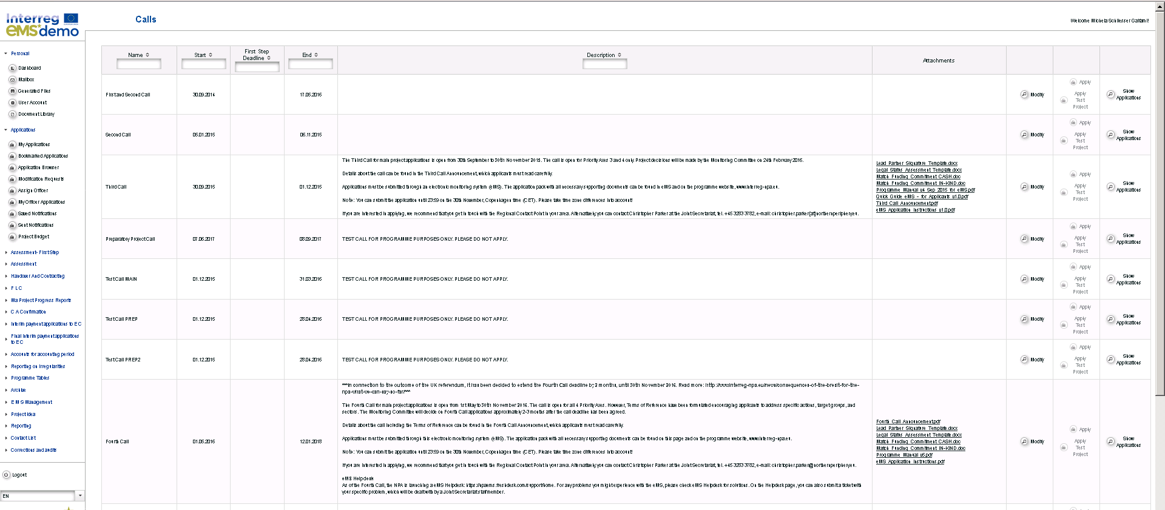
Create application
Click on “Add project” on the Dashboard or on the page “My applications”. Scroll to Fifth Call and click on “Apply”.

Slide 11
Assign users: lead applicant
By creating an application in eMS, you will be considered the Lead Applicant, meaning that you are the person responsible for submitting the application. Additionally, you can grant rights to read or edit an application to other users. You can do this under menu item “User Management”.

Slide 12
Assign users: editor or reader
Other users need to register and provide user names to you as Lead Applicant.
After granting access rights to other users, it is possible to work in parallel on the application. Warning: do not have eMS open simultaneously with other users or in different tabs!

Slide 13
Input data
Project summary
Partners
Project description
Work plan
Project budget
Attachments

Slide 14
General tips and tricks
eMS allows you to save your work and resume a data entry session at any time,
To avoid a loss of data, please remember always to save your information regularly, always before leaving a section!
Certain fields are mandatory

Slide 15
General tips and tricks
You are working in a browser: be careful with keys such as Enter, PageUp/Down
When copying information from Word/Excel files, use command keys:
Ctrl + c: copy
Ctrl + v: paste
Alt + Tab: switching between open windows

Slide 16
General tips and tricks
Follow the “Application Instructions” step by step.
There are many short fields which feed features, foresee enough time to fill in all fields.
Get a PDF of the draft→ Generated files.

Slide 17
Disclaimer
eMS is a relatively new system for both the programme and the applicants, and it is partially still under development. For this reason, we ask for your understanding in case something should not work quite as it should.

Slide 18
Helpdesk
https://npaems.freshdesk.com/support/home.
For any problems you might experience with eMS, please check Helpdesk for solutions. You can also submit a ticket with your specific problem, which will be dealt with by a Joint Secretariat member.

Slide 19
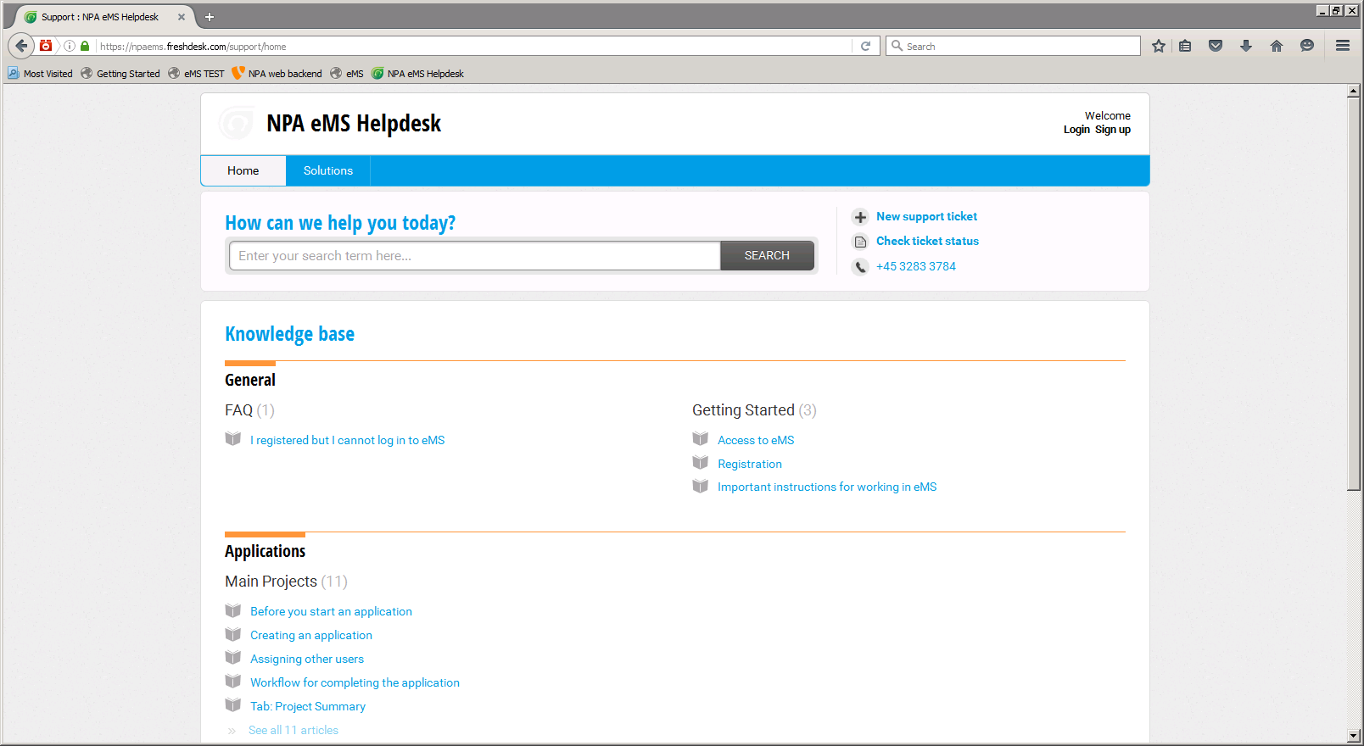
Helpdesk

Slide 20
Thank you for listening

